Slide 1
Welcome
A teacher affects eternity; He/she never knows when his/her influence will stop

Slide 2
Promoting Meaningful Learning through Cooperation Mónica Torres C.

Slide 3
Social Constructivism
Cognitive
Constructivism
COOPERATIVE LEARNING

Slide 4
Cooperative Learning
Permanent interaction process in which everybody has a piece of work to reach a common goal. The solidarity, tolerance, respect for other’s criteria, the responsibility, collaboration, mutual help and fixing commitment for their work and that of others are the main pillars of the axiological class.

Slide 5
Cooperative Learning
Highly structured task.
Everybody has a piece of work to reach a
common goal.
Mutual help and fixing commitment for their
work and that of others.

Slide 6
PRINCIPLES
Positive Interdependence
Face to Face Interaction
Individual and Group Responsibility
Interpersonal Abilities

Slide 7
CHARACTERISTICS
Replace competition for cooperation
Replace teacher-fronted for student-centered
Reduce learner's stress
Raise of achievement of all students

Slide 8
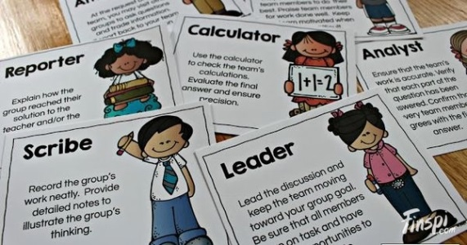
TASK STRUCTURE
Heterogeneous cooperative teams
Teacher’s reponsibility
Work Distribution

Slide 9
Cooperation in the classroom
Before Implementation
Design the task
Positive environment
Implementation
Present and clearly explain
Evaluate each group performance
Have the learning teams asses how they performed
Discuss how they can improve
Assign roles
Monitor and assist as needed
After Implementation

Slide 10
COOPERATIVE
LEARNING STRATEGIES
Learning Together
Group Investigation
Peer Tutoring
Jigsaw

