Slide 1
CAUSATIVE VERBS (ACTIVE)
1. GET
Meaning: Convince or persuade someone to do something.
Structure:
Subject + get + object + infinitive
2. HAVE
Meaning: Give someone the responsibility to do a task. it means you assign or arrange for someone to do something.
Structure:
Subject + have + object + base form (verb)
3. MAKE
Meaning: Force or require someone to do something.
Structure:
Subject + make + object + base form ( verb)
4. LET
Meaning: Allow /Permit someone to do something.
Structure:
Subject + let + object + base form (verb)

Slide 2
CAUSATIVE GET Is used to persuade, convince/encourage someone to do something
STRUCTURE
GET + OBJECT + INFINITIVE

Slide 3
I usually get my sister to wash the dishes.
GET + OBJECT + INFINITIVE
(I usually convince her to do the dishes)
I usually persuade my sister to do the disshes.
2. I usually get my brother to do my homework.
I usually convince HIM to do my Homework.
3. I got my siblings to mop the floor.
(I persusaded/convinced them to mop the floor)

Slide 4
FUTURE:
GET + OBJECT + INFINITIVE
She will get her friend to study for the exam.
PAST (MY DAD – MY MOM)
My dad got my mom to prepare pasta for dinner last weekend.
PRESENT (I – BEST FRIEND)
I get my best friend to help me with my mathematics homework every week.

Slide 5
CAUSATIVE HAVE To give responsibility to someone else
STRUCTURE
HAVE + OBJECT + BASE FORM (VERB)

Slide 6
I had my son clean his room.
(I gave him the responsibility to clean his room)
They had the coach explain the rules for the game.
My boss always has me finish the reports.

Slide 7
My mom has my sister prepare dinner every night.
My dad has me wash his car on Saturdays.
Wilson had his daughter do the laundry last weekend.

Slide 8
CAUSATIVE MAKE
Is used to express the idea that one person forces another to do something.
STRUCTURE
MAKE + OBJECT + BASE FORM (VERB)

Slide 9
My dad made me apologize to my sister.
(He forced me to apoligize to her)
My brother made me organize my room.

Slide 10
CAUSATIVE LET
Is used to indicate permission.
STRUCTURE
LET + OBJECT + BASE FORM (VERB)

Slide 11
My parents let me go to the party.
They let us join their soccer game.

Slide 12
PASSIVE CAUSATIVE
"It describes situations where someone arranges for a task to be completed by another person as a service."
key verbs: "have" and "get“
"Have" is more formal and common in written English.
"Get" is informal and more conversational.

Slide 13
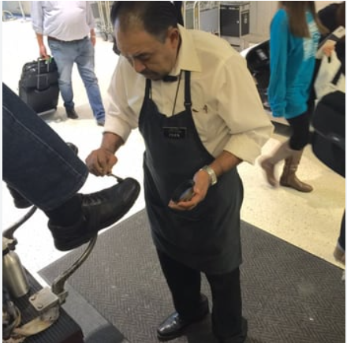


PASSIVE CAUSATIVE
FOR SERVICES
An activity that someone else does for you and you pay for it.

Slide 14
Structure: SUBJECT + HAVE/GET + OBJECT + PAST PARTICIPLE (VERB)
YOU NEED TO HAVE…….
1. I can’t see very well.
You need to have your eyes checked.
2. My living room is old and outdated.
You need to get your living room redecorated.
3. My gums are irritated. I need to get them examined ASAP.
I will get my car washed tomorrow.
My phone was damaged. I HAD TO TAKE IT TO GET IT REPAIRED
My phone is cracked. I will get it fixed tomorrow.

Slide 15
Structure: SUBJECT + HAVE/GET + OBJECT + PAST PARTICIPLE (VERB)
My computer is not working properly. I am going to have it fixed (by a technician) next week.
* My hair is too long. I will get it cut tomorrow.
Peter usually has his hair cut at Linda´s Beauty Salon.
My washing machine is damaged. My mother is getting it repaired tomorrow.
My car was dirty. My sister got it washed this afternoon.

Slide 16
Structure: SUBJECT + HAVE/GET + OBJECT + PAST PARTICIPLE (VERB)
MY FATHER HAD THE DOOR LOCK CHANGED.
Rita had her cellphone battery replaced last week.
Mary is getting her washing machine fixed by a technician now.
Iwill have my jacket dry-cleaned at Martinizing this weekend.

Slide 17
Structure: SUBJECT + HAVE/GET + OBJECT + PAST PARTICIPLE (VERB)
1.Melissa is having her shoes shined.
She is having them shined.
2. My parents got their car serviced.
They got it serviced.
3. Emilio had his TV repaired.
He had it repaired.
4. My phone is cracked. I need to have it fixed.

Slide 18
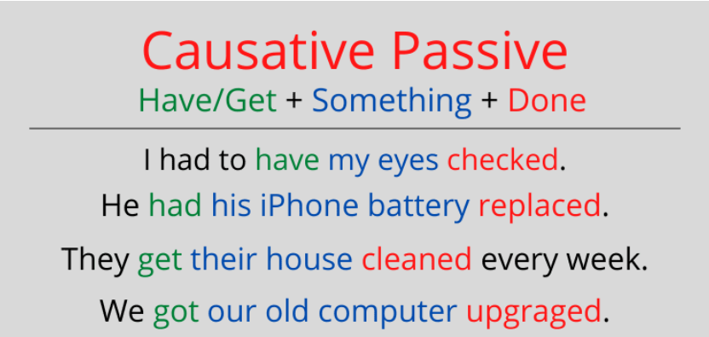
STRUCTURE
Subject + have/get + object + past participle

