Slide 1
Past Perfect

Slide 2
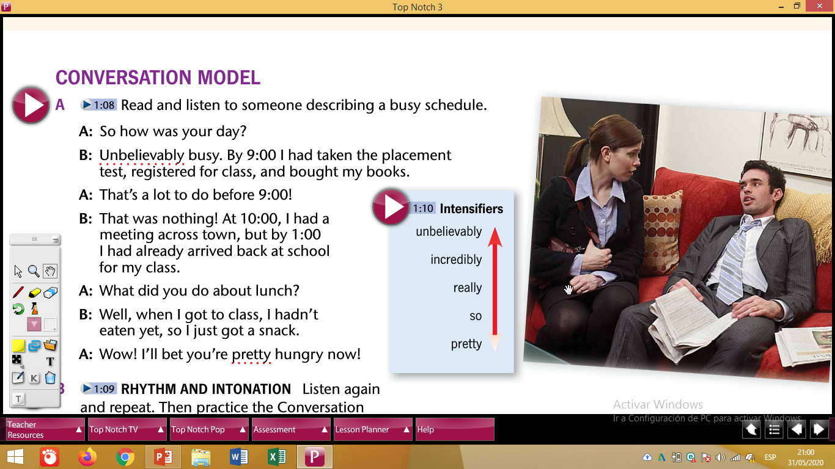

Slide 3
Description of an action that occurred before in a specific time in the past.
Grammar Structure:
Situation: My mom wanted to buy a new house, but my father bought a car.
Subject + HAD + PAST PARTICIPLE + Object
MY FATHER HAD BOUGHT A CAR.

Slide 4
Example:
The situation 1:
The class started at 2 p.m., but we arrived at 2:30.
The class had started before we arrived.
The situation 2:
It was 8 p.m., but Peter prepared the dinner at 7 p.m.
Peter had prepared the dinner before 8 p.m

Slide 5
ALREADY AFFIRMATIVE
BY TIME
YET NEGATIVE

Slide 6
ALREADY AFFIRMATIVE
The situation 1:
The class started at 2 p.m, but we arrived at 2:30.
The class had started before we arrived.
The class had already started.

Slide 7
The situation 2:
It was 8 p.m, but Peter prepared the dinner at 7 p.m.
Peter had prepared the dinner before 8 p.m.
Peter had already prepared the dinner.

Slide 8
EXAMPLES TO PARTICIPATE: What had already happened?
1. Xavier presented the Project last Wednesday, but Julia presented it yesterday.
Xavier had already presented the Project.
2. My son woke up at eight, I prepared the breakfast at seven.
I had already prepared the breakfast.

Slide 9
BY TIME
The situation 1:
The class started at 7 a.m., but we arrived at 7:30.
The class had started before we arrived.
By 7:30 a.m. the class had already started.

Slide 10
The situation 2:
It was 8 p.m., but Peter prepared the dinner at 7 p.m.
Peter had prepared the dinner before 8 p.m.
By seven o’clock Peter had already prepared the dinner.

Slide 11
EXAMPLES TO PARTICIPATE: What had happened? And what time?
1. We left the house at six, but it started raining at five.
By five it had already started raining.
2. The seminar started at 10, but the students arrived at 10:30.
By 10 the seminar had already started.

Slide 12
YET NEGATIVE
The situation 1: hadn’t + yet / had not yet
The class started at 7 am, but we arrived at 7:30.
We hadn’t yet arrived when the class started.
We had not yet arrived.
We had not arrived yet.

Slide 13
The situation 2:
It was 8 p.m., but Peter prepared the dinner at 7 p.m.
It hadn’t yet been 8 and the dinner was ready.

Slide 14
EXAMPLES TO PARTICIPATE: What hadn’t yet happened?
1. Rose presented the Project yesterday, but the professor checked the projects last Friday.
Rose hadn’t yet presented the Project.
2. I called Daniel in the afternoon, but he arrived home at night.
Daniel hadn’t yet arrived home.

Slide 15
CLASSWORK
NAME:
LEVE:
DATE:
PAST PERFECT

Slide 16
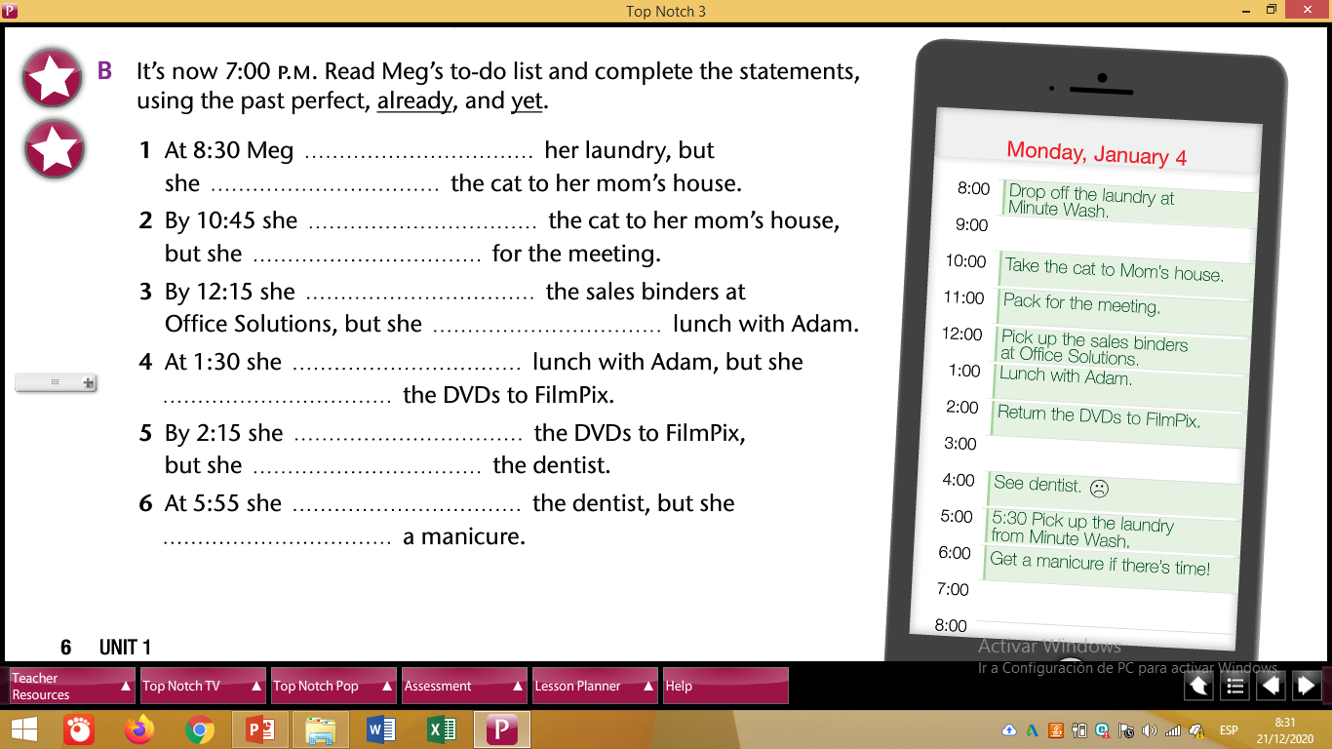

Slide 18
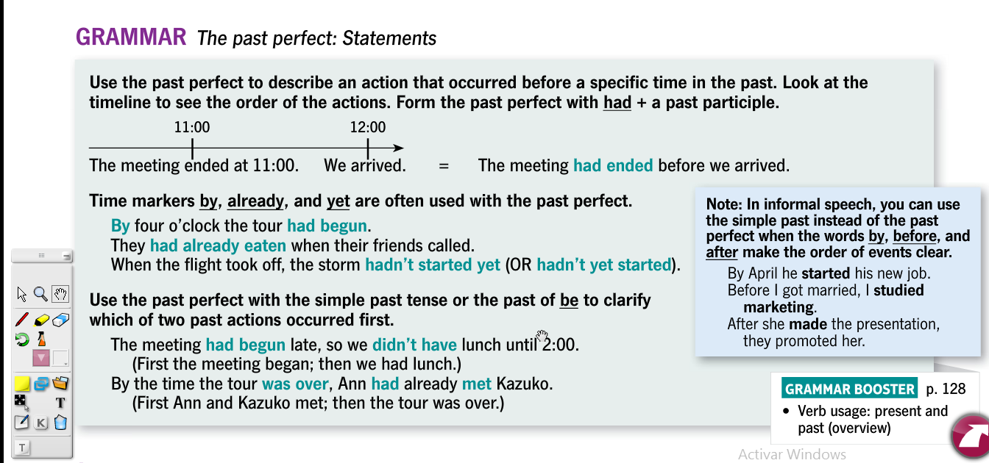

Slide 19
