Slide 1
ACULTURATION VS ENCULURATION

Slide 6
The sources of cultural knowledge
RACE: is a classification of people according to their physical appearances, geographic ancestry, and heritable characteristics.
ETHNICITY: which relates to culturally contingent features, characterizes all human groups. It refers to a sense of identity and membership in a group that shares common language, cultural traits (values, beliefs, religion, food habits, customs, etc.), and a sense of a common history.

Slide 7
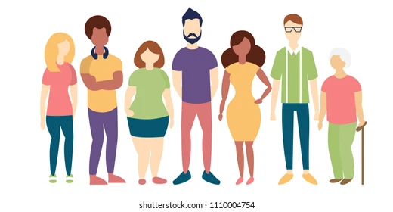
GENDER: Describes how women and men feel that they and their colleagues have been influenced by these cultures, and how they reinforce persistent stereotypes about “women and work”. Gender cultures affect both men and women′s decisions and behavior at work.
AGE: According to social representations theory the views of aging held within a given culture are a form of shared cultural representation. They constitute systems of ideas, values, and customs related to aging that are treated by members of the society as if they were established reality.

Slide 8
RELIGION: The relationship between culture and religion is revealed in the motivation and manifestation of cultural expression. If culture expresses how humans experience and understand the world; religion is a fundamental way in which humans experience and understand the world.
SOCIAL CLASS: social class, also called class, a group of people within a society who possess the same socioeconomic status. Besides being important in social theory, the concept of class as a collection of individuals sharing similar economic circumstances has been widely used in censuses and in studies of social mobility.

Slide 9
HEALTH STATUS: is an individual's relative level of wellness and illness, taking into account the presence of biological or physiological dysfunction, symptoms, and functional impairment. Health perceptions (or perceived health status) are subjective ratings by the affected individual of his or her health status.

Slide 10
CLASS WORK
Students identify the most relevant aspects about other countrie´s culture and which ones they will be learn of them.
Create the graphic organizer considering the cultural aspects they want to learn of those countries.
Students present their work to the class.

