Slide 1
The past tense of be
IS =WAS
ARE =WERE

Slide 2
I
He
She was / wasn’t
It
We
You were/ weren’t
They

Slide 3
Use was and were for affirmative statements. Use wasn’t and weren’t for negative statements
POSSITIVE POSSITIVE
I was in Rome yesterday They were in Paris
NEGATIVE NEGATIVE
She wasn’t in Rome yesterday They weren’t in Paris yesterday

Slide 4
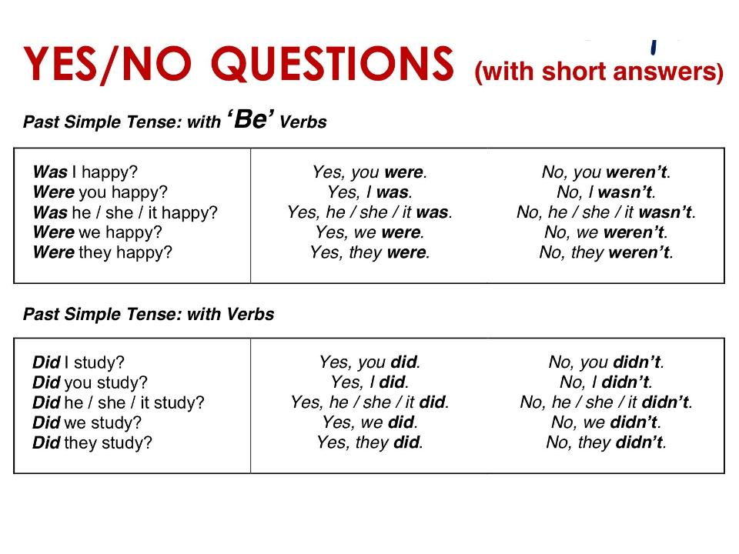

Slide 5
Information questions
Begin information questions with a questions word followed by was or were
How long was your vacations?
Two hours
Only a few hours
Where was your passaport?
It was in my desk
How many people were there?
There were three people
Where were your tickets?
There were in the jacket

Slide 6
THE SIMPLE PAST TENSE
Use the simple past tense to talk about completed actions in the past
REGULAR VERBS
Finish in ed
Play / played
Dance /danced
Visit/ visited
Work/ worked
Study/ studied
Travel/ traveled
Open/ opened
Like/ liked
Close /closed
IREGULAR VERBS
It has the proper form
Be/ was were
Buy bought
Become became
Do did
Come came

Slide 7
AFFIRMATIVE
I played SOCCER IN THE PARK
He lived in Boston
I studied English yesterday
I bought clothes the last week.
NEGATIVE
I didn’t play SOCCER IN THE PARK
He didn’t live in Boston
I didn’t study English yesterday
I didn’t buy clothes the last week.

Slide 8
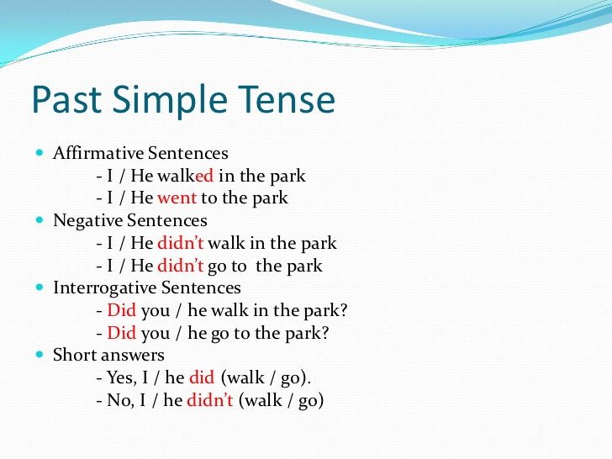

Slide 9
Begin yes no questions with Did. Use the base form of the verb

Slide 10
Begin information questions with a question word followed by did. Use the base form of the verb.
Where did you go shopping?
I went shopping at the mall in Riobamba
When did he arrive?
He arrived yesterday
He arrived at night
What did JUANITA eat yesterday?
JUANITA ate chicken yesterday

Slide 11
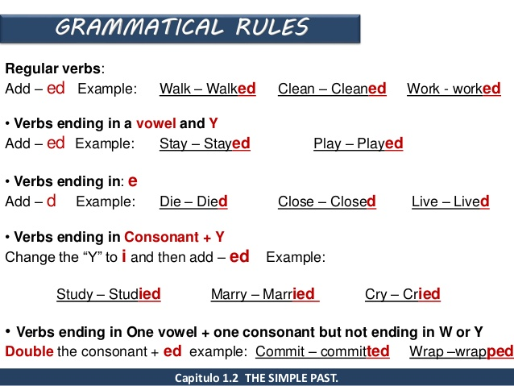

Slide 12
