Slide 1
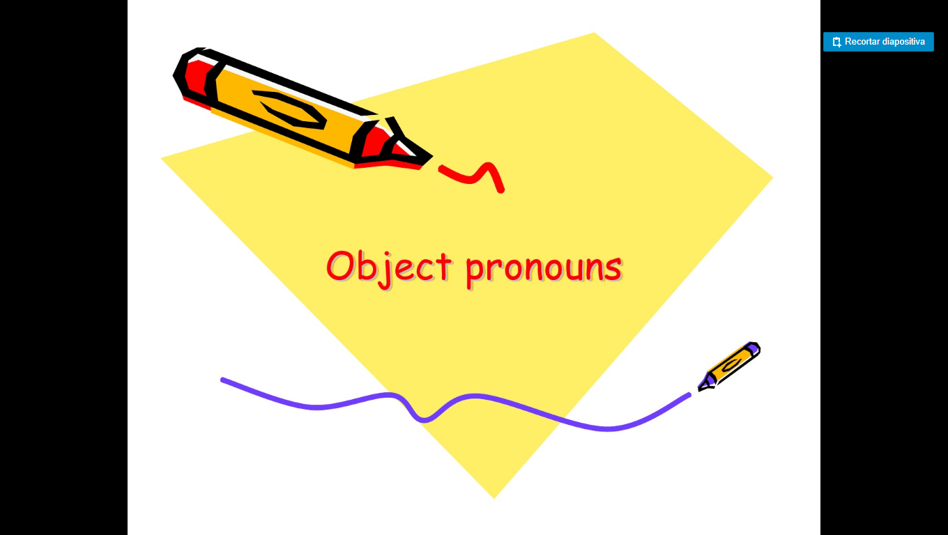

Slide 2
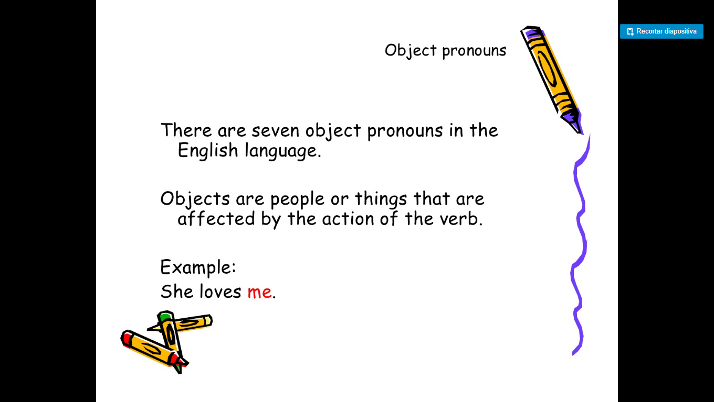

Slide 3
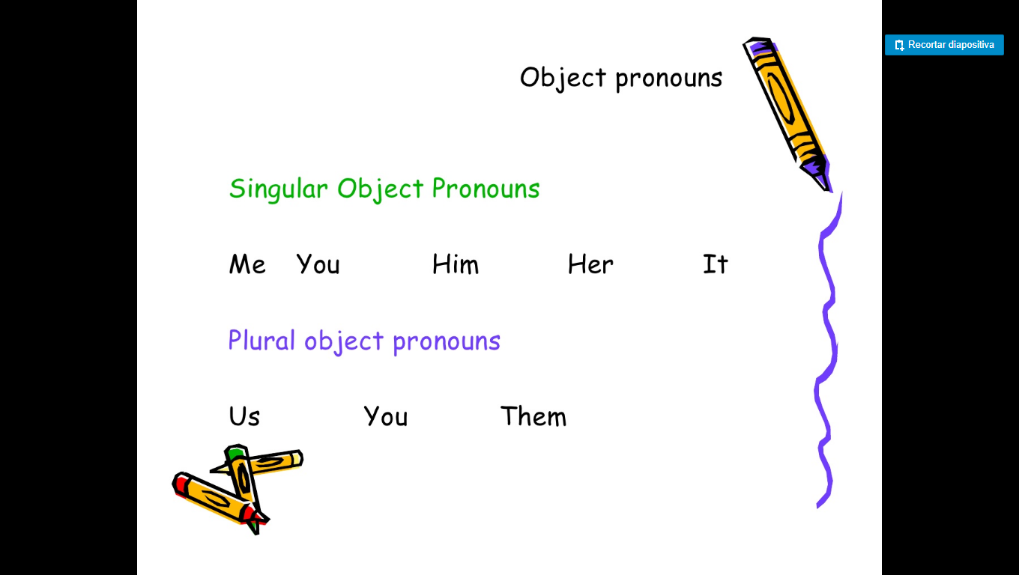

Slide 4
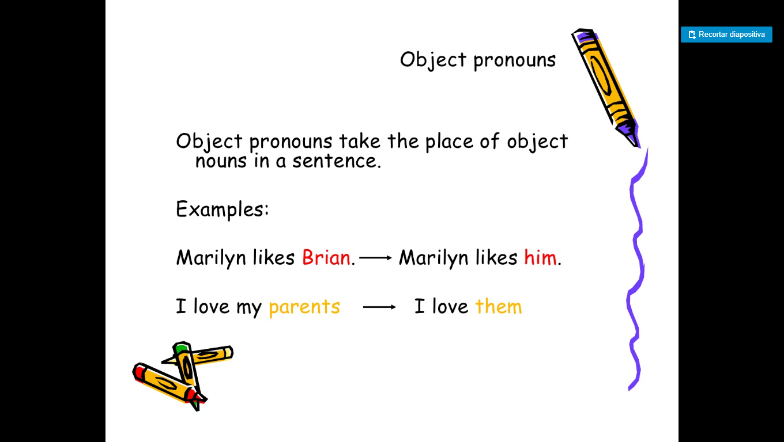

Slide 5
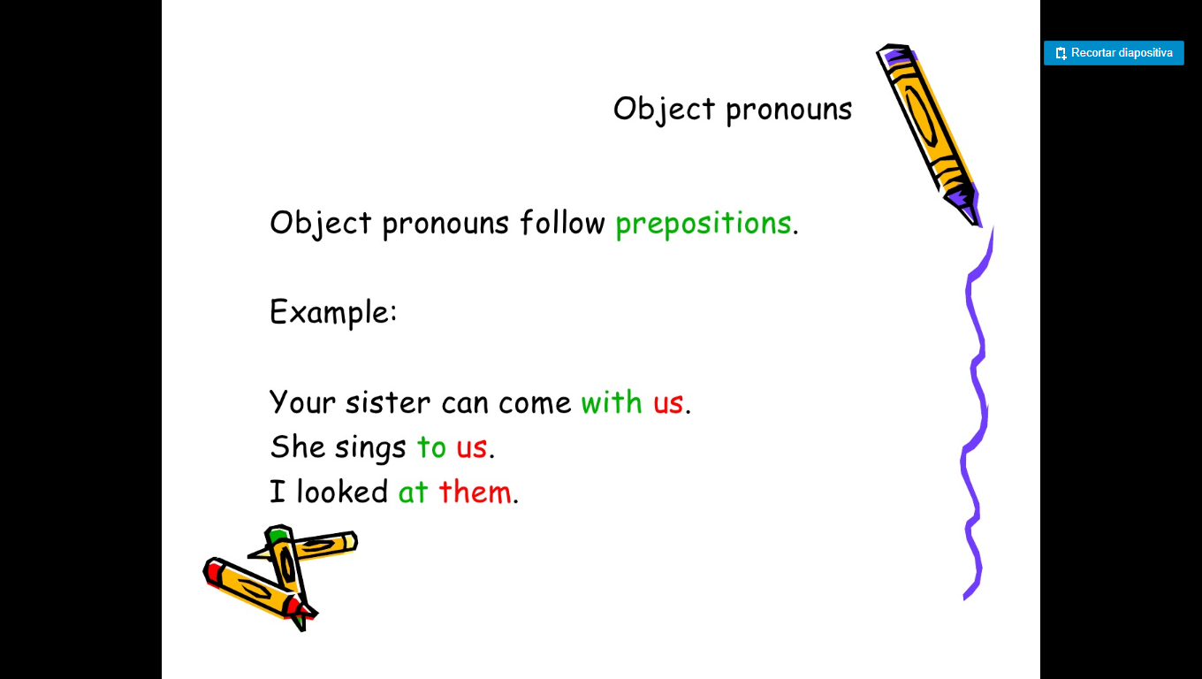

Slide 6
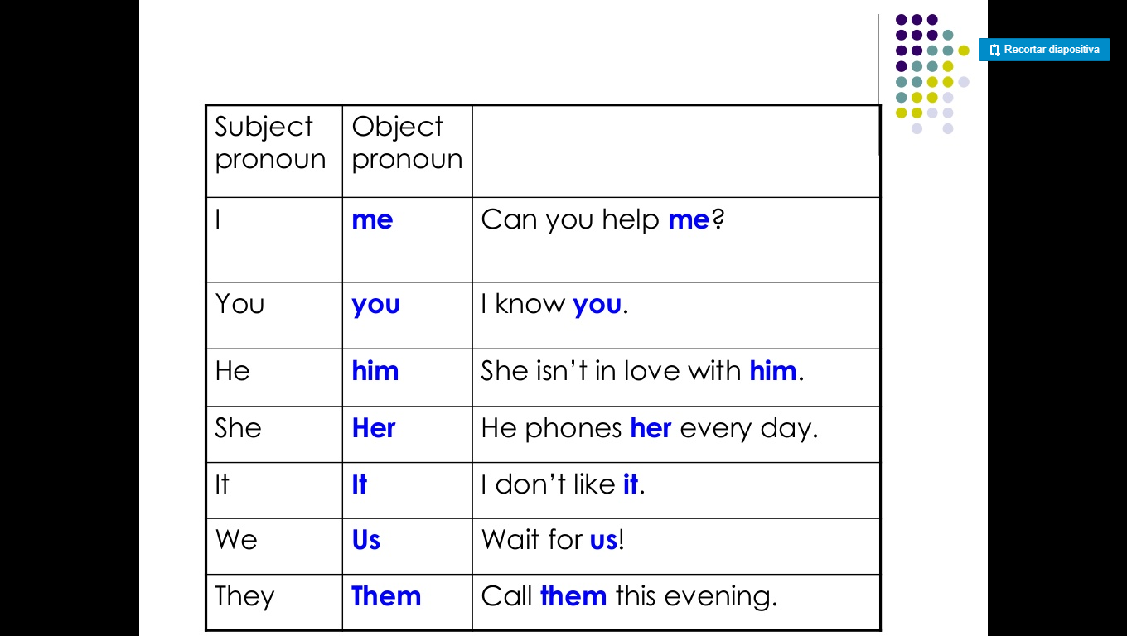

Slide 7
OBJECT PRONOUNS
Complete the conversations. Use object pronouns.
Are your sisters going to the party?
I hope so. I invited_____
This sweatshirt is really old.
That´s ok. I wear_____ to exercise
Did you meet Ms. Jacobs?
Yes, I met _____this morning

Slide 8
When can I call you?
Let’s see. Call _____tomorrow
I´ll be home all day.
I didn’t see you and Emma at the concert.
You didn’t see______? We were right near the stage.

