Slide 1
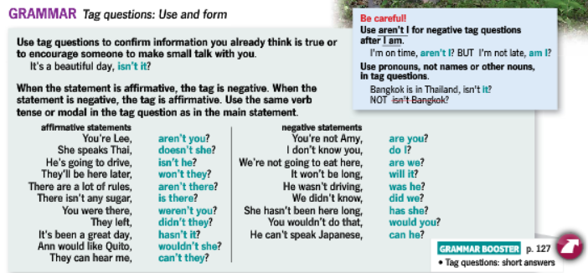
UNIT 1 MAKE SMALL TALK (GRAMMAR)

Slide 2
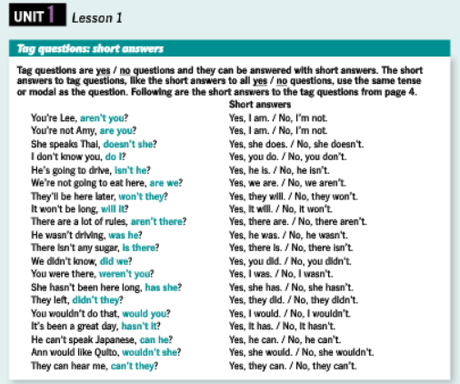

Slide 3
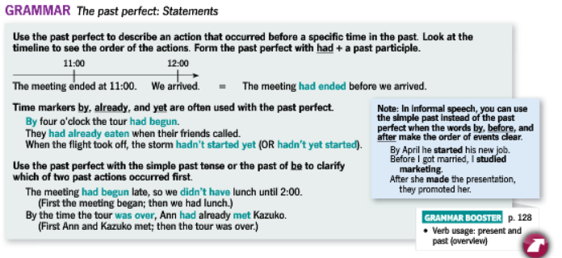

Slide 4
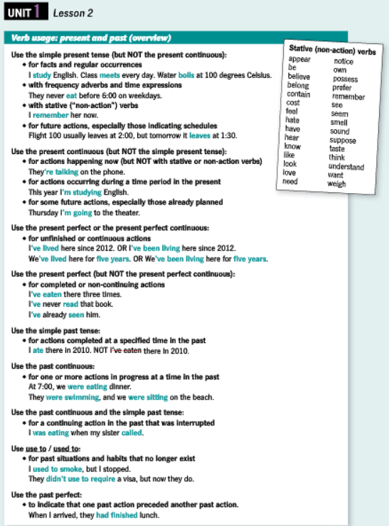

Slide 5
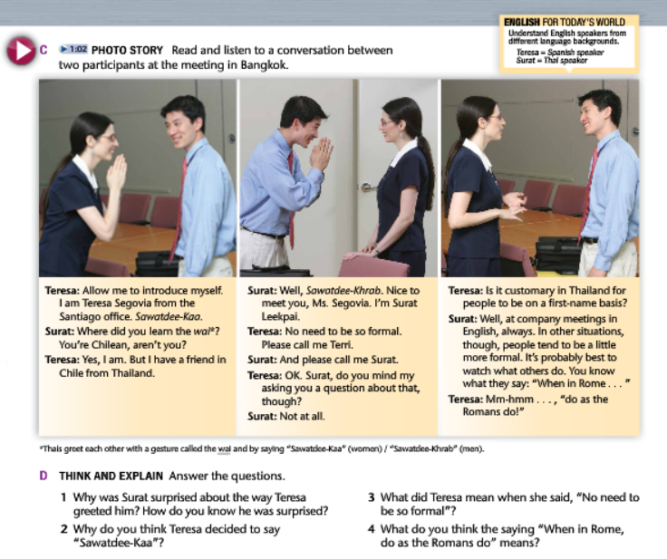
UNIT 1 MAKE SMALL TALK (VOCABULARY)

Slide 6
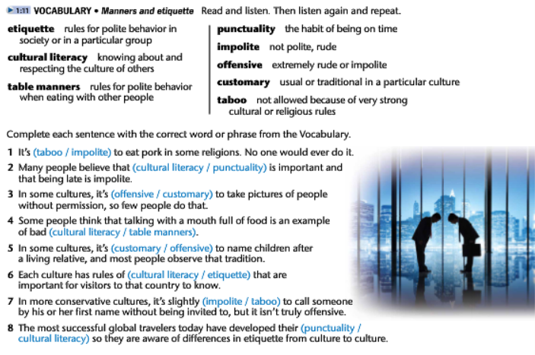

Slide 7
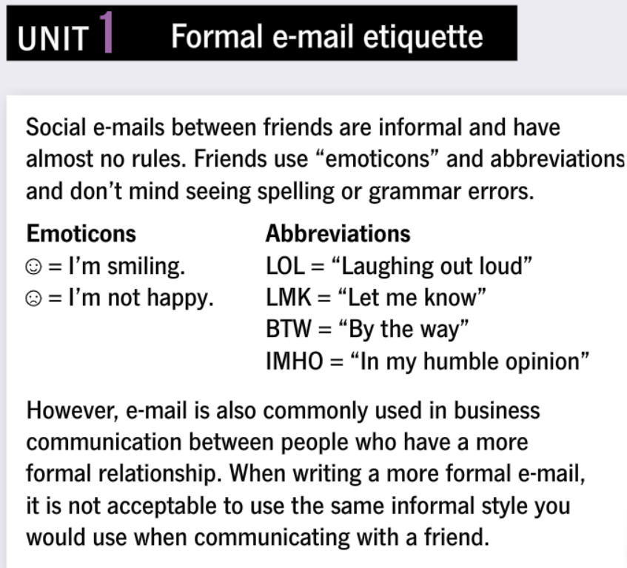
UNIT 1 MAKE SMALL TALK (WRITING)

Slide 8
