Slide 1
THE CAUSATIVE FORM and PASSIVE
have/get something done
Asking to do something

Slide 2
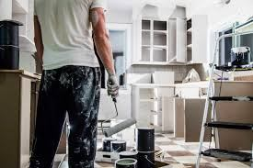
Have: request
Made: force
Get: persuade

Slide 3
A month ago
James painted his house.
But… it was a disaster!!!

Slide 4
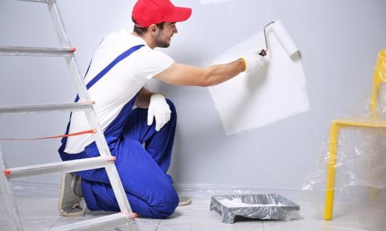
So he decided to call a professional painter.
Last Sunday,
James had/got his house painted.

Slide 5
Causative Form
have something do
.made something do
get something to do

Slide 6
Passive Causative Form
have something done(PP)
. get something done(PP)

Slide 7
Structure
Example: I am fixing my computer now.
Causative form:
I am making my computer fix now.
Subject+ Make/have+ Object+ based form
I am getting my computer to fix now.
Subject+ get+ Object+ infinitive

Slide 8
Structure
Example: I am fixing my computer right now.
Passive Causative form:
I am having my computer fixed right now
I am getting my computer fixed right now
Subject+have/get+ Object+ Past participle (Passive causative structure)
Subject+verb to be +Main Verb(ing)+C (Progressive)

Slide 9
Present Simple have
Present Continuous (vert to be+main verb(ing)) am/is/are having
Past Simple had
Past Continuous was/were having
Present Perfect Simple has/have had
Present Perfect Continuous has/have been having
Past Perfect Simple had had
Past Perfect Continuous had been having
I fix my TV

Slide 10
Future Simple will have
Future Continuous will be having
Future Perfect Simple will have had
Future Perfect Continuous will have been having
Infinitive (to) have
Gerund having

Slide 11
Present Simple get
Present Continuous am/is/are getting
Past Simple got
Past Continuous was/were getting
Present Perfect Simple has/have got
Present Perfect Continuous has/have been getting
Past Perfect Simple had got
Past Perfect Continuous had been getting
Jane develops her homework

Slide 12
Future Simple will get
Future Continuous will be getting
Future Perfect Simple will have got
Future Perfect Continuous will have been getting
Infinitive (to) get
Gerund getting

Slide 13
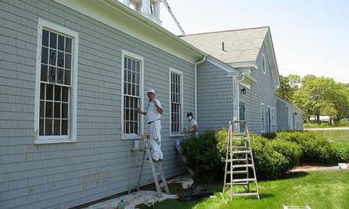
They paint the windows every spring.
They ……………………………………………….. every spring.
They ……………………………………………….. every spring.
have the windows paint
get the windows to paint

Slide 14
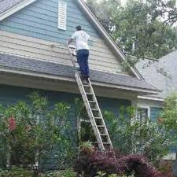
He is fixing the roof now.
He ………………………………………….. now.
He ……………………………………………….. now.
is having the roof fix
is getting the roof to fix

Slide 15

He installed a new game yesterday.
He ……………………………………………….. yesterday.
He……………………………………………….. yesterday.
made a new game install

Slide 16
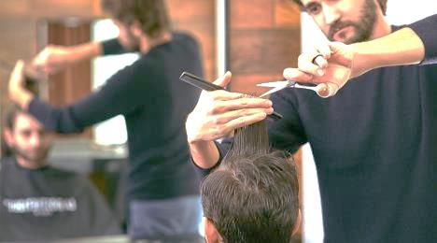
He was cutting his hair yesterday morning.
He ……………………………………………….. yesterday morning.
He ……………………………………………….. yesterday morning.
was having his hair cut
was getting his hair to cut

Slide 17
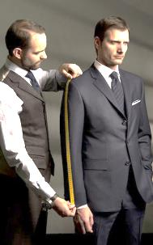
He has made a new suit.
He ………………………………………………..
He ……………………………………………….. .
has had a new suit made
has gotten a new suit made

Slide 18

She will repair her bike.
She ……………………………………………….. .
She ……………………………………………….. .
will have her bike repaired
will get her bike repaired

Slide 19


