Slide 1
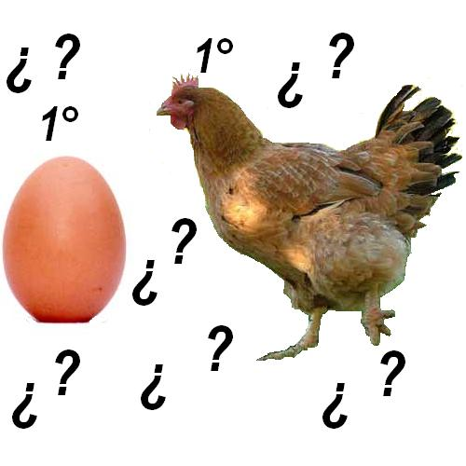
WHAT HAPPENED FIRST?

Slide 2
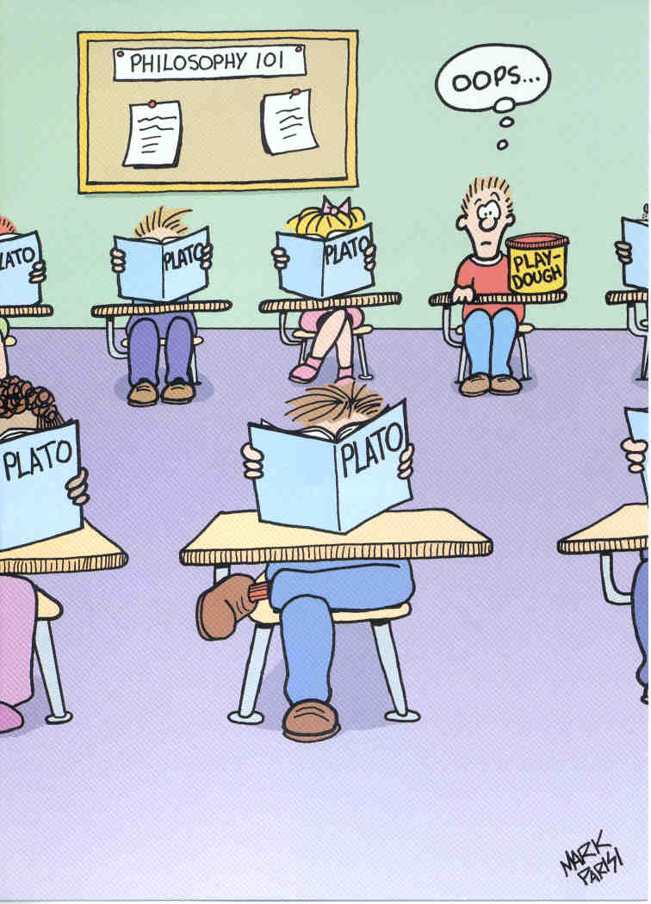

When Kevin arrived to school the class had already started.

Slide 3
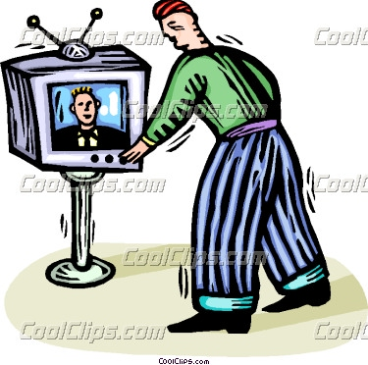
When he turned on the TV, the program had already started.

Slide 4


When Paul got home , he realized he had left the door open.

Slide 5
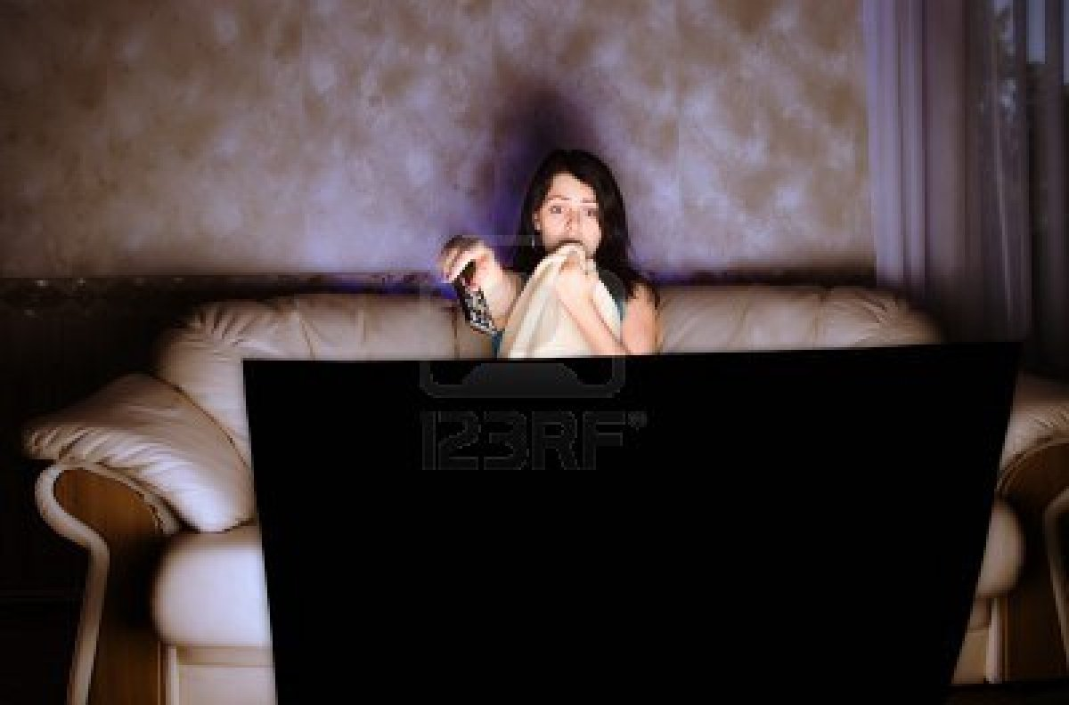
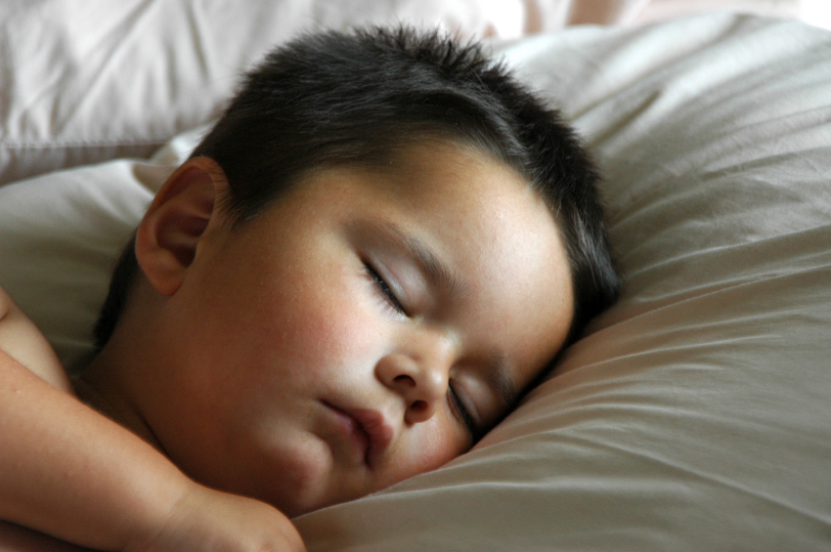
After my son had gone to bed, I watched a movie.

Slide 6
TIME EXPRESSIONS
By the time – Ex: By the time Doris got to the party, everyone had gone home.
After – Ex: I arrived after the teacher had called the roll.
Before – Ex: She had seen the movie before she went to bed.
When – Ex: I went to bed when I had finished my homework.

Slide 7
TIME EXPRESSIONS
Use after, as soon as, until before using the PAST PERFECT SIMPLE.
Ex: After she had moved out, I found her notes./ I didn’t say anything until she had finished talking. / As soon as I had finished my homework, I went to bed.

Slide 8
TIME EXPRESSIONS
Use before, when, by the time before the PAST SIMPLE:
Ex. Before I knew it, she had run out the door. / By the time he phoned her, she had turned off her cellphone. / She had left when I got home.

Slide 9
EXERCISES
After I ______ (finish) my lunch, I went back to work.
George ________ (repair) his car before he went fishing.
She _______ (tell) me she _________ (buy) a new car.
I _____(buy) a new car because some thieves __________ (steal) my old one.

Slide 10
EXERCISES
5- After the company _____Joe, he began to work on his first project. (hire)
6- _____you _______ the news before you saw it on TV? (hear)
7- Michael didn’t want to see the movie because he _______ the book yet. (not read)
8-The concert ______ already _______when we _______ the stadium. (begin/ enter)
9- Until Anne ________ Mark, she ____ never ______in love. (meet, be)

Slide 11
EXERCISES
10- Bill __________ for years before he finally _______. (smoke/ quit)
11- _______ Sara ever _______to London by herself before October? (drive)
12- How many fish ______ the boys _____ by the time it started raining? (catch)
13- You ________ them to go to the beach, hadn’t you? (forbid)
14- The girls _______ in weeks. That’s why they ______ so much afterwards. (not exercise / hurt)

Slide 12
Circle the correct answers. In some cases only one is correct, and in others both are correct.
As James was introduced to Mrs. Snape, he realized that he had met / met her before.

Slide 13
2. During the previous week, I had been / went to the gym every evening.
3. He denied that he had taken / took the money from the office.
4. I didn’t know the marking would take so long until I had read / read the first couple of essays.
5. The boy told me that he had lost / lost his train ticket and didn’t know how he would get home.
6. At the conference, scientists reported that they had found / found a cure for malaria.

Slide 14
7. The teacher guessed that some of the children had cheated / cheated in the exam.
8. Thomas explained that he had gone / went home early because he felt ill.
9. The waiter took my plate away before I had finished / finished eating.
10. Jane didn’t want any dinner. She had eaten / ate already.

