Slide 1
Passive Voice

Slide 2
AGENDA
Goal: Passive voice
Video “The Passive”
Explanation of Passive voice
Exercises

Slide 3
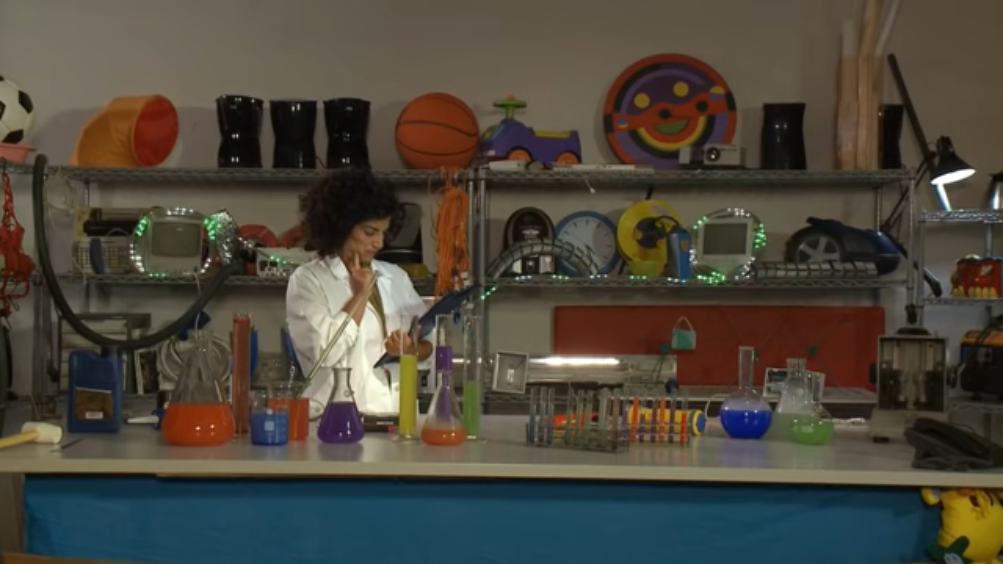
The Passive
https://www.youtube.com/watch?v=s2m8kivDZ-s

Slide 4
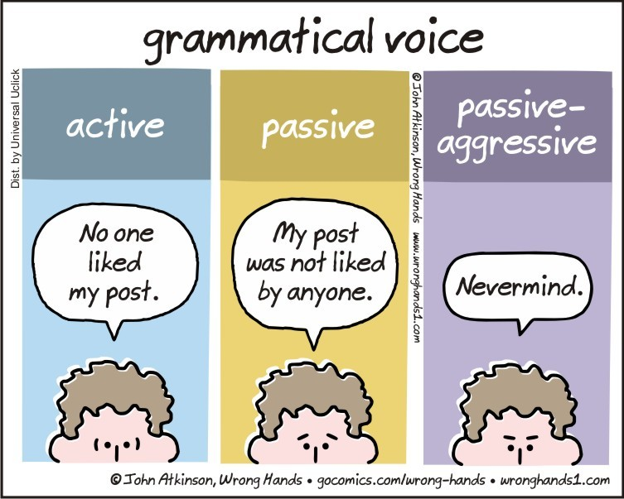

Slide 5
Source: Unknown

Slide 6
Source: Unknown

Slide 7
Source: Unknown

Slide 8
Source: Unknown

Slide 9
Source: English: read, learn, enjoy!

Slide 10
Sing – sang- sung drink- drank- drunk write- wrote – written read- read /red/- read

Slide 11
Is/are + past participle isn’t/ aren’t + past participle was/were + past participle wasn’t/weren’t + past participle

Slide 12
It was not made by Colombian people They were not repaired by the mechanic

Slide 13
Is/are + past participle isn’t/ aren’t + past participle The car ________ (use) by me The papers _________ (read) in the morning.

Slide 14
was/were + past participle wasn’t/weren’t + past participle The house _____________ (paint) yesterday. The pictures __________ (take) last year.

Slide 16
are sold
were not found
Source: Adapted material from Unknown sources

Slide 17
are made
Source: ISL Collective

