Slide 2
It’s sunny outside! What would you like to do?

Slide 3
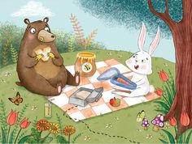
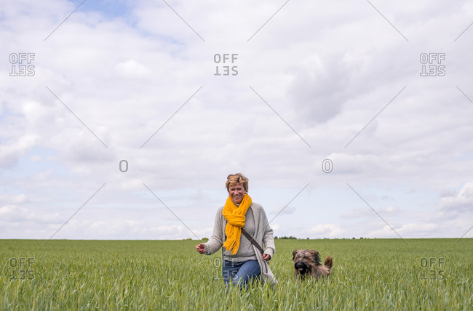
Would you like to go
Go on a picnic?
Go for a stroll?

Slide 4
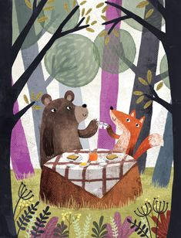
Yes, I would! I like picnics! It’s really fun! let’s go!
Would you like to go on a picnic?

Slide 5
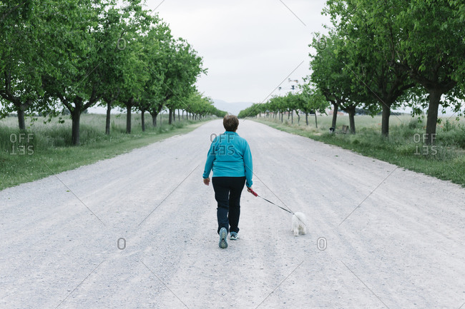
Would you like to go for a stroll?
No, I wouldn’t.
I don’t like strolling.
It’s my number eight.
I don’t think it’s fun at all.
I can’t, I have a class this afternoon.

Slide 6
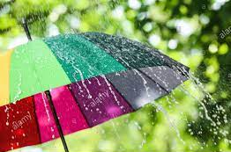
Let’s stay in! we can’t go outside. I would like to do something at home.
It’s rainning. It’s snowing.

Slide 7
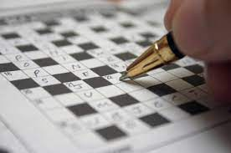
What would you like to do?
Let’s do a jigsaw puzzle! I really like jigsaw puzzles.
We can also do a crossword. Do you like crosswords?

Slide 8
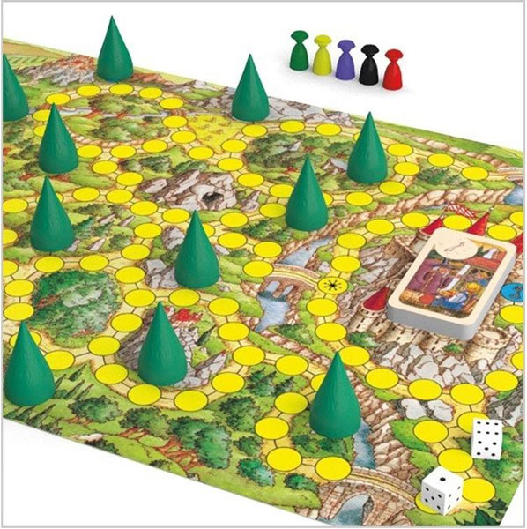
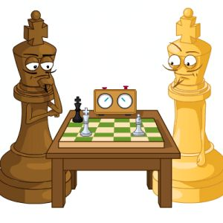
I’m bored! Let’s do something fun.
What would you like to do?
Would you like to play a board game?
Would you like to play chess?

Slide 9
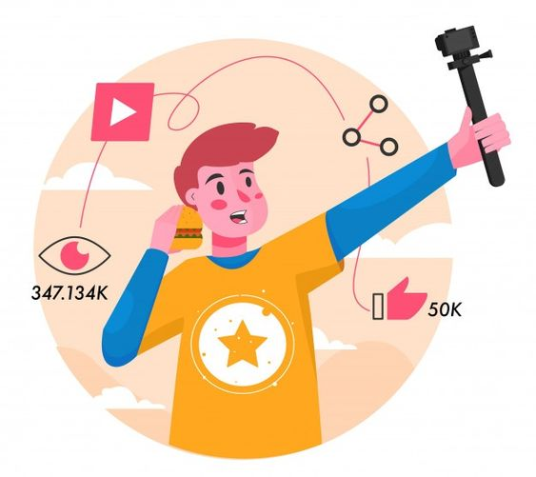
What would you like to make?
I would like to make popcorn. How about you?
I’d like to make a video! How about you?

Slide 10
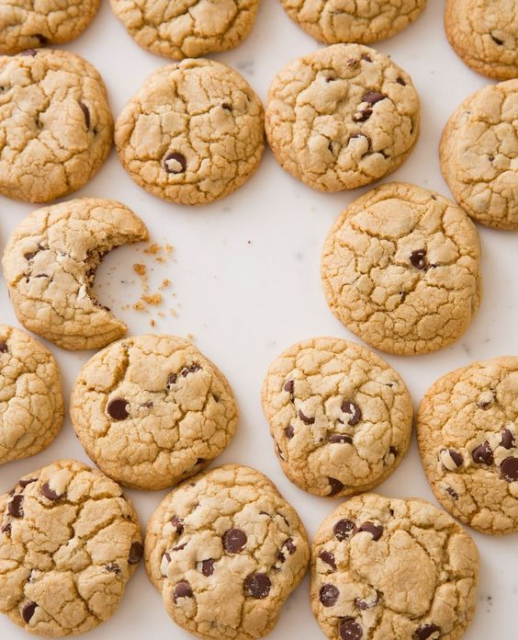
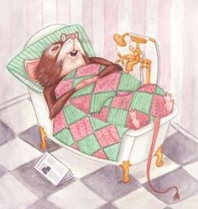
Would you like to bake some cookies?
No, I wouldn’t like to bake now. I’m sorry but I’m really tired. I’d like to take a short nap right now.
Let’s bake later.
Yes! I would!
That’s really fun!
Let’s do it now!

Slide 11
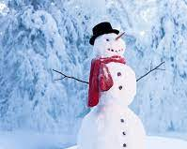
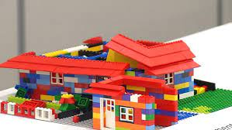
Which would Anna like to do?
build a snow man?
Build a lego house?
How about you? Would you like to build a snowman?

Slide 12
To say politely what we want:
I would like some tea, please.
I would like to have a ticket for tomorrow.
Would you like to play chess with me?
I would like some help here.
I would like to ask for a second opinion.
Would you like to have dinner with us tonight?
Do you think she would like to go out with me?

Slide 13
To accept or reject an offer:
No, that’s ok! Thank you.
Actually I don’t like baking.
I would like to do something else.
I never take a nap!
I don’t think that’s fun at all.
We can’t do that! It’s rainy outside.
I’m sorry but I can’t. I have a class today.
Great idea! But let’s play a bit later.
Yes ,please. Thank you.
I like picnics!
It’s really fun!
let’s do it!
That would be nice/lovely
Thank you, that is great.
I do a crossword everyday! I like it!
I think that’s really fun.

Slide 14
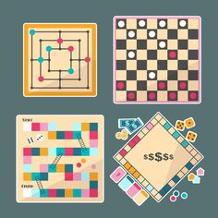
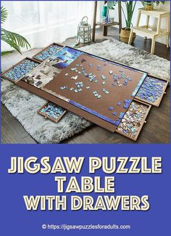
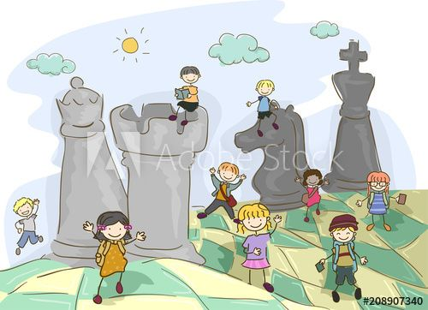
Which game would they like to play?

Slide 15
I like
To express general preferences
Used for situations that
have already been experienced
and we have a feeling for
To express your idea
Similar to enjoy in meaning and grammar:
It’s followed by a gerund.

Slide 16
examples
I like snorkeling but she doesn’t.
We both like your cats but they don’t like us!
Do you like chess?
I think puzzles are fun. I like them!
I don’t like riding a bike. It’s my number eight.
I like your new hair style!

Slide 17
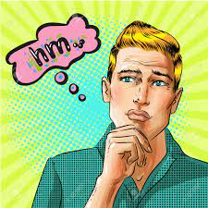
I would like to …
To make offers, To make requests, to say politely what we want
To express desire and ambition, especially used for first-hand experiences
Sometimes is used for imaginary and unlikely situations
Relates to the time being, near future or general future
Similar in meaning and grammar to “want”

Slide 18
Examples
Would you like to go to cinema this weekend? (offer)
I wouldn’t like to play card games now. (offer)
Would he like to be a teacher? (desire)
She says she would like to be in army. (unlikely)
I would like to get a return ticket for tomorrow. (polite request)
In a restaurant: what would you like to order? I’d like to have the pizza. (polite request)
Would you like to be a president one day? (imaginary – general future)
Would they like to join us for dinner tomorrow? (offer)
I would like to buy a pet but my wife wouldn’t. (desire)
Would you like some biscuits with your tea?
To doctor: We both would like to have a second opinion. (polite request)
I would like to know if we can have a meeting regarding the issue soon.
I like parrots but I wouldn’t like to keep one at my home.
I like soccer and I would like to become a couch.
I have never played golf before but I would like to try it.

Slide 19
Categories: 1. Weather 2.job 3.food 4.travel 5.literature 6. media 7.nightlife
In pairs talk about these categories and find 5 similarities and 5 differences between you and your partner.
Examples:
We both like doing crosswords.
Neither of us likes playing card games.
She would like to cook cookies tonight but I wouldn’t.
We would like to have more time.
We both like comedy movies. We would like to watch one together later today.

Slide 20
Click on the link and do the quiz:
http://www.quiz-maker.com/QRE8MFRY6

