Slide 1
GERUNDS AND INFINITIVES
PART 1: GERUNDS

Slide 2
GERUNDS-FORM
playing
studying
giving
swimming
collecting

Slide 3
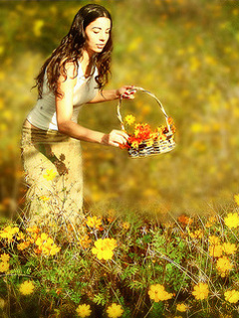
GERUNDS-USE
1. As the subject or object of a sentence
Collecting flowers is my hobby.
I like collecting flowers.

Slide 4
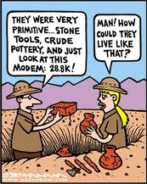
2. After prepositions
They are interested in studying archaeology.
They dream of becoming archaeologists.
They are crazy about discovering ancient cities.
They are tired of digging in the sand.
Other expressions: good at/ bad at/ keen on/ bored with/ fed up with/ afraid of

Slide 5



3. After specific verbs such as:
like
hate
dislike
can’t stand mind
look forward to
enjoy
prefer
fancy
feel like
start
stop
continue
Begin
finish
quit
give up
practise
remember
forget
avoid
can’t help

Slide 6
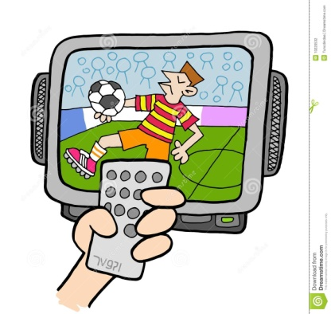
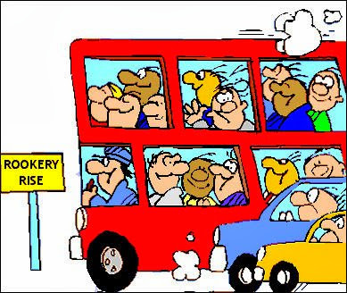

Examples
I enjoy watching football on T.V.
I hate travelling by coach.
She started playing the guitar two years ago.

Slide 7
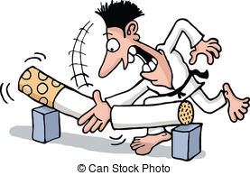
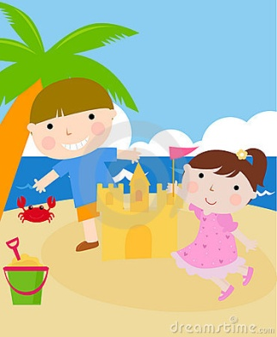

Examples
He is trying to quit smoking.
Do you remember building sandcastles when we were kids?

Slide 8

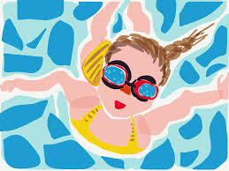
4. Go + ing
We’re going shopping tomorrow.
Other:
go shopping
go swimming
go fishing
go skiing
etc.
I go swimming twice a week.

Slide 9

5. be/get used to + ing
I’m used to getting up early in the morning.

Slide 10
THE END

