Slide 1

Modal Verbs
can will have to must might

Slide 2





Modal verb: Must (Drawing a conclusion)
Head
Brainstorming
Truth information
Clues
Read contend
Subject+must+verb+C (Structure)

Slide 3
Modals
can
will
have to
must
might
You can take a break when you are tired.
The weather will be really cold tomorrow.
You have to work really hard to pass the proficiency exam.
You must have a driver licence to drive a car.
I might go to Starbucks with my friends ater school.

Slide 4

Can

Slide 5
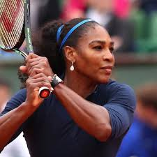

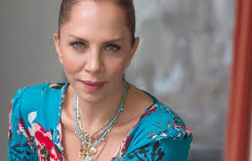
Can//ability
Say their names and what they can do ☺

Slide 6


will

Slide 7
Modal verb: Will/won’t (Future ability)+be able to (can)
Will (possiblity)+Be able to (preparation)
Don’t use in future.
Posibility in the future to develop something
Capacity to develop something
resources
Can be used in another time
Subject+will+be able to+verb+C (Structure)
Subject+will+can+verb+C (Structure)

Slide 8
Examples
Subject+will+be able to+verb+C (Structure)
I will be able to cook delicious dishes. Now the cooking course was finished.
I’d like to be able to run as fast as you do
We will be able to swim after practicing in a pool few times.
Peter will be able to sleep early tomorrow.

Slide 9


Have to

Slide 10
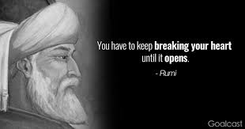
Have to

Slide 11


Slide 12

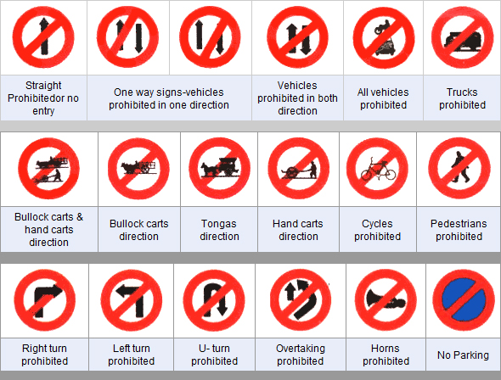
Must

Slide 13
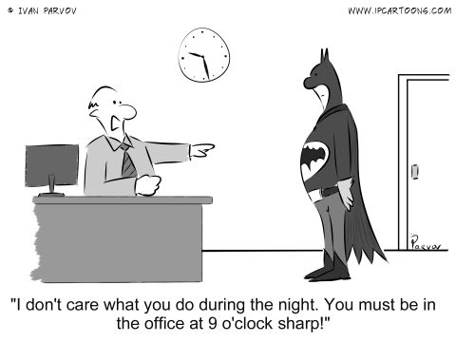

Slide 14

Should

Slide 15




Should
Personal
Trainer
Secretary
Artist
Doctor
Should
Wash her hands
Be patient
Should
Know how to use equipments
Be a good example
Should
Be organised
kind
Should
Be creative

Slide 16
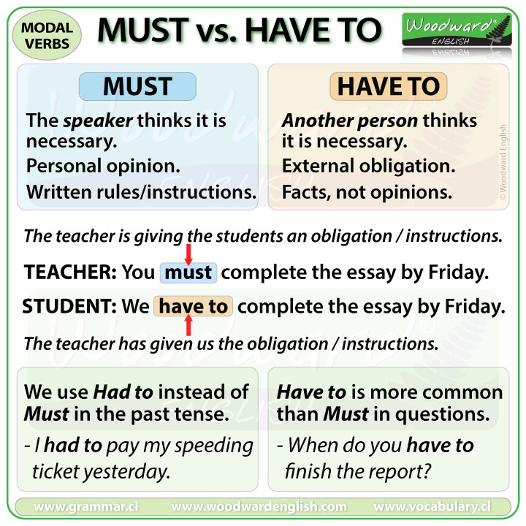
Have to vs must

Slide 17

May/Might/might not

Slide 18
Modal verb: MAY/Might (Future possibility) (be able to)
Posibility in the future
Express future
The activity can be happened.
Must +be able to (conclusion)
Subject+may/might+be able to+verb+C (Structure)

Slide 19

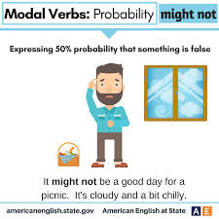
Why did he use might?

Slide 20
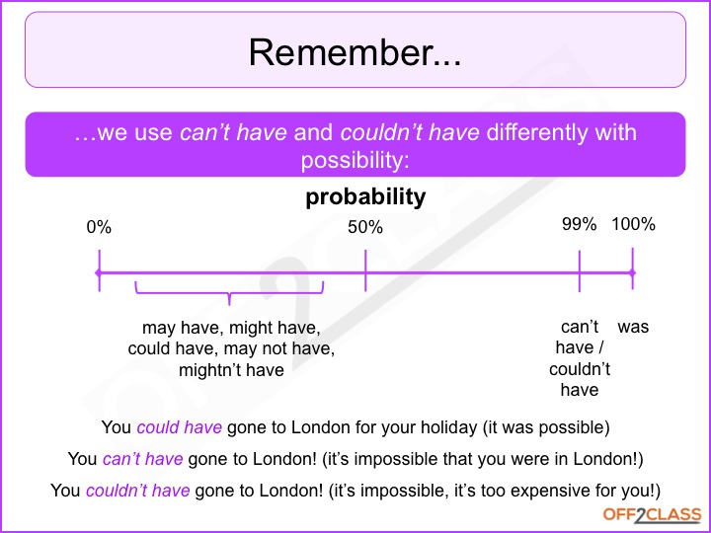
Probabilities

Slide 21
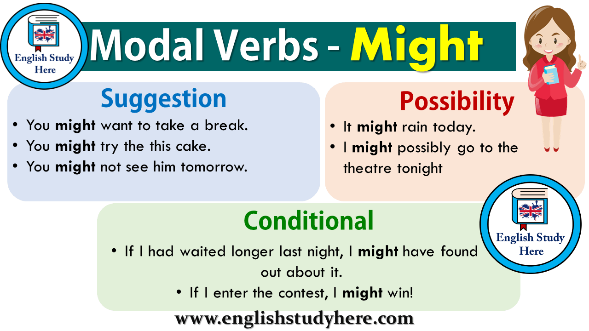

Slide 22


Thank You
H-205

