Slide 1
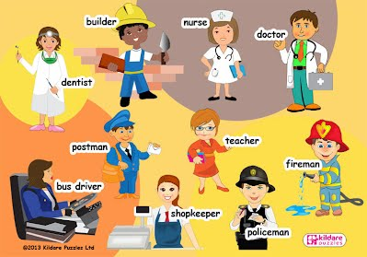
Unit 5
LIFE PLANS

Slide 2
Expressing intentions
Past situations

Slide 3
1.Was/ were going to
2. would + verb

Slide 4
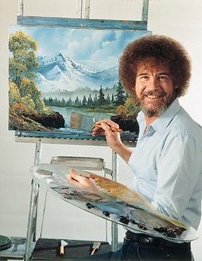
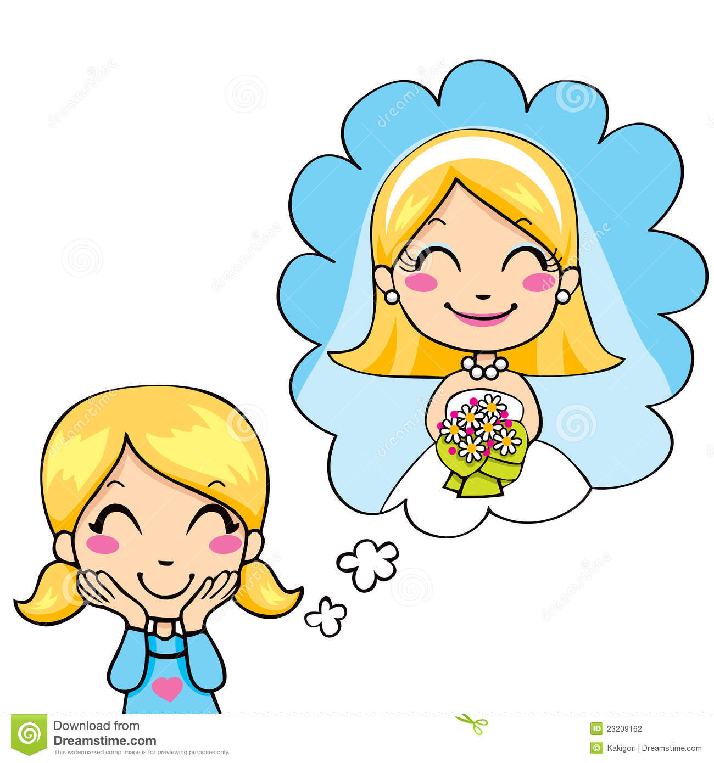

PLANS THAT CHANGED
AFFIRMATIVE SENTENCES
WAS GOING TO + VERB
Joey was going to be a painter, but he prefered to study Law.
I was going to study Law, but I changed my mind.
Gaby was going to get married, but she decided to stay single.

Slide 5


PLANS THAT CHANGE
AFFIRMATIVE SENTENCES
WERE GOING TO + VERB
We were going to be rock stars, but it was not a good idea.
Joe and Lili were going to study Medicine, but many things happened.

Slide 6
Examples to practice. Create “plans that change” sentences using:
WAS GOING TO / WERE GOING TO
Travel to Europe (Paul) - Get a full time job (We)
Have a baby (George and his wife) - Buy a car (I)

Slide 7
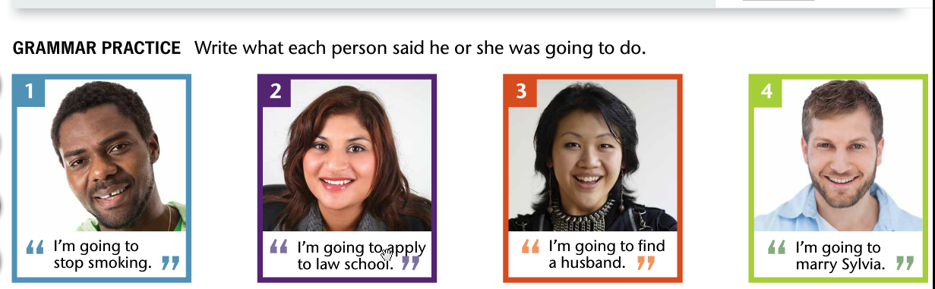
Henry Madeline Sonia George
1. Henry said he was going to stop smoking.
2.

Slide 8
NEGATIVE SENTENCES
WASN’T GOING TO + VERB /
WEREN’T GOING TO

Slide 9
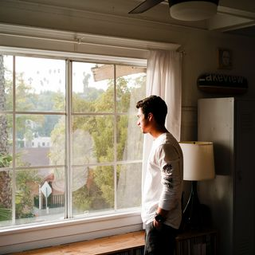


NEGATIVE SENTENCES
WASN’T GOING TO + VERB
CRY STAY ALONE PREPARE THE DINNER
I wasn’t going to cry, but I felt so bad.
Kevin
Laura

Slide 10
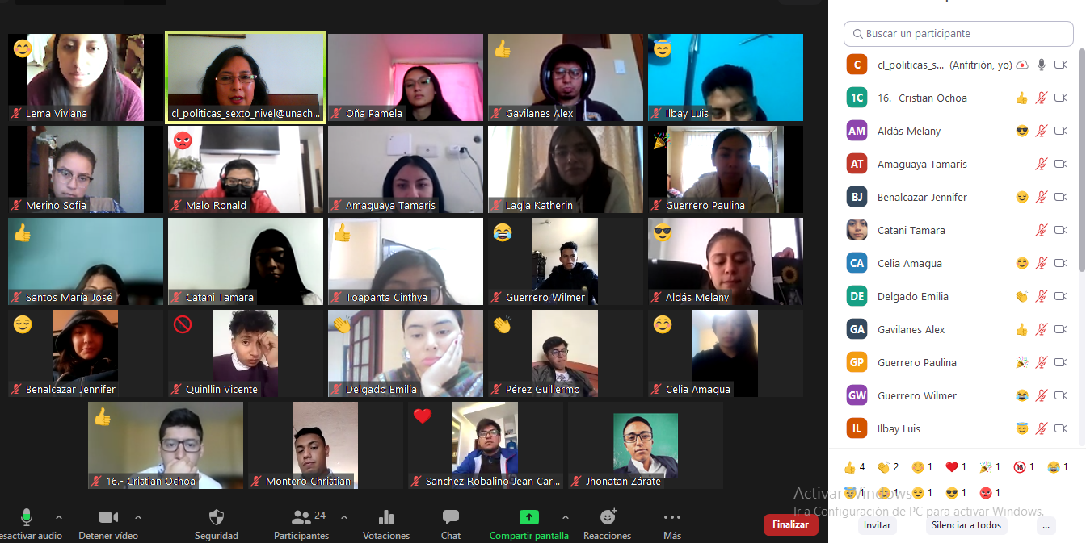

NEGATIVE SENTENCES
WEREN’T GOING TO + VERB
have zoom class avoid corruption

Slide 11
Examples to practice. Change these sentences into Negative sentences.
Daniela was going to work, but she didn’t.
We were going to travel to Guayaquil, but we didn’t.
David was going to play football, but he didn’t.
The professors were going to take a diagnostic test, but they didn’t.
You were going to be at the party, but you didn’t
Use Negative forms

Slide 12
Questions WAS/WERE going to
I was going to study Law.
Was I going to study Law?
Yes, you were / No, you weren’t
When was I going to study Law?
When you were 18 years old.

Slide 13
Gaby was going to get married.
Was Gaby going to get married?
Yes, she was / No, she wasn’t
Where was Gaby going to get married?
She was going to get married in a church.

Slide 14
We were going to travel to Guayaquil.
Were we going to travel to Guayaquil?
Yes, we were / No, we weren’t
Why were we going to travel to Guayaquil?
Because it was our first plan.

Slide 15
WOULD + VERB intention
(ría)
Thought:
Peter thought he would get married in November.
Said:
My parents said Miguel would travel on Monday.
Believed:
Many people belived Pademia would not affect us.

Slide 16
Examples to practice
Use WOULD to express intention with these verbs.
Live in USA. - Work in an Enterprise - Get money
Manage the Enterprise - Prioritize the work - Bring solutions

