Slide 1

MODAL VERBS
Talking about health matters

Slide 2
MODAL VERBS
They don’t need an auxiliary for questions or short answers.
They don’t need the particle “to” for infinitive.
They don’t need to be added “s” or “es” for 3rd personal pronoun conjugation.
They need another verb to complete the idea.
SUBJECT + MODAL VERB + VERB + OBJECT
BRUNO CAN PLAY THE PIANO

Slide 3
MODAL VERBS
MODAL VERB | IDEA
CAN | Ability (be able to)
MAY | Permission (has/have permission to)
MIGHT | Possibility (it’s possible that)

Slide 4
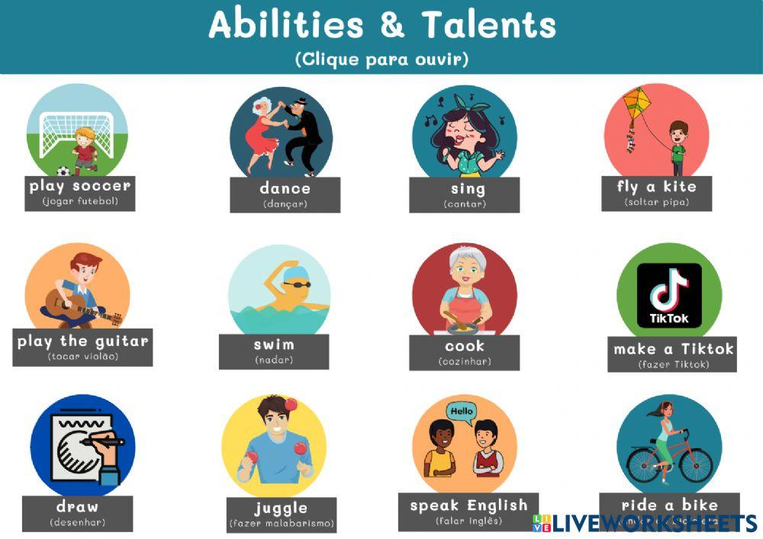
CAN – ABILITY (be able to)
Leo Messi is able to play soccer.
LEO MESSI CAN PLAY SOCCER VERY WELL.
Peter and his wife are able to dance salsa.
PETER AND HIS WIFE CAN DANCE SALSA.
I am able to sing very well.
I CAN SING VERY WELL.
My son is able to fly a kite.
MY SON CAN FLY A KITE.

Slide 6

CAN – ABILITY (be able to)
Examples to practice
BRUNO IS ABLE TO PLAY THE GUITAR.
BRUNO CAN PLAY THE GUITAR.
I AM ABLE TO SWIM FAST.
I CAN SWIM FAST.
MY MOTHER IS ABLE TO COOK ENCEBOLLADO.
MY MOTHER CAN COOK ENCEBOLLADO.
WE ARE ABLE TO MAKE A TIK TOK.
- WE CAN MAKE A TIK TOK.

Slide 7
MY PARENTS ARE ABLE TO DRAW A KITE.
MY PARENTS CAN DRAW A KITE.
MY SISTER IS ABLE TO JUGGLE WITH KNIVES.
MY SISTER CAN JUGGLE WITH KNIVES.
MY CAT IS ABLE TO SPEAK ENGLISH.
MY CAT CAN SPEAK ENGLISH.
MY NEPHEW IS ABLE TO RIDE A BIKE.
MY NEPHEW CAN RIDE A BIKE.

Slide 8
CAN not/ can’t – ABILITY (be able to)
Examples to practice
BRUNO CAN’T PLAY THE GUITAR.
I CAN NOT SWIM FAST.
MY MOTHER CAN’T COOK ENCEBOLLADO.
WE CAN’T MAKE A TIK TOK TOGETHER.
MY PARENTS CAN’T DRAW A KITE.
MY NEPHEW CAN’T RIDE A BIKE.
MY CAT CAN’T SPEAK ENGLISH.

Slide 9



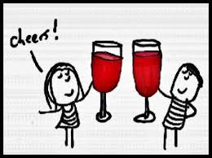
MAY – PERMISSION
(HAVE PERMISSION to)
Ricky has permission to eat candies.
Ricky may eat candies.
My children have permission to go to the park.
My children may go to the park.
I have permission to play video games.
I may play video games.
Julia and her husband have permission to drink a glass of wine.
Julia and her husband may drink a glass of wine.

Slide 10

MAY – PERMISSION
(HAVE PERMISSION to) Examples
Explain what students may do in class.
_____________________________________________________________________________
_____________________________________________________________________________
_____________________________________________________________________________
_____________________________________________________________________________
_____________________________________________________________________________

Slide 11
MAY not – PERMISSION
(HAVE PERMISSION to) Examples
Explain what students may not do in class.
We may not eat in the classroom.
We may not smoke in the classroom.
The students may not arrive late to classes.
The students may not use cellphones in class.
The students may not copy during the tests.

Slide 12


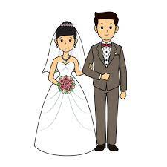

Might – Possibility
(it’s possible that)
It’s posible that i travel by plane.
I might travel by plane.
It’s posible that Vecky Works in an office.
Vecky might work in an office.
It’s posible that Jenny and javier get married.
Jenny and Javier might get married.
It’s posible that you live in new york.
You might live in new york.

Slide 13
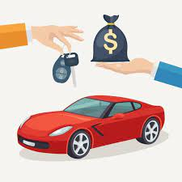
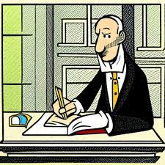

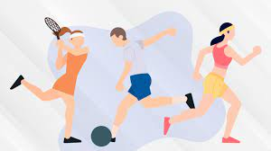
Might – Possibility
(it’s possible that)
_______________________________________
_______________________________________
_______________________________________
_______________________________________

Slide 14
Might NOT – Possibility
I might not buy a car by now.
My boyfriend might not write a poem.
Pablo might not feel better. He is crying.
You might not do excersise at the university.

Slide 15
MODAL VERBS
MODAL VERB | IDEA
SHOULD | Suggestion
MUST | Conclusion

Slide 16

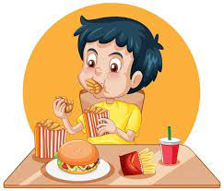
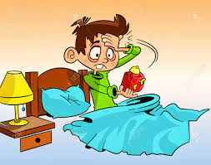
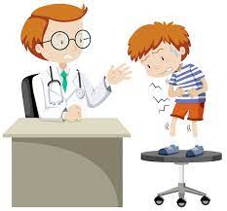
SHOULD – SUGGESTION
Check the situations to build up a suggestion
Charles got a bad grade.
________________________________________
My brother just eats fast food.
________________________________________
I got up late.
________________________________________
You have pain in your stomach.
________________________________________

Slide 17
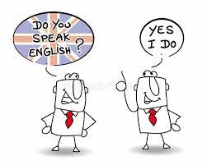
SHOULD – SUGGESTION
Examples to practice
Write suggestions to pass english.
_______________________________________________________
_______________________________________________________
_______________________________________________________
_______________________________________________________

Slide 18
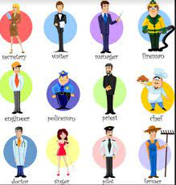
SHOULD NOT – SUGGESTION
Examples to practice
Write SUGGESTIONS FOR AN excellent professional.
_______________________________________________________
_______________________________________________________
_______________________________________________________
_______________________________________________________

Slide 19
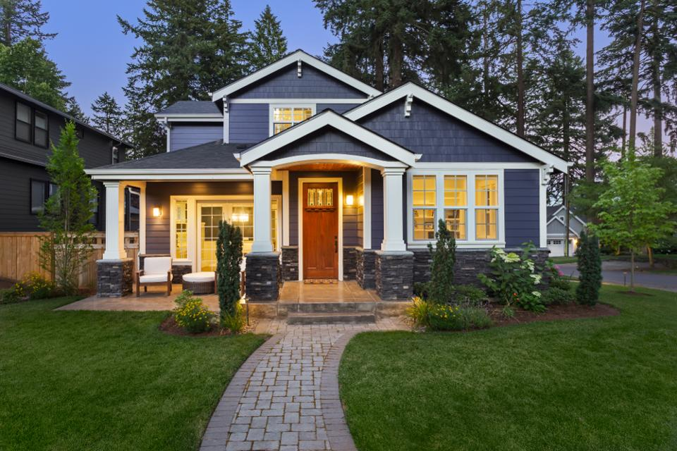
Must = conclusion
Situation: The lights in the house are on.
Conclusion: Somebody must be in the house. (Affirmative)

Slide 20
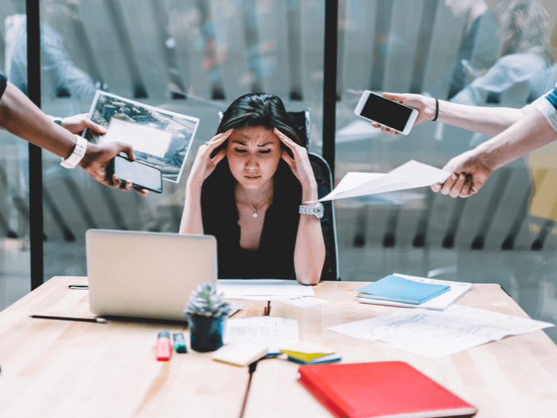
Situation: Sandra has a problem in her job.
Conclusion: She must not feel o.k. (negative)

Slide 21
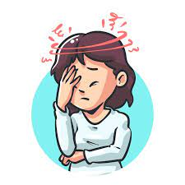
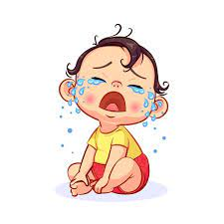
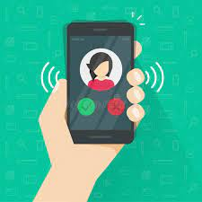
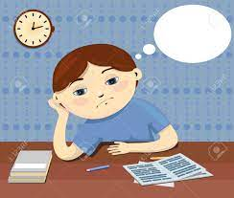
Extra examples: MUST/MUST NOT
My mom has a terrible headache.
Her baby cries a lot.
Peter doesn’t answer his cellphone.
- The students do not do the homework.

Slide 22
MODAL VERBS
MODAL VERB | IDEA
WILL | Future
COULD | Possibility / Past of CAN
WOULD | Past of WILL / Conditional

Slide 23
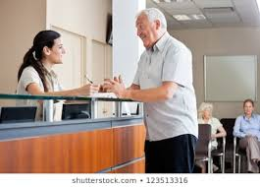
WILL = future possibility
TOMORROW, NEXT, THIS (day/month/year)
The doctor will see you tomorrow. (Affirmative)

Slide 24
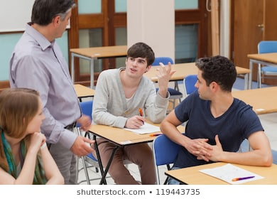
Karla won’t come to class this week. (Negative)

Slide 25


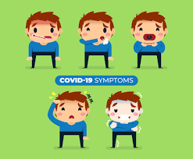
Extra examples: Will/WILL NOT (WON’T)
travel to europe.
(not) Buy medications.
be a good doctor.
(not) stop symptoms.

Slide 26
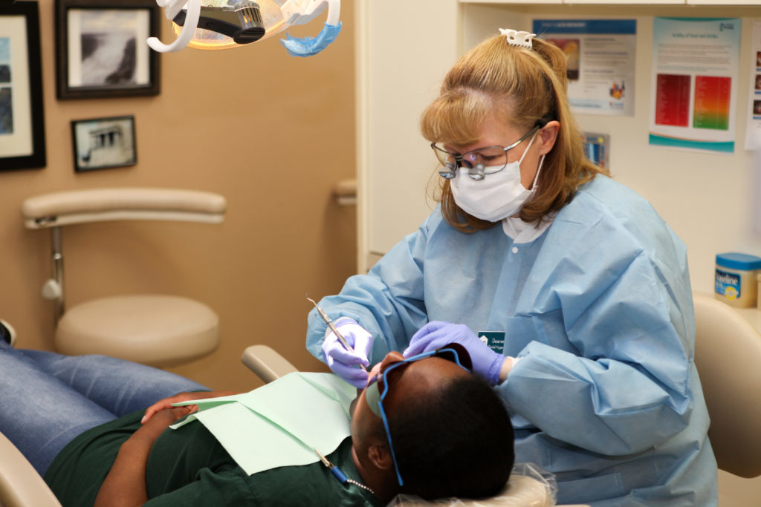
COULD = possibility/PAST OF “CAN”
Could not/ couldn’t
The dentist COULD HELP ME LAST SUNDAY.
I could not stand the pain.

Slide 27




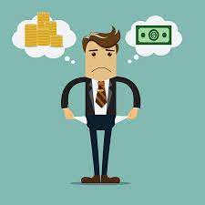
EXAMPLES TO PRACTICE
COMPLETE THESE IDEAS, USE COULD/COULDN’T
Because i was sick.
I couldn’t go to the party because i was sick.
Because english is necessary.
Because Peter worked yesterday.
Because Janeth lives in usa.
Because we don’t have enough money.

Slide 28



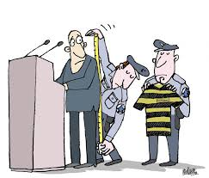
WOULD = UNREAL CONDITIONAL (desires)
WOULD/ WOULD NOT (WOULDN’T)
IF I WERE A PRESIDENT, I WOULD HELP POOR PEOPLE.
If a patient got covid, …
If there were more money in ecuador,
If politicians worked honestly,

Slide 29
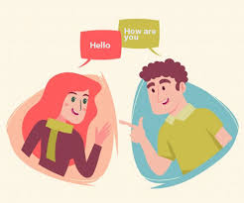



WOULD LIKE= desires
WOULD/ WOULD NOT LIKE (WOULDN’T)
I would like to speak english.
Karen would not LIKE to work far from home.
We would like to get 10 over 10 in english.
ecuadorians would like to live in a peaceful country.

