Slide 1
CAUSATIVES AND PASSIVE CAUSATIVES
UNIT 3: GETTING THINGS DONE

Slide 2

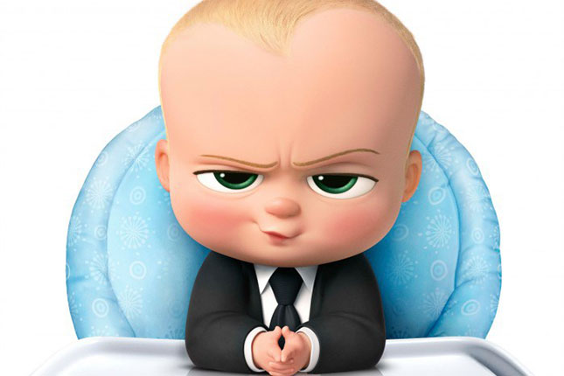
CAUSATIVE SENTENCES
Make someone else to do something.
GET vs. HAVE

Slide 3

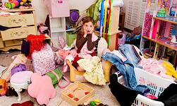
GET /GETS / GOT/ WILL GET / HAS -HAVE GOTTEN
My mom gets me to clean up my room.
a person verb

Slide 4
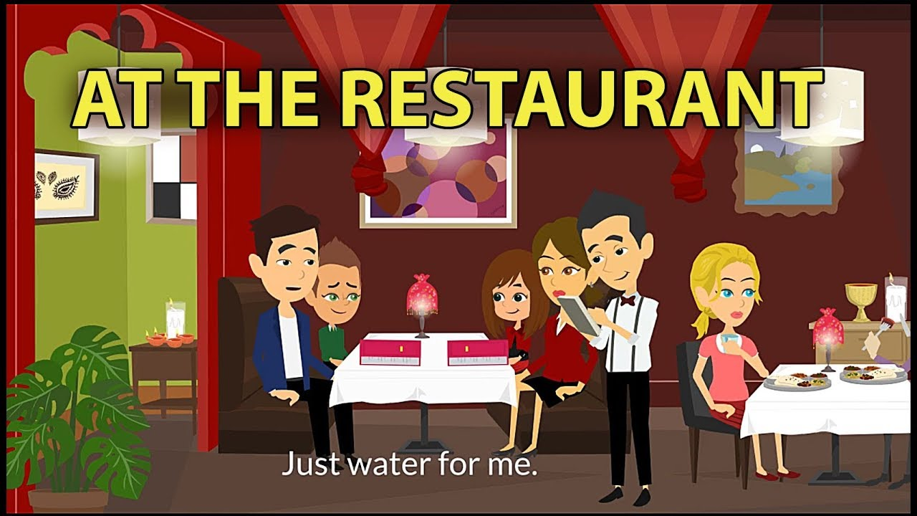
- I will get the waiter to bring the menú.
a person verb

Slide 5

Jeffry got the assistant to go to the post office.
a person verb

Slide 6
Examples to practice. Complete these sentences by using GET and its tenses.
1. (write) Why don’t you your assistant the report.
2. (buy) My mom my father the house last month.
3. (wash) Rose her husband the dishes tomorrow.
4. (give) His son Paul the Project already.
5. (read) The professor the students that book.

Slide 7
HAVE /HAS / HAD/ WILL HAVE / HAS -HAVE HAD
My mom gets me to clean up my room.
My mom has me clean up my room.
-

Slide 8
- I will get the waiter to bring the menú.
- I will have the waiter bring the menú.

Slide 9
Jeffry got the assistant to go to the post office.
Jeffry had the assistant go to the post office.

Slide 10
Examples to practice. Change these sentences from GET to HAVE and its tenses.

Slide 11

PASSIVE CAUSATIVES
An object that recieves an acción made by someone else.
HAVE – OBJECT(thing) – PAST PARTICIPLE
- We had our picture taken after dinner.

Slide 12
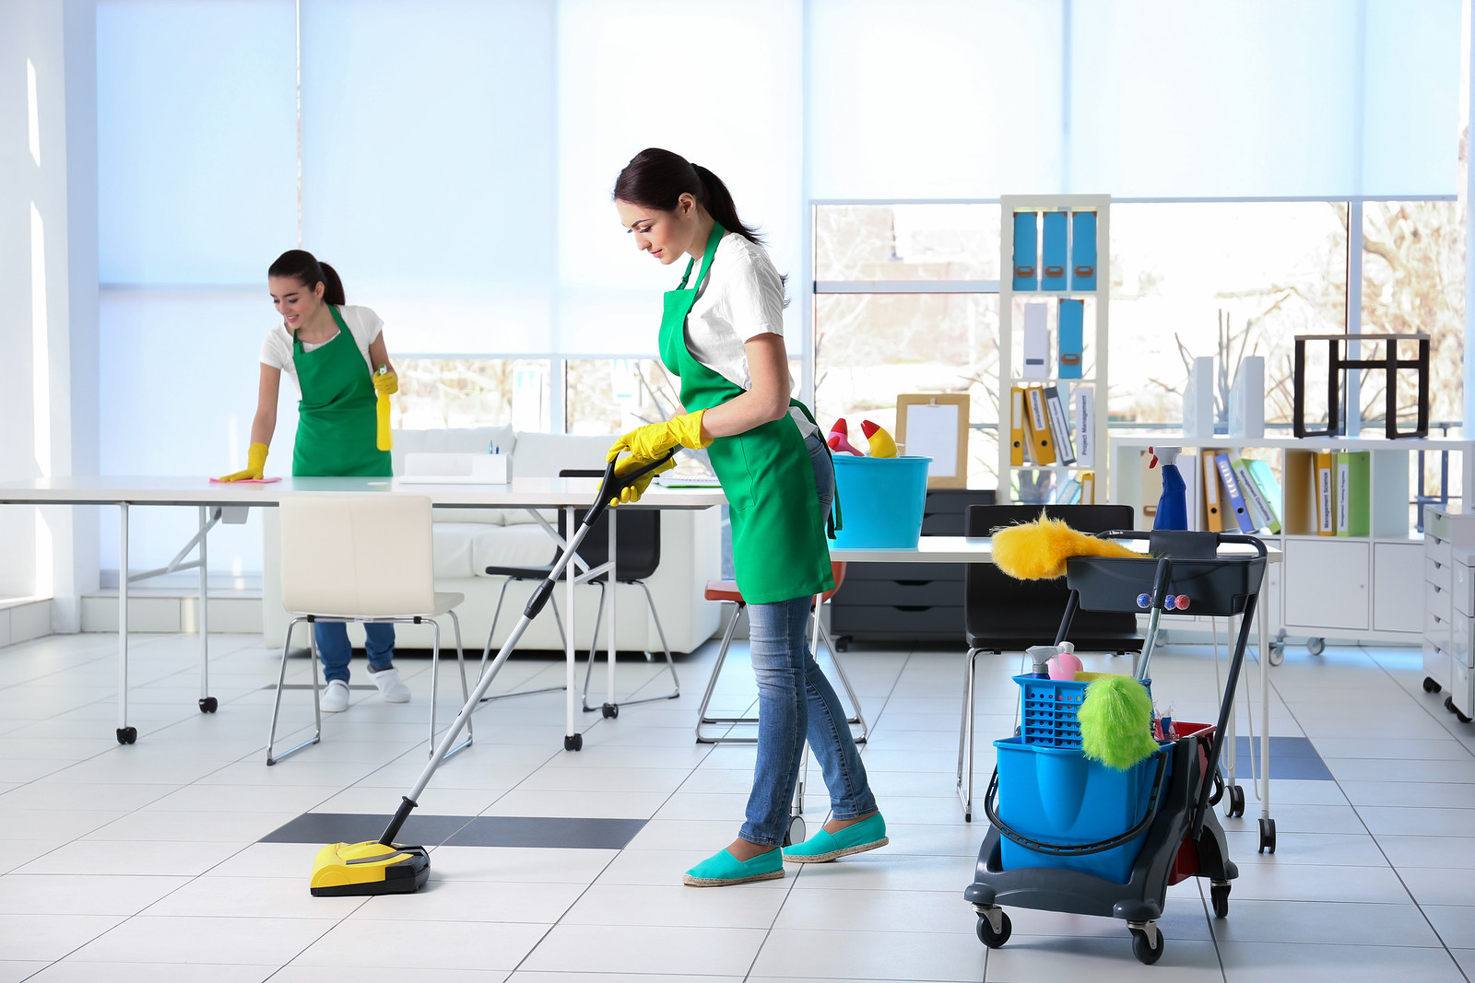
HAVE – OBJECT(thing) – PAST PARTICIPLE
-The boss has the offices cleaned up everyday.

Slide 13
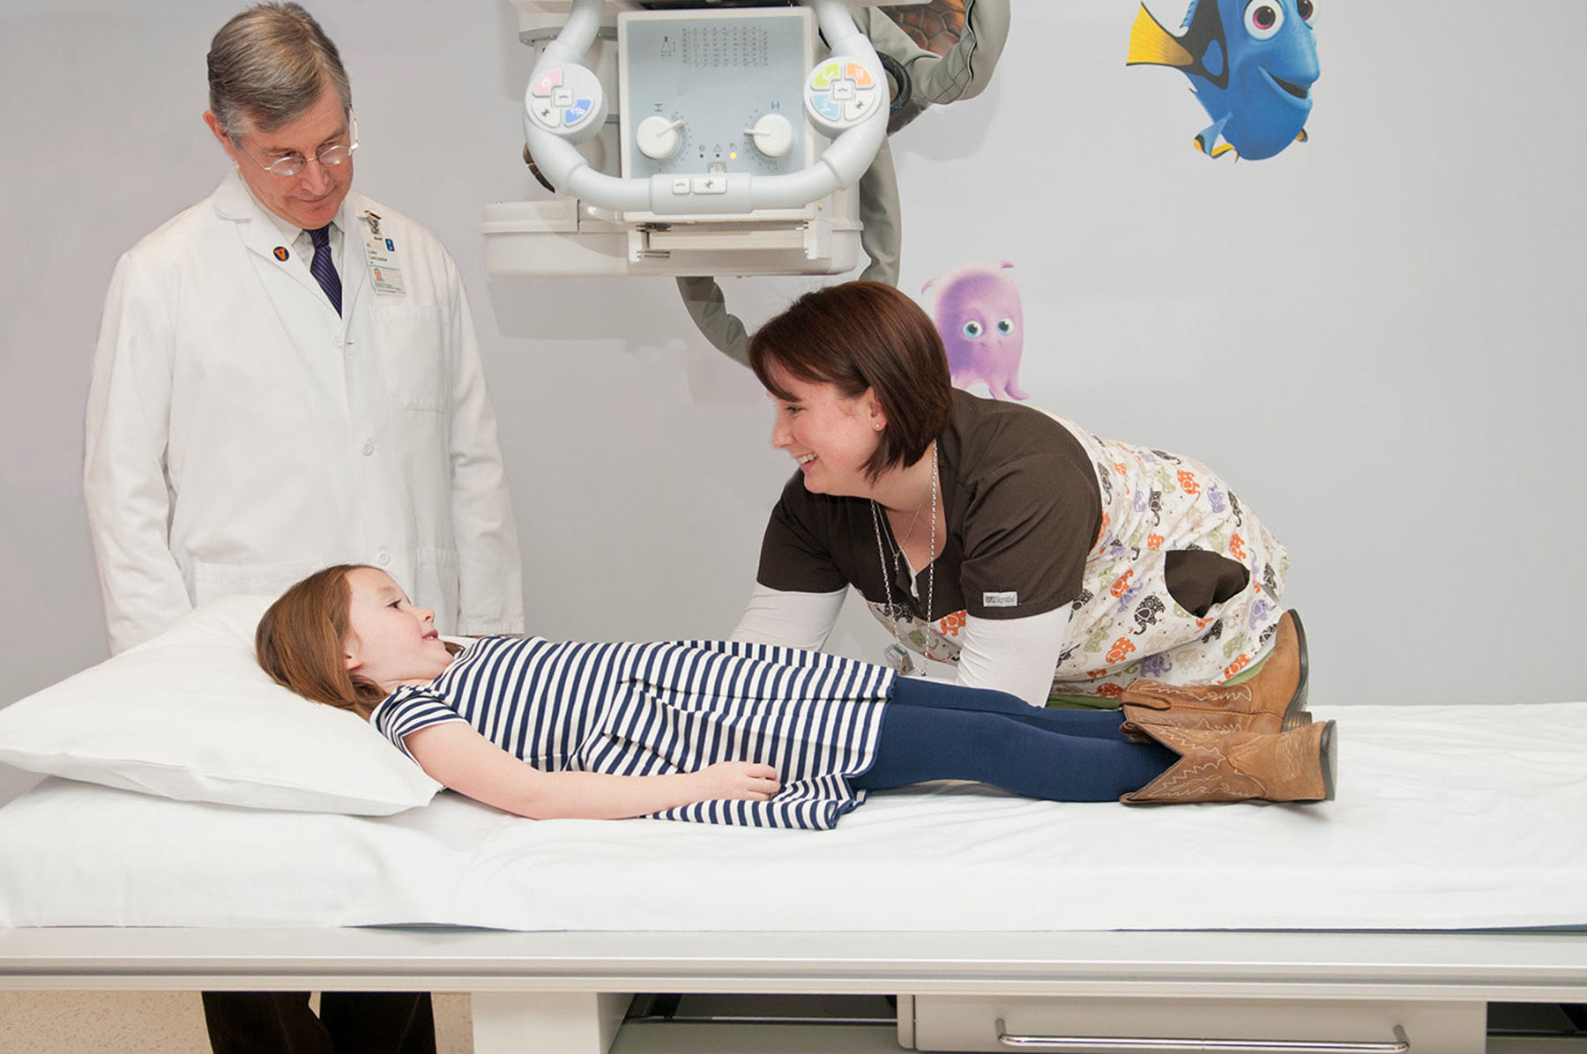
HAVE – OBJECT(thing) – PAST PARTICIPLE
Dr. Smith can have the x-ray sent this morning.

Slide 14
Examples to practice. Write statements and questions, using the Passive Causative with HAVE.
1. Could I/ these two letters/ send?
_________________________________________
2. where can I/ my car/ wash?
_________________________________________
3. Laura/ her house/ clean/ tomorrow.
_________________________________________
4. Charles/ his book/ bring/ yesterday.
_________________________________________
5. We / these letters / write/ already.

