Slide 1
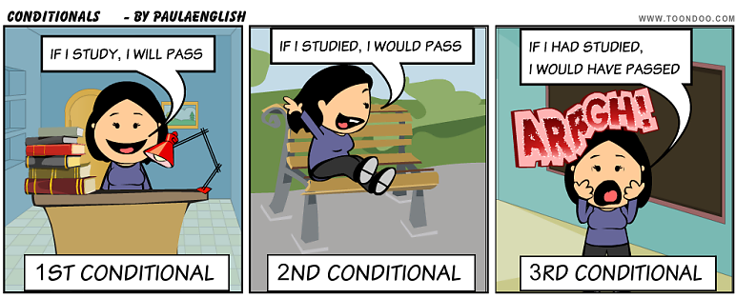
THE UNREAL CONDITIONAL

Slide 2
Unreal Conditionals
Conditional sentences have two parts – a condition and a result. Unreal conditionals are similar to real conditionals, but with unreal conditionals, the condition is not true and not real. Or it is very unlikely to happen or be true. We are just imagining what we would do in a situation that is not real or very unlikely to be real.
This conditional is used to talk about events that are unlikely to happen in the future.
If this shirt were on sale, I would buy it. (Really, the shirt is not on sale and I will not buy it.)
If I were an animal, I would be a lion. (Really, I am not an animal.)

Slide 3
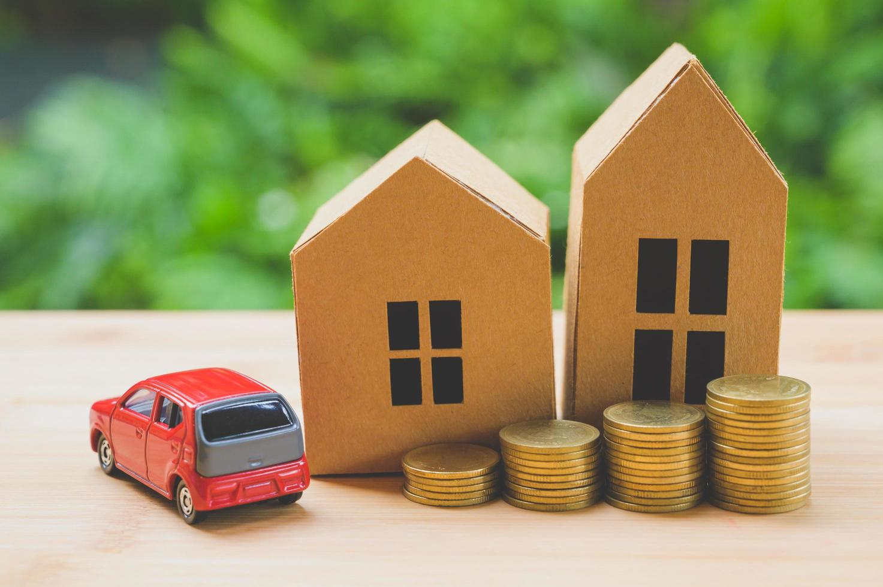
Here are some examples of when we might use an unreal conditional for a highly unlikely thing.
If I won the lottery, I would buy a house and a car. (The probability of winning the lottery is so low that we use the unreal conditional.)
If I met the President, I would want to tell him to lower taxes. (The chances of me meeting the President are very low.)

Slide 4
STRUCTURE
If + subject + past simple, subject+ would + verb base form
CLAUSE RESULT
[If / ... Simple Past ..., ... Would + verb in a base form ...]
RESULT CLAUSE
[.. ... Would + verb in a base form ... if /... Simple Past ...]
EXAMPLE:
If I ate less, I would lose weight.
I would lose weight if I ate less.

Slide 5
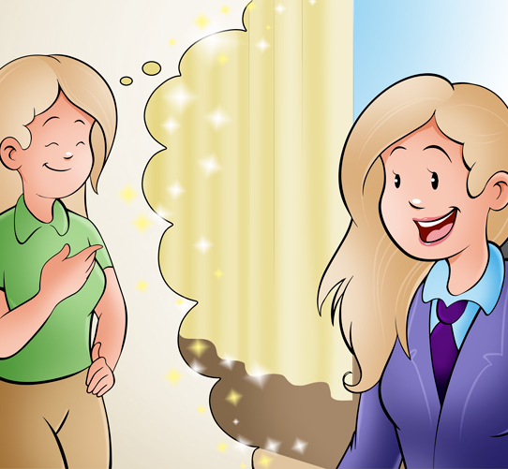
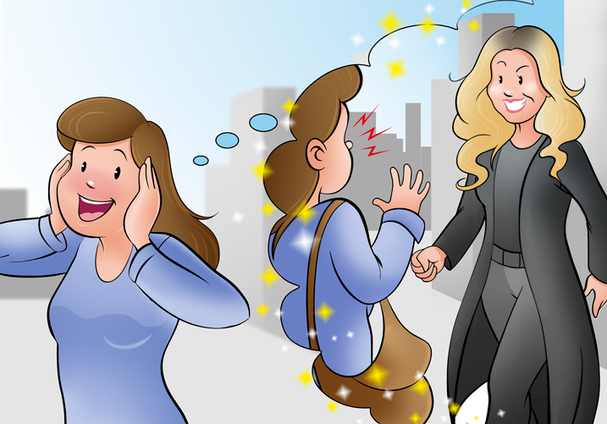
1.- For situations in which the speaker considers that they are unlikely to happen in the future.
If I became President, I would change many things.
If I saw Madonna, I would scream.

Slide 6
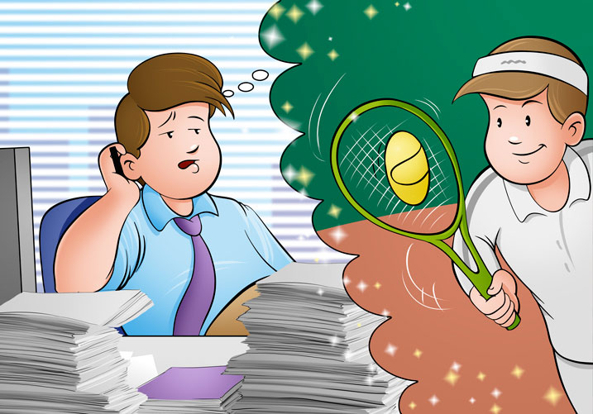
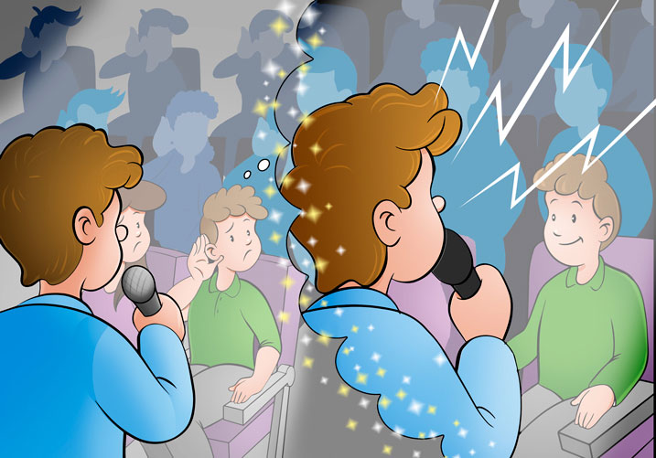
2.-For situations that are not true at the present time..
If I had more time, I would take up a sport.
If you spoke up, I'd hear you.

Slide 7
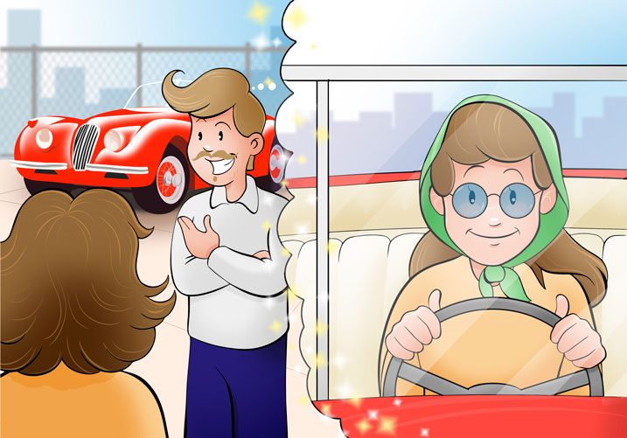
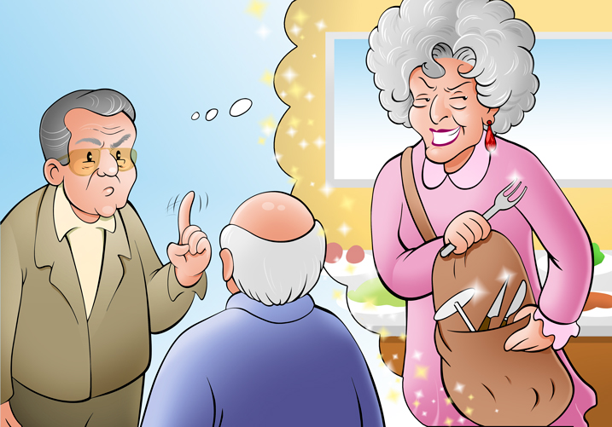
3.-To give advice to someone using the expression If I were you (Si yo fuese tu).
If I were you, I'd say yes.
If I were you, I wouldn't invite her.

