Slide 1
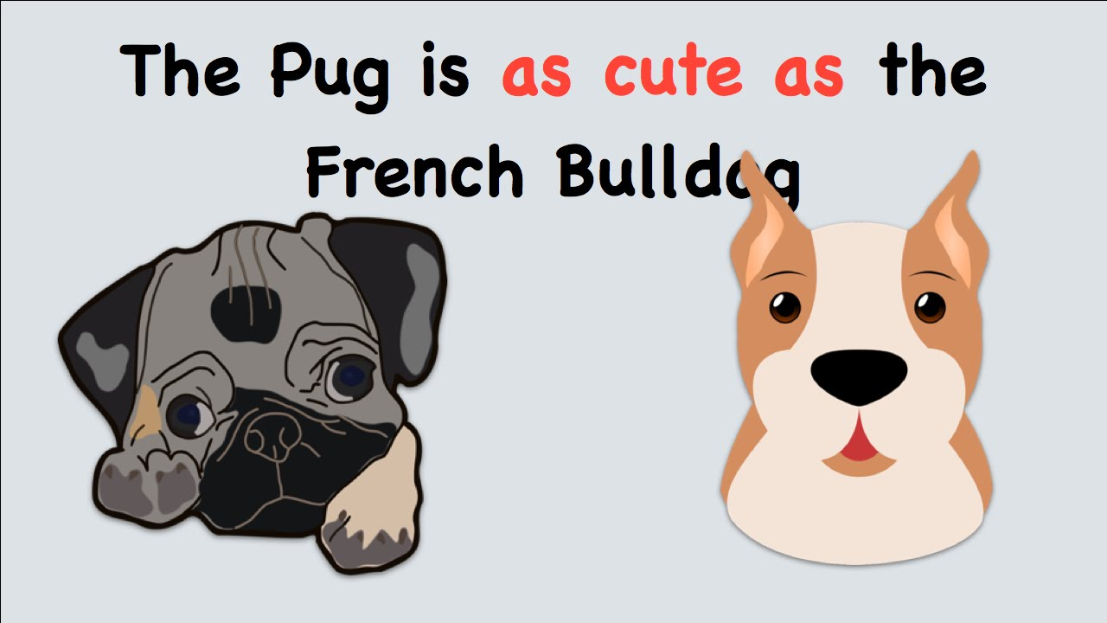
COMPARISONS WITH AS………AS

Slide 2
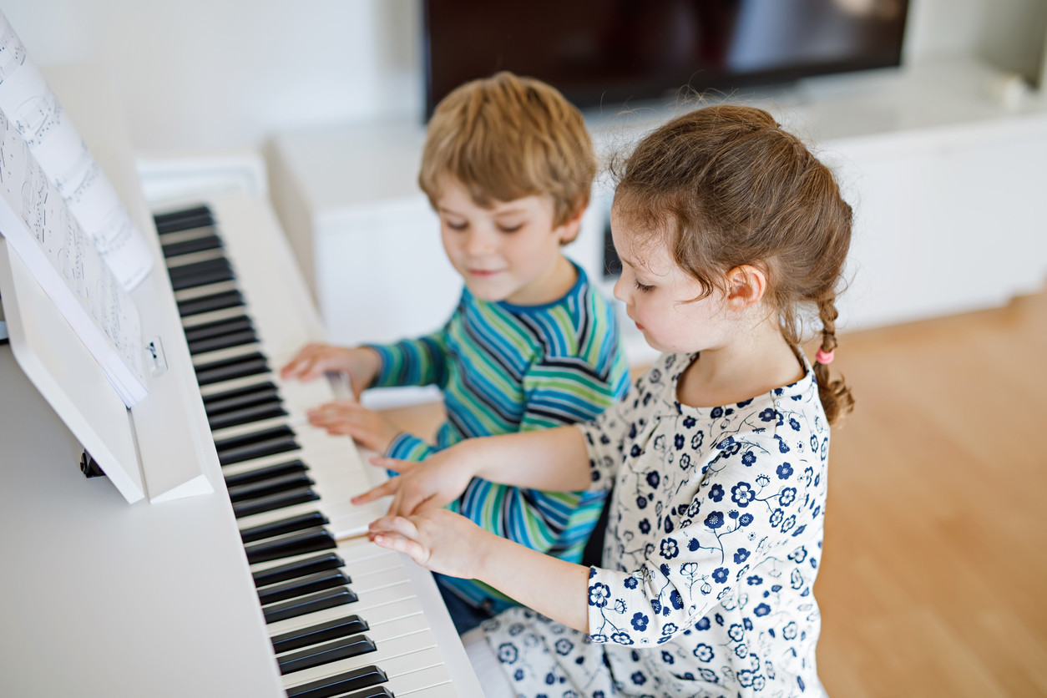

We use AS + ADJECTIVE + AS to make comparisons the things we are comparing are equal in some way:
My brother and I both play the piano but I don’t play as well as he does.
The weather this summer is as bad as last year. It hasn’t stopped raining for weeks.
You have to unwrap it as carefully as you can. It’s quite fragile.
My restaurant is as good as yours.
I can sing as well as you can.

Slide 3
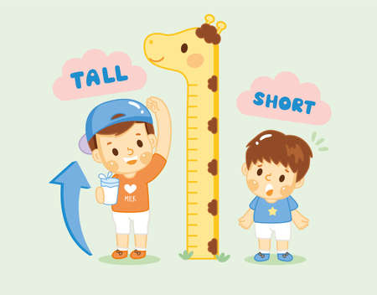

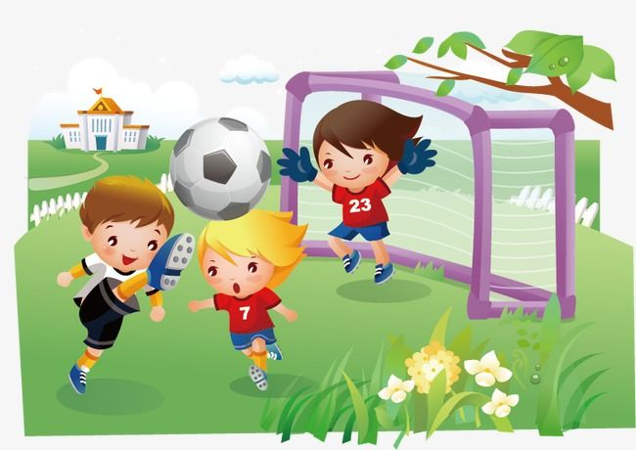
Not as … as
We use not as … as to make comparisons between things that aren’t equal:
It’s not as heavy as I thought it would be.
Rory hasn’t grown as tall as Tommy.
She’s not singing as nice as she can.
They didn’t play as well as they usually do.

Slide 4

WITH ALMOST AS……AS
WE USE THE ADVERB ALMOST IN AFFIRMATIVE STATEMENTS TO INDICATE THAT TWO THINGS ARE VERY SIMILAR BUT NOT EXACTLY THE SAME:
We can use "almost" with "as...as" to show that two things are almost the same, but not exactly the same. Write almost after the "be verb".
My TV LG is almost as good as your TV SONY.
She is almost as tall as I am.
The blue shirt is almost as expensive as the red shirt.

