Slide 1
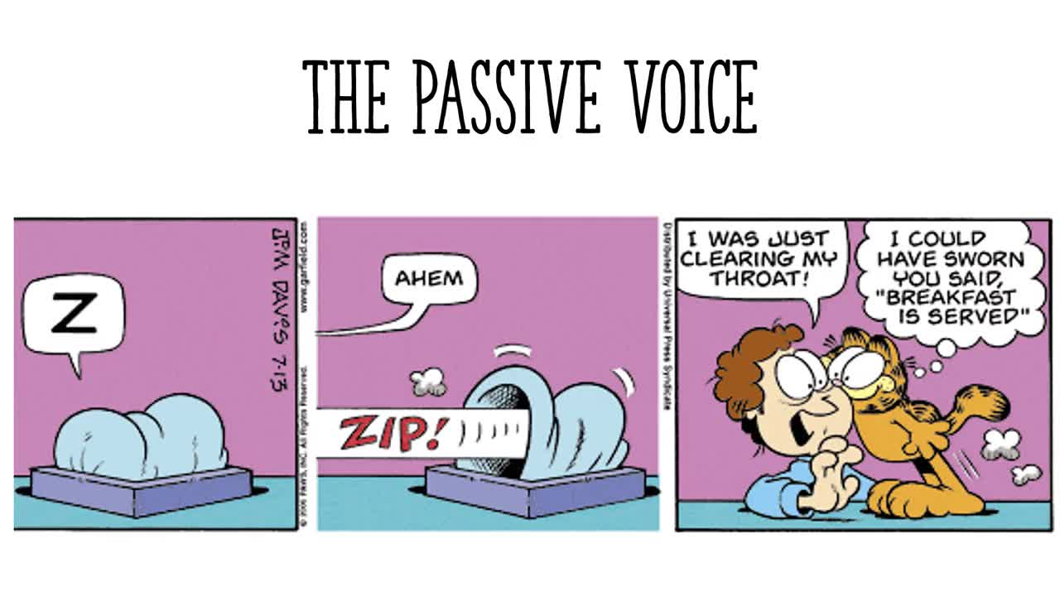
Passive Voice

Slide 2
What is the passive voice?
In general we tend to use the active voice.
That is when a Subject does an verb action + object.
Somebody stole my laptop.
(subject = Somebody /action(verb) = stole / object = my laptop)
The passive voice is used when we want to emphasize the action (the verb) and the object of a sentence, rather than subject.
ACTIVE VOICE= Someone stole my laptop.
PASSIVE VOICE= My laptop was stolen.
(The object – now the subject = My laptop / action= was stolen)

Slide 3
Active: The Beatles wrote "A Hard Day's Night".
Passive: "A Hard Day's Night" was written by the Beatles.
Active: Spielberg directed the movie ET.
Passive:The movie ET was directed by Spielberg.

Slide 4
Forming the passive voice
The passive voice is not a tense in English.
Each tense has its own passive voice denpend of the verb tense in the active voice which is created by using a form of the VERB BE + Verb in (past participle).
The Grand Canyon is visited by thousands of tourists every year.
Active: The Beatles wrote "A Hard Day's Night".
Passive: "A Hard Day's Night" was written by the Beatles.
Active: Spielberg directed the movie ET.
Passive:The movie ET was directed by Spielberg.

Slide 5
The passive agent
When we know who the subject is, we put it at the end with by.
We call this an agent.
Active: Leonardo Da Vinci painted the Mona Lisa.
Passive: The Mona Lisa was painted by Leonardo Da Vinci.
(agent =Leonardo Da Vinci )

Slide 6
Tense | Auxiliary verb + sample V3 (past participle) | Examples
Present simple | am, is, are + made | Wine is made from grapes. Many cars are made in Japan.
Present progressive | am, is, are + being + sent | The document is being sent right now. I am being sent to work in the London office.
Past simple | was, were + invited | John was invited to speak at the conference. We were invited to Daniel and Mary’s wedding.
Past progressive | was, were + being + washed | Their cars were being washed while they were in the mall shopping.

Slide 7
Future (will) | will be + signed | The contract will be signed tomorrow. The documents will all be signed by next week.
Future (going to) | am, is, are + going to be + built | A bridge is going to be built within the next two years. New houses are going to be built in our neighborhood.
Present perfect | has, have + been + sold | That start-up has been sold for $5 million. The rights to his book have been sold for $250,000.
Past perfect | had + been + hired | The new manager had been hired before John left the company. All the employees had hired before the store opened.

