Slide 1
Gerunds and Infinitives

Slide 2
1. A gerund is a noun made from a verb by adding "-ing." The gerund form of the verb "read" is "reading." You can use a gerund as the subject, the complement, or the object of a sentence.
Examples:
Reading helps you learn English. subject of sentence
Her favorite hobby is reading. complement of sentence
I enjoy reading. object of sentence
.

Slide 3
2. Infinitive is form "to“ plus the verb. Example "learn" - "to learn." You can also use an infinitive as the subject, the complement, or the object
Examples:
To learn is important. subject of sentence
The most important thing is to learn. complement of sentence
He wants to learn. object of sentence

Slide 4
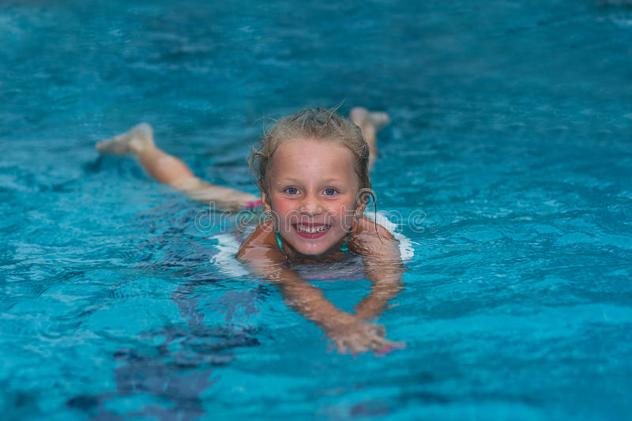
Usually, the main verb in the sentence determines if you use a gerund or an infinitive.
Examples:
He enjoys swimming. "Enjoy" requires a gerund.
He wants to swim. "Want" requires an infinitive.

Slide 5
5. Some verbs are followed by gerunds.
Examples:
Swimming is good exercise.(Nadar es un buen ejercicio)
Drinking and driving is dangerous.(Beber y conducir es peligroso.)
6. Some verbs are followed by infinitives.
Examples:
She wants to go to a mall.
Mary needs to talk about her problems.

Slide 6
Objeto:
I like cooking. / I like to cook.
She continued working. / She continued to work.
Sujeto:
Swimming is good exercise.
Drinking and driving is dangerous.
To travel around the world requires a lot of time and money.
Complemento:
The best thing to do when you are sick is to drink a lot of water.
My favorite exercise is swimming.
Daniel quit smoking a year ago.

