Slide 1
NEGATIVE YES-NO QUESTIONS

Slide 2
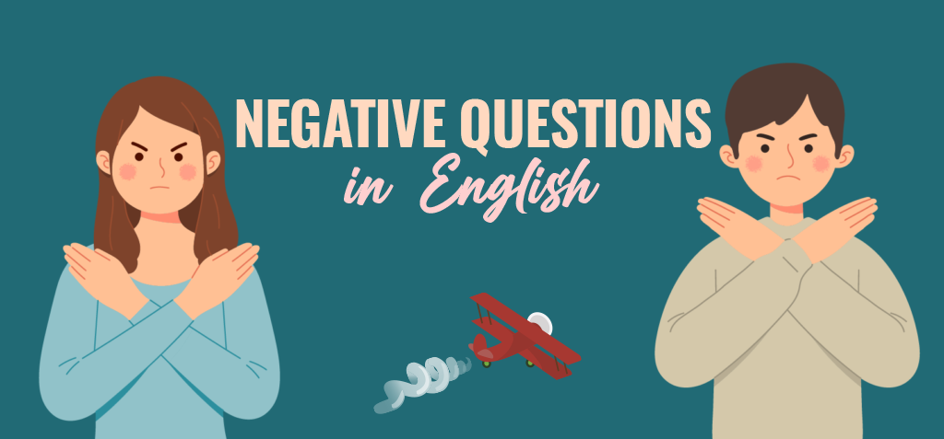
When are negative and interrogative questions used at the same time?
We use negative questions to show surprise and when we expect the listener to agree with us.

Slide 3
We use Negative Questions in English in the same cases as general questions.
Almost everything we can ask with a general question we can ask using a negative one.
General question: Are you going to work? Negative question: Aren’t you going to work?
General question: Did John buy a car? Negative question: Didn’t John buy a car?

Slide 4
STRUCTURE:
Contracted negative auxiliary + subject +verb+complements +?
Didn’t you do your homework? ¿No hiciste tu tarea/tus deberes?
Aren’t you taking the job? ¿No vas a aceptar el trabajo?
Won’t you not buy a car? ¿No comprarás un auto/coche?
Don’t you want to visit your aunt? ¿No quieres visitar a tu tía?
Won’t they travel to Spain next month? ¿No viajarán a España el próximo año?

Slide 5
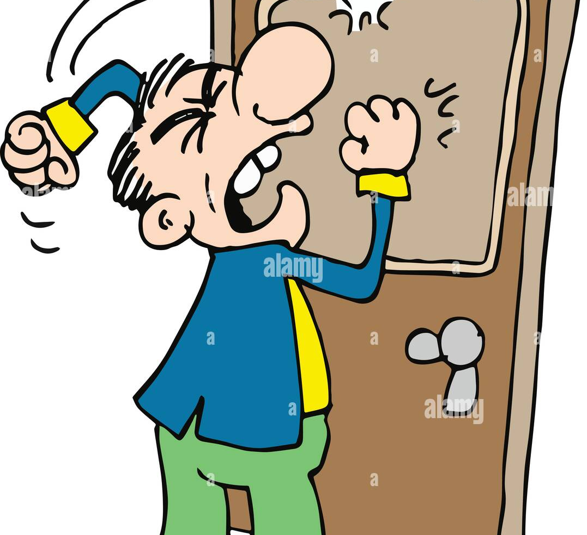
1. TO SHOW SURPRISE (Para demostrar sorpresa)
Didn't you hear the bell? I rang it four times.
(¿No escuchaste el timbre? Toqué tres veces.)
2. IN EXCLAMATIONS (En exclamaciones)
Doesn't that house look beautiful?
(No sé ve hermosa esa casa?)
3. WHEN WE EXPECT THE LISTENER TO AGREE WITH US
"Haven't we met somewhere before?" "Yes, I think we have."
("¿No nos hemos visto antes en alguna parte?" "Sí, creo que sí.")

Slide 6
YES AND NO IN ANSWERS TO NEGATIVE QUESTIONS:
Didn't Roberto pass his exams?
Yes. (= Yes, he passed them.)
No. (= No, he didn't pass them.)
Isn’t Erika on diet?
Yes. (= Yes, she is on diet.)
No. (= No, she isn’t on diet.)

Slide 7
NEGATIVE QUESTIONS WITH WHY...?:
Why didn't you lock the door?
(¿Por qué no cerraste la puerta con llave?)
Why don't we go out to Harley's restaurant?
(¿Por qué no vamos a cenar al restaurante Harley's)
Why can't you help me?
(¿Por qué no me puedes ayudar?)
Why wasn't Claudia invited to the party?
(¿Por qué no invitaron a Claudia?)

