Slide 1
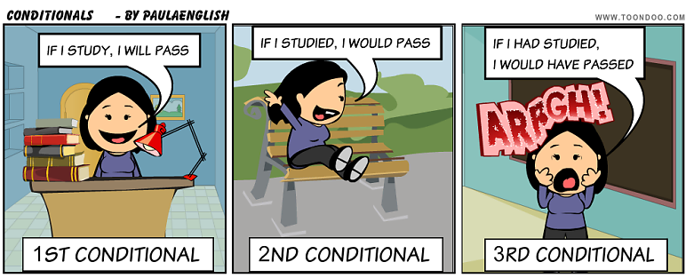
Future
Real Conditional

Slide 2
CONDITIONAL If = SI
USE
The Future Real Conditional describes what you think you will do in a specific situation in the future. Although this form is called "real", you are usually imagining or guessing about the future. Too it is called "real" because it is possible that the action might occur in the future.
Examples:
Conditional RESULT
If I go to my friend's house for dinner tonight, I will take a bottle of wine or a dessert.
            RESULT Conditional
Jerry will help me with my homework if he has time.

Slide 3
FORM IF = SI
Conditional RESULT
[If / When ... Simple Present ..., ... Simple Future ...]
RESULT Conditional
[... Simple Future ... if / when ... Simple Present ...]
EXAMPLE:
CONDITIONAL RESULT
If the weather is nice, she will walk to work.
She will walk to work If the weather is nice

Slide 4

QUESTIONS
In questions we have to do the questions in the result
Example:
If we have a day off from work, we will go to the beach.
we will go to the beach If we have a day off from work.
Will we go to the beach If we have a day off from work?
Yes, we will
No, we won’t
Where will we go if we have a day off from work?
To the beach
BE CAREFUL
Never use will in the if conditional
If you will hurry, you will catch the bus. Incorrect

