Slide 1
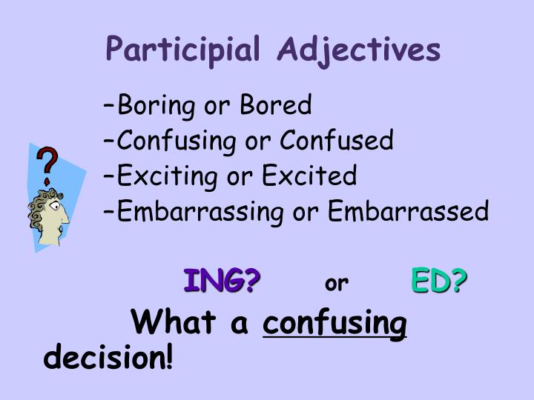
Participial Adjectives
ED: BORED, FASCINATED, INTERESTED
ING: BORING, FASCINATING, INTERESTING

Slide 2
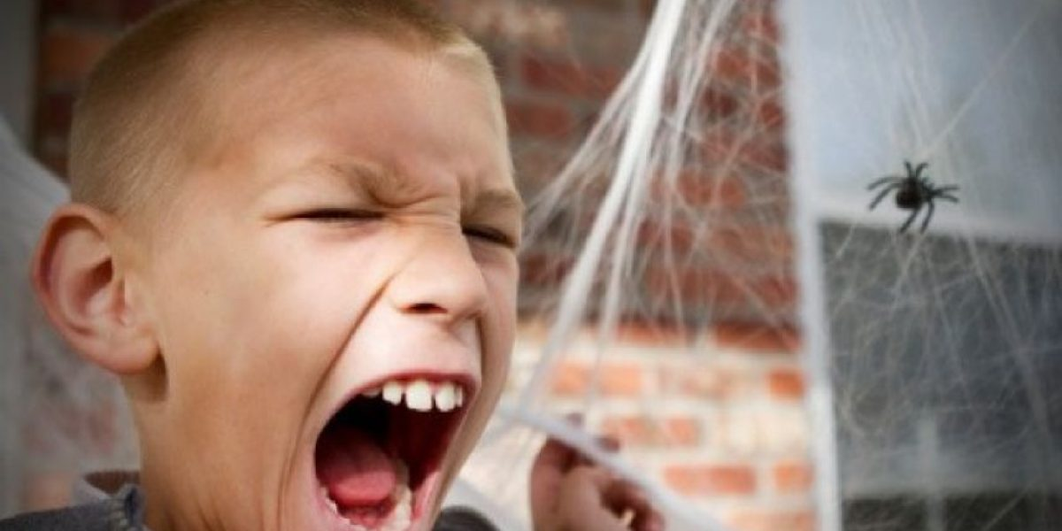
Some participials adjectives (like 'bored' or 'boring') can be used as adjectives. These are used in a slightly different way from normal adjectives.
We usually use participial adjective with (ending in -ED) to talk about how someone feels or emotions :
Examples
I was really bored during the flight.
She's interested in history.
John's frightened of spiders.
Some participles (like 'bored' or 'boring') can be used as adjectives. These are used in a slightly different way from normal adjectives. We usually use the past participle (ending in -ed) to talk about how someone feels:
Examples
I was really bored during the flight (NOT: I was really boring during the flight).
She's interested in history (NOT: She's really interesting in history).
John's frightened of spiders (NOT: John's frightening of spiders).

Slide 3

We usually use the participial adjective with (ending in -ing) to talk about the characteristic of a person, thing, or situation which has caused the feeling:
EXAMPLE:
It was such a long, boring flight (so I was bored)
I read a really interesting book about history (so I was interested).
Many people find spiders frightening (so they're frightened when they see spiders).

Slide 4
