Slide 1
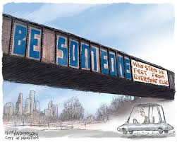
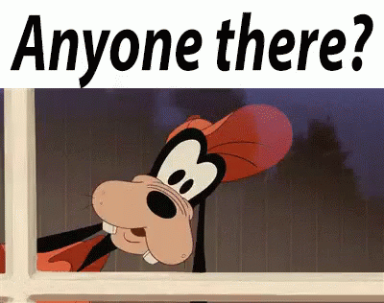
SOMEONE-NO ONE-ANYONE

Slide 2
INDEFINITE PRONOUNS
SOMEONE, NO ONE, ANYONE: Are indefinite pronouns. Each refers to a nunnamed person.
Use indefinite pronouns when the identity of the person is unknow or unimportant.
SOMEONE= ALGUNO, ALGUNA / PERSONAS AFFIRMATIVE SENTENCES
NO ONE= NINGUNO, NINGUNA, NADIE / PERSONAS AFFIRMATIVE SENTENCES
ANYONE= NINGUNO, NINGUNA /PERSONAS NEGATIVE SENTENCES

Slide 3
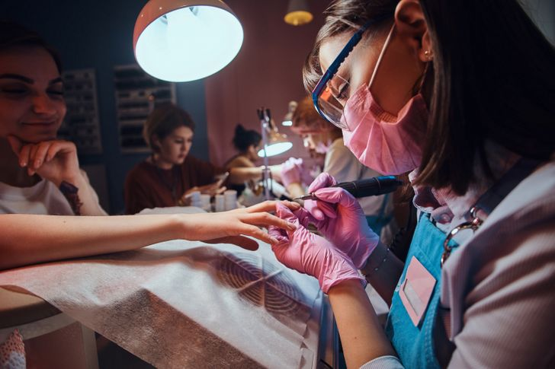
AFFIRMATIVE SENTENCES SOMEONE NO ONE
SOMEONE IS AVAILABLE ALGUIEN ESTA DISPONIBLE
NO ONE IS AVAILABLE NADIE ESTA DISPONIBLE
SOMEONE IS WAITING FOR THE MANICURIST ALGUIEN ESTA ESPERANDO POR EL MANICURISTA
NO ONE IS WAITING FOR THE MANICURIST NADIE ESTA ESPERANDO POR EL MANICURISTA
Someone is sleeping in my bed. ALGUIEN ESTA DURMIENDO EN MI CAMA
No one is sleeping in my bed. NADIE ESTA DURMIENDO EN MI CAMA

Slide 4
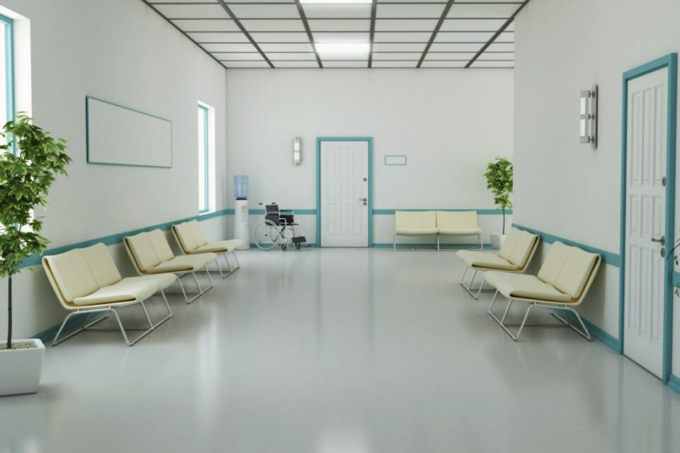
NEGATIVE SENTENCES ANYONE
THERE ISN¨T ANYONE WAITING NO HAY NADIE ESPERANDO
I DIDN¨T SEE ANYONE AT THE SALON NO VI A NADIE EN EL SALON
THERE ISN’T ANYONE AT THE DOOR. NO HAY NADIE EN LA PUERTA
SHE WILL NOT BRING ANYONE WITH HER ELLA NO TRAERA A NADIE CON ELLA

Slide 5
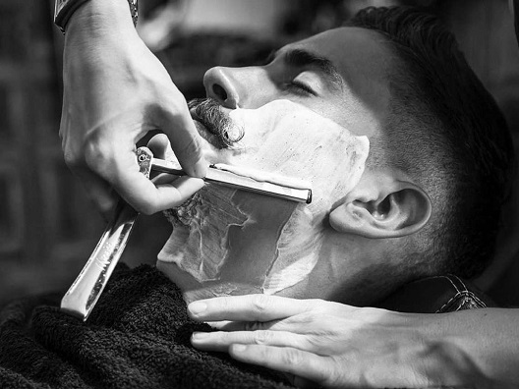
QUESTIONS? SOMEONE/ANYONE
CAN ANYONE WASH MY HAIR? PUEDE ALGUIEN LAVARME MI CABELLO?
CAN SOMEONE WASH MY HAIR? PUEDE ALGUIEN LAVARME MI CABELLO?
IS THERE ANYONE AT THE DESK? HAY ALGUIEN EN EL ESCRITORIO?
IS THERE SOMEONE AT THE DESK? HAY ALGUIEN EN EL ESCRITORIO?
DID YOU SEE ANYONE WAITING FOR THE SHAVE? VISTE A ALGUIEN ESPERANDO PARA AFEITARSE?
DID YOU SEE SOMEONE WAITING FOR THE SHAVE? VISTE A ALGUIEN ESPERANDO PARA AFEITARSE?

