Slide 1

Phrasal verbs

Slide 2

What are Phrasal Verbs?
A phrasal verb is a verb like pick up, turn on or get on with. These verbs consists of a basic verb + another word or words. The two or three words that make up a phrasal verb form a short "phrase" - which is why we call them "phrasal verbs". But a phrasal verb is still a verb. Look is a verb. Look up is also a verb - a different verb. They do not have the same meaning, and they behave differently grammatically. You should treat each phrasal verb as a different verb, and learn it like any other verb. Look at these examples. You can see that there are three types of phrasal verb formed from a single-word verb:

Slide 3
 |  | verb | definition | example
single-word verb |  | look | direct your eyes in a certain direction Mirar | You must look before you leap.
phrasal verb | verb + adverb | look up | search for and find information in a reference book Buscar informacion cient | You can look up the word in a dictionary.
 | verb + preposition | look after | take care of cuidar | Who is looking after the baby?
 | verb + adverb + preposition | look forward to | anticipate with pleasure Tener muchas ganas de | I look forward to meeting you.

Slide 4

A phrasal verb has a meaning different from the original verb. You may need to realized the meaning from the context.
For example:
She has always looked down on me.
Ella siempre me ha despreciado.
I’ll see to the animals.
Me ocuparé de los animales.
Don’t put me off, I’m trying to concentrate.
No me desanime, estoy tratando de concentrarme.

Slide 5

Separable or inseparable phrasal verbs
The first important thing to remember is that some phrasal verbs are separable (the verb and the preposition can be separated, putting the object in the middle), while others are inseparable (the object must come at the end because the verb and the preposition must stay together).
"Run into" is an example for an inseparable verb.
"Run into" means to meet someone when you were not expecting to.
Correct: I always run into Molly at the mall.
Incorrect: I always run Molly into at the mall.
Incorrect: I always run Molly at the mall into.

Slide 6
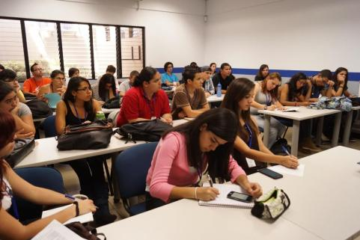
Some phrasal verbs can be separated when we used them with objects. We can put the object between the verb and the preposition, or we can put the object at the end, just like we do for inseparable phrasal verbs.
"Write down" is an example for a separable phrasal verb.
"Write down" means to make a note some information on paper.
We can separate this phrasal verb if we want! Look at the examples below to see how this construction works.
Correct: His students write down everything he says.
Correct: His students write everything he says down.

Slide 7


EXAMPLES OF PHRASAL VERBS:
1. Get on
Subir
The bus was full.We couldn’t get on.
2. Drive off
Marcharse (en un vehículo) de algún lugar
A woman got into the car and drove off.
3. Turn round
Cambiar de dirección, girarse
When I touched him on the shoulder, he turned round.
4. Break down
Dejar de funcionar , dejar de operar. (romperse)
Sorry I’m late. The car broke down.
5. Look out
Ser cuidadoso, estar atento, permanecer atento.
Look out! There’s a car coming

Slide 8


6.Take off
Despegar
It was my first flight. I was nervous as the plane took off.
7. Run away (from)
Escaparse, huir, alejarse.
Why did you run away from me?
8. Keep up (with)
Llevar el ritmo
You’re walking too fast. I can’t keep up with you.
9. Get in
Entrar
How did the thieves get in?
10. Lock out
Quedarse encerrado, no poder entrar
I had no key, so I was locked out.

