Slide 1
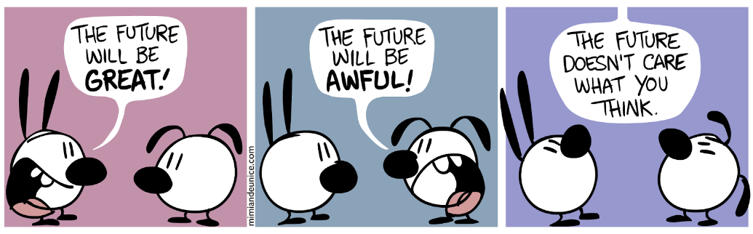
The Future with WILL

Slide 2


We can use “will” to talk about the future. We also use will to make predictions, talk about decisions, and to make promises, offers, requests and threats.
Grammar rules:
It does not change in the third person (i.e. he, she, it)
It is always combined with another verb in the base form
We don't use it with 'Do' in questions or negatives.
STRUCTURE
SUBJECT + WILL +BASE FORM OF VERB +COMPLEMENT
I will go to the cinema tonight.
He will play tennis tomorrow.
She will be happy with her exam results.
They will take the bus to the South next week.

Slide 3

Using will
Here are some of the ways we use will:
1. To talk about the future
We can often use “will” + infinitive without “to” to refer to future events. This is often called the “pure” future:
“I’ll be back later tonight – don’t bother making me dinner.”
“I’m busy right now – I’ll call you tomorrow.”

Slide 4

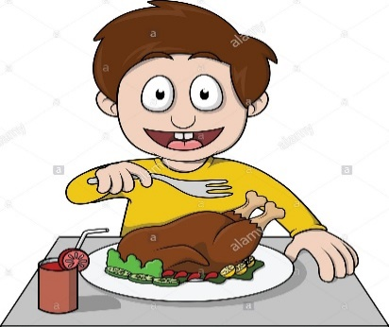
2. To make predictions
We also use “will” to talk about what we think will happen in the future.
“I think it’ll rain tonight.”
I’m sure he’ll be a successful lawyer one day.”
3. To make decisions
When we make decisions at the same time as we speak, we use “will”.
For example, in a restaurant:
Waiter: “What would you like to eat?”
Customer: “I think I’ll have the chicken.”

Slide 5

To make promises, offers, requests and threats
These are some other ways we can use “will” in English.
Promises: “I’ll help you with your homework tomorrow.”
Offers: “I’ll look after the children for you if you like.”
Requests: “Will you tell Tony I called?”
Threats: “If you cheat again, I’ll tell the teacher.”
Negative Sentences with WILL
In the negative, we add NOT to the end of WILL and not to the main verb. (= will not)
Examples:
I will not be in the office tomorrow. (correct)
I will be not in the office tomorrow. (Incorrect)

Slide 6
Contractions
It is possible to use contractions in both positive and negative sentences.
 | Positive Contraction
I will | I'll
You will | you'll
He will | he'll
She will | she'll
It will | it'll
We will | we'll
You will | you'll
They will | they'll
 | Negative Contraction
I will not | I won't
You will not | you won't
He will not | he won't
She will not | she won't
It will not | it won't
We will not | we won't
You will not | you won't
They will not | they won't

Slide 7
Questions
To form a question using WILL, we reverse the order of the subject and WILL:
Affirmative | He | will | be | here tomorrow.
 | Subject | WILL | Verb
Question | Will | he | be | here tomorrow?
 | WILL | Subject | Verb
Examples:
Will they win the cup?
- Yes, they will.
- No, they won't.
Will you tell him the truth?
- Yes, I will.
- No, I won't.

