Slide 1
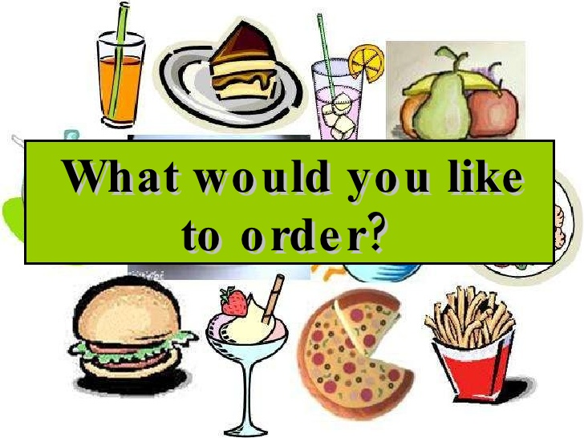
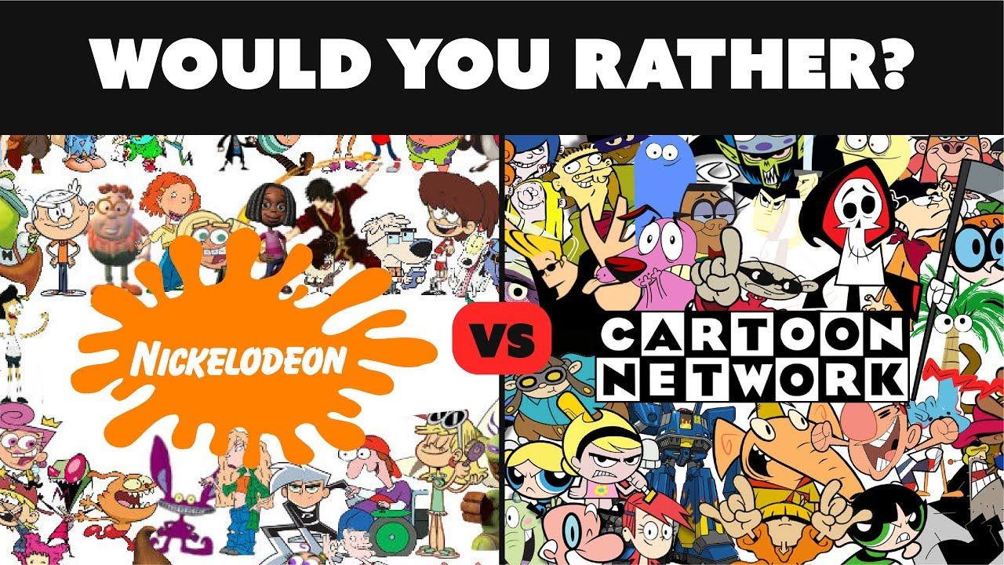
Would You Like..? Would you rather?

Slide 2
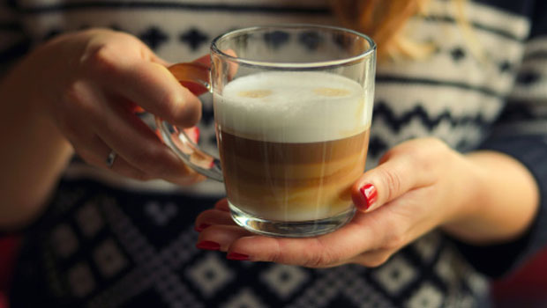
How to use "would like" “(gustaria)
Would like" has the meaning of "want", but it is used for more polite expressions. In affirmative form
Example: Do you want some coffee? ( This is less formal and polite. We usually use this for friends, children, and etc.)
Would you like some coffee? (This is more polite and formal.)

Slide 3
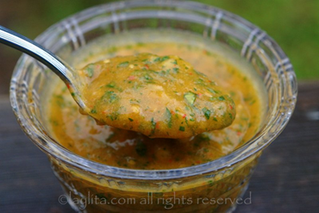
Form:
Subject + would like + noun I would like a glass of coke.
She would like a piece of cake.
Peter would like some water
Questions Form:
Would + subject + like +noun?
Would you like some water?
Would you like a little of hot sauce?
Yes, I would

Slide 4
How to use "would rather“(preferir)
We use would + rather when express or ask preference between two or more activities
Example:
SUBJECT+WOULD+ RATHER+VERB BASE FORM+COMPLEMENT
I'd rather speak to him in person that discuss things over the phone.
I’d rather stay at home than go out tonight.
NEGATIVE FORM
SUBJECT+WOULD+RATHER+NOT+VERB BASE FORM+COMPLEMENT
I’d rather not tell anyone.
They’d rather not go if you don’t mind.

