Slide 1
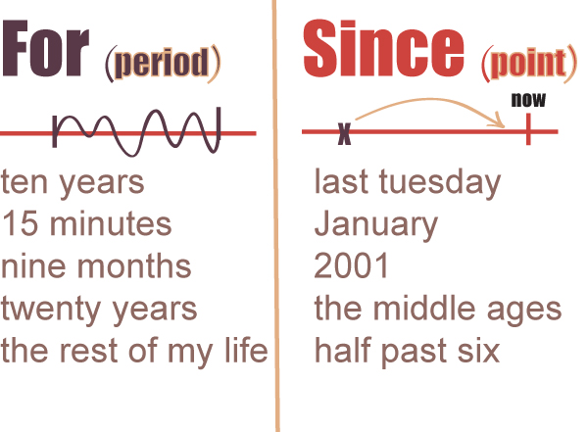
For - Since
English Grammar Rules

Slide 2

for and since for Time
Using the present perfect, we can use (for + a period of time), considering its starting in a determinated point in the time, and we can use since + a point in time.
FOR + A PERIOD OF TIME
for six years, for a week, for a month, for hours, for two hours
EXAMPLES:
I have worked here for five years.
I haven't smoked for weeks
FOR+period expresses duration (HOW LONG?)
SINCE + starting point says when the action began (SINCE WHEN?)

Slide 3

SINCE + A POINT IN TIME
since this morning, since last week, since yesterday
since I was a child, since Wednesday, since 2 o'clock
EXAMPLES:
I Have worked here since 1990.
I haven't smoked since 2010

Slide 4
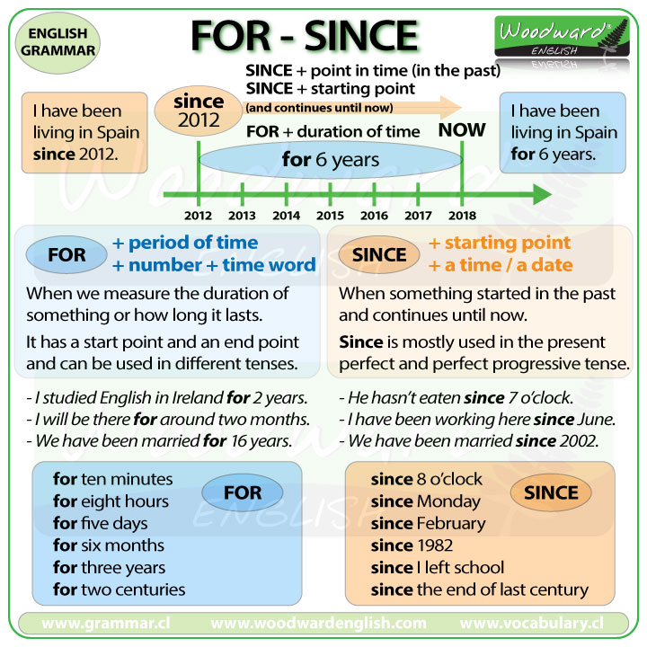

Slide 5

Other expressions
Lately= recientemente,ultimamente they have been watching too much television lately.
Just= “acabar de” o “justo” Beth has just moved to New York.
Still= “aún” o “todavía” They still haven’t finished their homework.
So far= 'hasta aquí', 'hasta ahora‘ I have met half of the staff so far.

