Slide 1

Present Perfect

Slide 2

Definition of the present perfect tense
The present perfect is used to indicate a link between the present and the past. We use the present perfect simple (have or has + past participle) to talk about past actions or states which are still connected to the present.
First-person: I have finished the report.
Second person: You have finished the report.
Third-person plural: They have finished the report.
Third-person singular: He/she/it has finished the report.

Slide 3
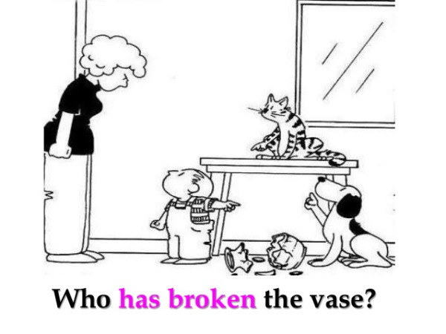
You CANNOT use the Present Perfect with specific time expressions such as: yesterday, one year ago, last week, when I was a child, when I lived in Japan, at that moment, that day, one day, etc. PAST | We CAN use the Present Perfect with unspecific expressions such as: ever, never, once, many times, several times, before, so far, already, yet, etc.

Slide 4
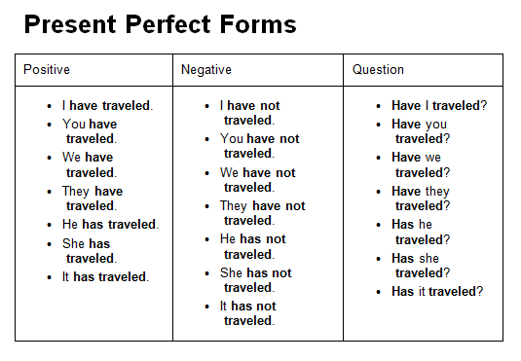


Slide 5

FORM
Subject + has (she,he, it) /have + VERB in past participle + complement (positive form)
(be-been)
Subject + has (she,he, it) /have + not + VERB in past participle + complement (negative form)
Has (she,he, it) /Have Subject + + VERB in past participle + complement (question form)
Examples:
You have seen that movie many times. Affirmative form
You have not seen that movie many times. Negative form
Have you seen that movie many times? Question
Yes, I have
No, I have not or haven’t

Slide 6
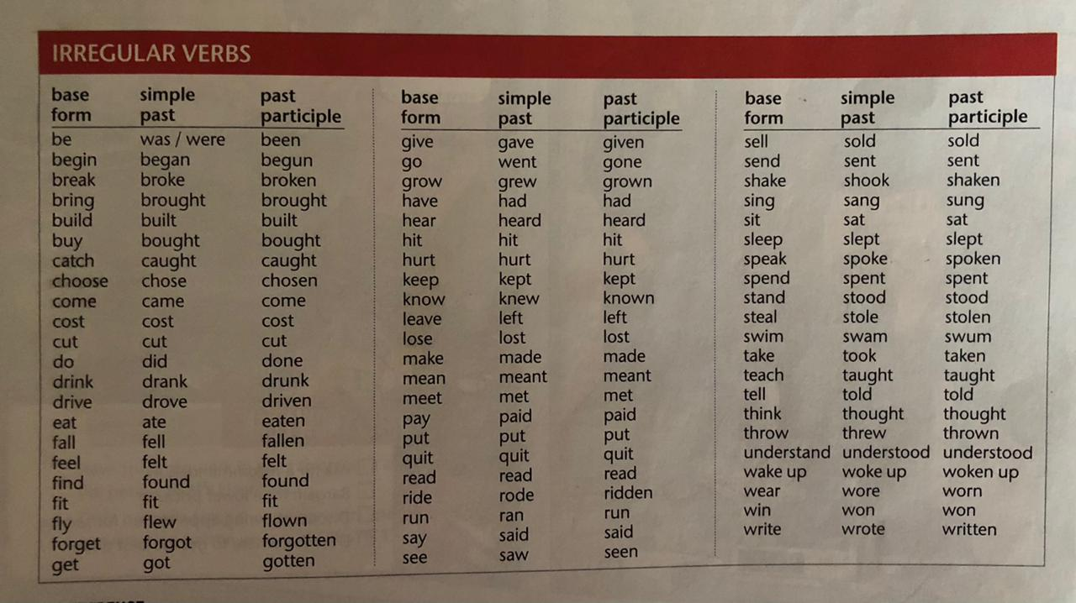
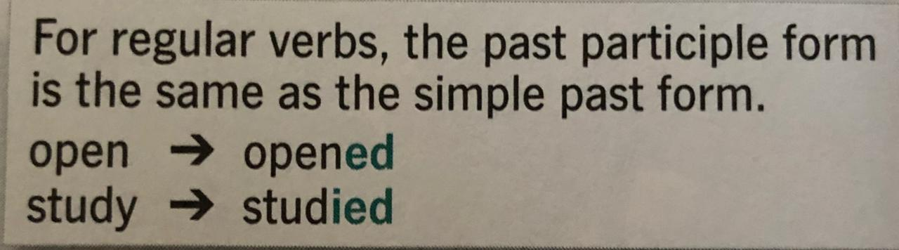

Slide 7


