Slide 1
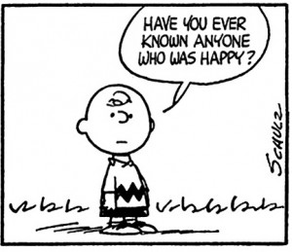
THE PRESENT PERFECT
ALREADY, EVER, NEVER, YET, BEFORE

Slide 2
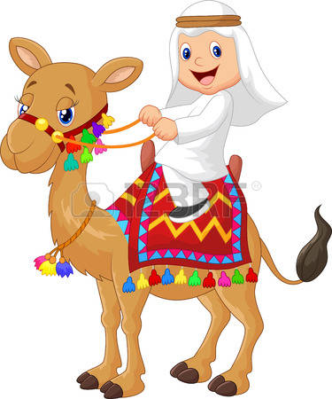
1. Ever: alguna vez
It is used in questions, after the subject and before the verb in past participle.
Examples:
Have you ever been to Brazil?
No, I have not been to Brazil
Has he ever ridden a camel?
Yes, He has ridden a camel

Slide 3

2. Never: nunca
It is used in affirmative sentences, after the auxiliary "have" and before the past participle.
Examples:
-I have never seen that movie.
-He has never drunk Tequila.

Slide 4

3. Already: Ya (for affirmative)
It is in use in affirmative sentences for indicating recent experiences, it is writes after the auxiliary "have" and before the past participle.
Examples:
-We have already bought the book.
-They have already booked the hotel.

Slide 5

4. Yet: (for negative) and (for interrogative)
4.1. In negative sentences the meaning of this word is aún ( and is located at the end of sentence.
Examples:
We haven’t bought the book yet. (Aun no hemos comprado el libro)
-They haven’t booked the hotel yet. (Ellos aun no han reservado el hotel)
4.2. In interrogative sentences this word means “ya" and is located at the end of the question.
Examples:
Have you written the report yet? (¿Ya has escrito el reporte?)
-Has he arrived yet? (¿Él ya ha llegado?)

Slide 6

5. Before: Antes
It is used to indicate the existence of past events or life experiences “ and it comes at the end of the sentence.
Examples:
I've seen this movie before.
I have worked for the company before.
I’ve played that game before, I don’t like it.

