Slide 1
MODAL VERBS
Talking about health matters

Slide 2
Must = conclusion
WILL BE ABLE TO = future possibility
May / might be able to = possibility

Slide 3
Must = conclusion
Situation: The lights in the house are on.
Conclusion: Somebody must be in the house. (Affirmative)

Slide 4
Situation: Sandra has a problem in her job.
Conclusion: She must not feel o.k. (negative)

Slide 5
Extra examples:

Slide 6
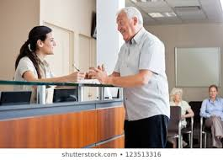
WILL BE ABLE TO = future possibility
The doctor can see you tomorrow.
The doctor will be able to see you tomorrow. (Affirmative)

Slide 7
Karla can´t come to class this week.
Karla won’t be able to come to class this week. (Negative)

Slide 8
Extra examples:

Slide 9
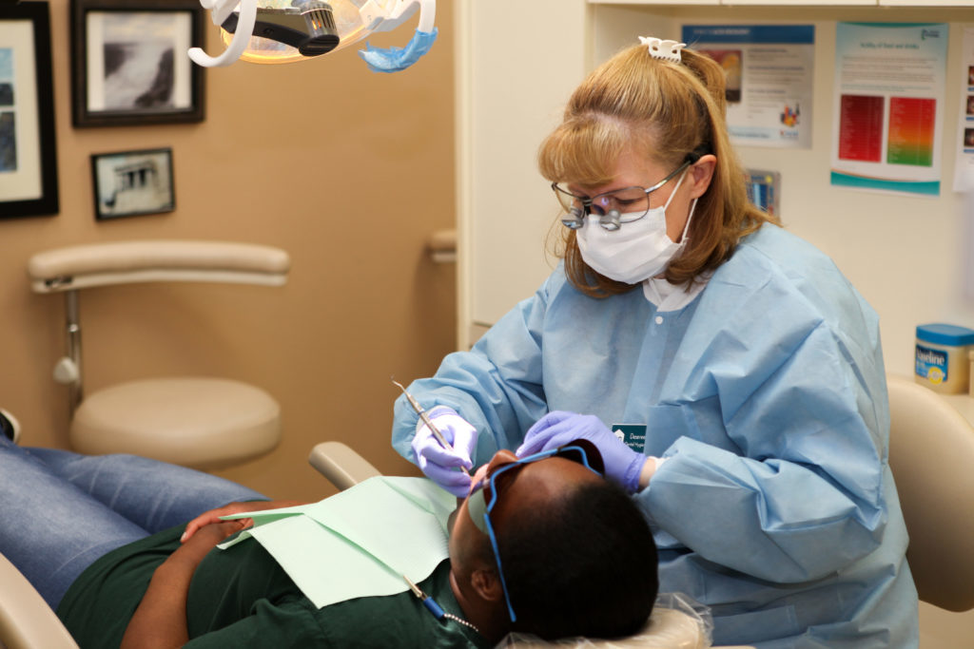
May / might be able to = possibility
The dentist is attending an emergency;
He may/might arrive late.

Slide 10
- If you feel pain.
- You may/might not make an appointment.

Slide 11
Extra examples:

