Slide 1

UNIT 1
Make a small talk

Slide 2
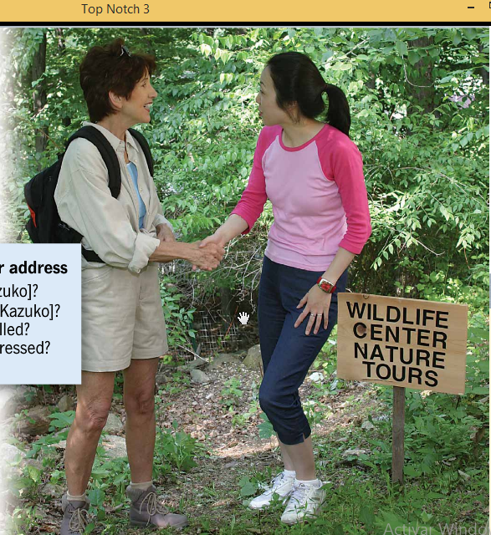

Slide 3
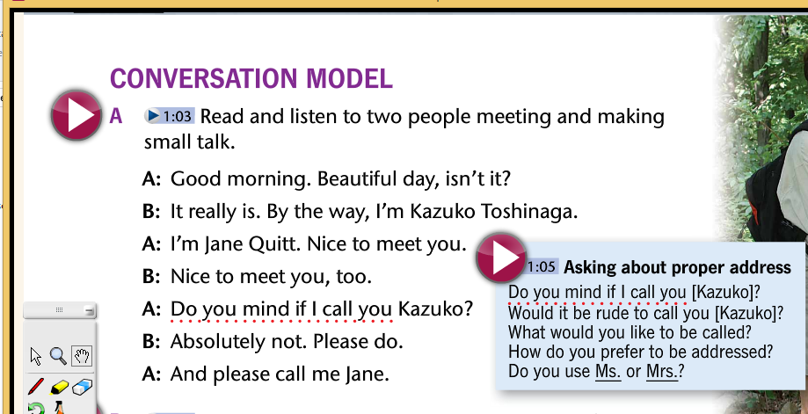

Slide 4
Basic Grammar Tenses
To be sentence:
Simple Presente:
Simple Past:
Present Perfect:
Modal Verbs:

Slide 5
TAG QUESTIONS
Short questions at the end of a sentence to confirm ideas.
We need to use Affirmative or Negative form and a Personal Pronoun (I, you, he, she, it, we, they).
Spanish: No es cierto? / O no?
Spanish: O sí?

Slide 6
1. Affirmative sentence Negative Tag question
It is a beautiful day, isn’t it?
2.Negative sentence Affirmative Tag question
You don’t live here, do you?

Slide 7
To be sentences:
Peter is in class, isn’t he?
We are learning grammar, aren’t we?
There is a class test today, isn’t there?
There are some changes here, aren’t there?
Sara was sick, wasn’t she?
The students were chatting, weren’t they?

Slide 8
I am … aren’t I?
I am your teacher, aren’t I?
I am a good friend, aren’t I?
I am right, aren’t I?

Slide 9
Examples to participate in class:
Complete these sentences with a correct Tag Question.
The students were here, I am in this class, There is an apple on the table,

Slide 10
Simple Presente: Negative forms DON’T /DOESN’T
You use internet to attend class, don´t you?
I explain the class clearly, don’t I?
We work eight hours, don’t we?
Paul lives in New York, doesn’t he?
Silvia studies English on line, doesn’t she?
Ecuador has four natural regions, doesn’t it?

Slide 11
Examples to participate in class:
Complete these sentences with a correct Tag Question.
You love me, We practice grammar, I get some money for this job, Sandy drinks a lot of wáter,

Slide 12
Simple Past: Negative form DIDN’T
- I gave you the instructions, didn’t I?
- The professors worked on line, didn’t they?
- Richard bought some food, didn’t he?
- Daniela had money, didn’t she?
-

Slide 13
Examples to participate in class:
Complete these sentences with a correct Tag Question.
Fernanda studied yesterday, My friend and I presented the homework, Ecuador had bad governments,

Slide 14
Present Perfect: Negative forms HASN’T/HAVEN´T
- I have arrived on time, haven’t I?
- People have stayed at home, haven’t they?
- Robert has driven all day long, hasn’t he?
- The activity has been easy, hasn’t it?

Slide 15
Examples to participate in class:
Complete these sentences with a correct Tag Question.
We have practiced speaking at home, Her husband has played soccer for 3 years, I have answered all questions,

Slide 16
Modal Verbs:
- I can say the truth, can’t I?
- Some People will get money, won’t they?
- Charlie should be here, shouldn’t he?
- Internet would help students, wouldn’t it?

Slide 17
Examples to participate in class:
Complete these sentences with a correct Tag Question.
Your son can run fast, Their daughter will travel tomorrow morning, Ecuadorians should respect health instructions, I would help you,

Slide 18
FEED BACK
I am in this class,
There was an apple on the table,
I get some money for this job,
Sandy drinks a lot of wáter,
My friend and I presented the homework,
Her husband has played soccer for 3 years,
Your son can run fast,

Slide 19
TAG QUESTIONS part 2
2. Negative sentence Affirmative Tag question.

Slide 20
To be sentences:
You are not from Riobamba, are you?
Daniel is not in this class, is he?
I am not wrong, am I?
There is not a problem, is there?
There are not books on the desk, are there?
The dog was not in the house, was it?
We were not classmates, were we?

Slide 21
Examples to participate in class:
Complete these sentences with a correct Tag Question.
Henry is not my student, His parents are not old, Robert and I were not angry, There was not an emergency,

Slide 22
Simple Presente: Affirmative forms DO /DOES
You don’t have internet connection, do you?
I don’t copy the sentence, do I?
People don’t go to work out of house, do they?
Luis doesn’t drive fast, does he?
Sonia doesn’t speak French, does she?
Faith doesn’t die, does it?

Slide 23
Examples to participate in class:
Complete these sentences with a correct Tag Question.
I don’t cry frequently, Paul and I don’t fight, The university doesn’t have enough money,

Slide 24
Simple Past: Affirmative form DID
- I didn’t present the homework, did I?
- The professors didn’t help the students, did they?
- Julio didn’t write the report, did he?
- Mariela didn’t cheat on you, did she?

Slide 25
Examples to participate in class:
Complete these sentences with a correct Tag Question.
You didn’t love me, Daniel’s sister didn’t come, The movie didn’t have good characters,

Slide 26
Present Perfect: Affirmative forms HAS/HAVE
- I have not cried, have I?
- Some children haven’t done the homework, have they?
- Rachel has not prepared the dinner, has she?
- The explanation hasn’t been long, has it?

Slide 27
Examples to participate in class:
Complete these sentences with a correct Tag Question.
You and I haven’t eaten yet, Vivian’s father hasn’t been sick, The D. J. hasn’t brought a mike,

Slide 28
Modal Verbs:
- I can’t send messages, can I?
- We won’t give up, will we?
- People shouldn’t leave the house, should they?
- VirtuaI classes wouldn’t be long, would they?

Slide 29
Examples to participate in class:
Complete these sentences with a correct Tag Question.
The professors won’t go to the university, The situation can’t be worst, People shouldn’t leave their houses, Our teacher wouldn’t send more instructions,

Slide 30
