Slide 1

NOUN CLAUSES
READING FOR PLEASURE

Slide 2
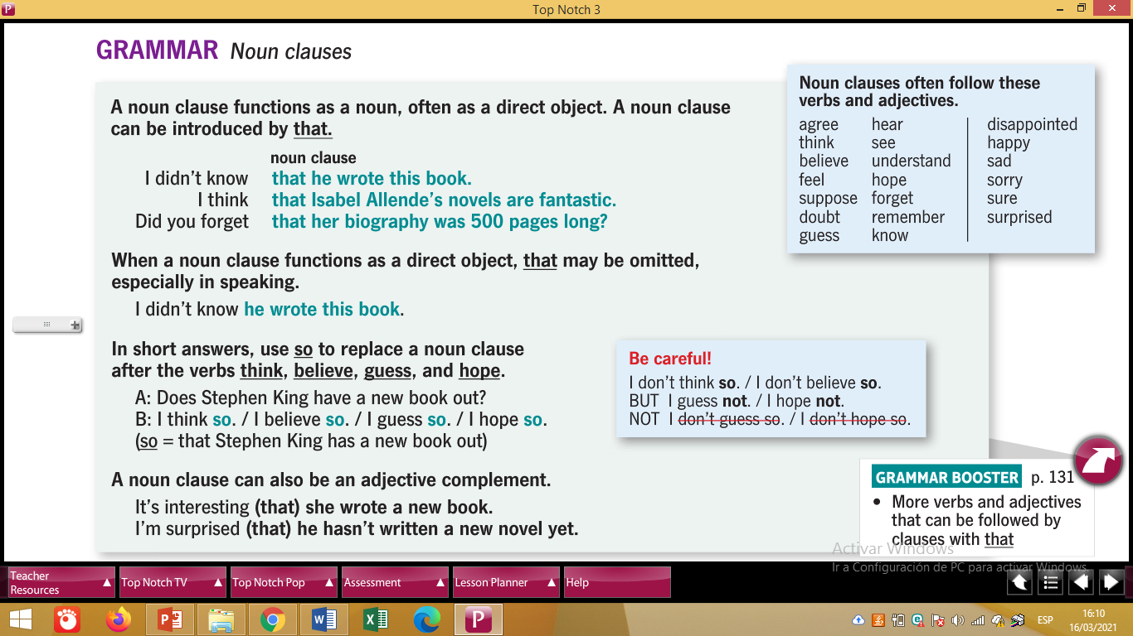

Slide 3


Slide 4

Joanne Kathleen Rowling
I didn´t know that J.K. Rowling wrote “Harry Potter”.
subject verb object
SENTENCE

Slide 5

I think that “Harry Potter” books are fantastic.
subject verb object
SENTENCE

Slide 6

- I am surprised that there are seven books about Harry Potter.
SENTENCE
adjective

Slide 7
VERBS BE(am/is/are/was/were) + ADJECTIVES
NOUN CLAUSES (VERBS) | NOUN CLAUSES (ADJECTIVES)
- I think that “Harry Potter” books are fantastic. | - I am surprised that there are seven books about Harry Potter.
- We hear that the professors will take tests. | - Daniel is sure that he will be a lawyer.
- Many people believe that Rafael was crazy. | - I was happy that my students practice English.
- My mom supposes that my brother works in Quito. | - We are disappointed that the situation does not change.

Slide 8
NOUN CLAUSES: EMBEDDED QUESTIONS
They are kind of Indirect Questions that are included in a sentence.
1. YES / NO QUESTIONS IF
2. INFORMATION QUESTIONS WHERE, WHEN, WHY, HOW, WHO, WHOSE, etc.

Slide 9

NOUN CLAUSES: EMBEDDED QUESTIONS
1. YES / NO QUESTIONS IF
Is that magazine interesting? Tell me if that magazine is interesting.
subject verb object

Slide 10
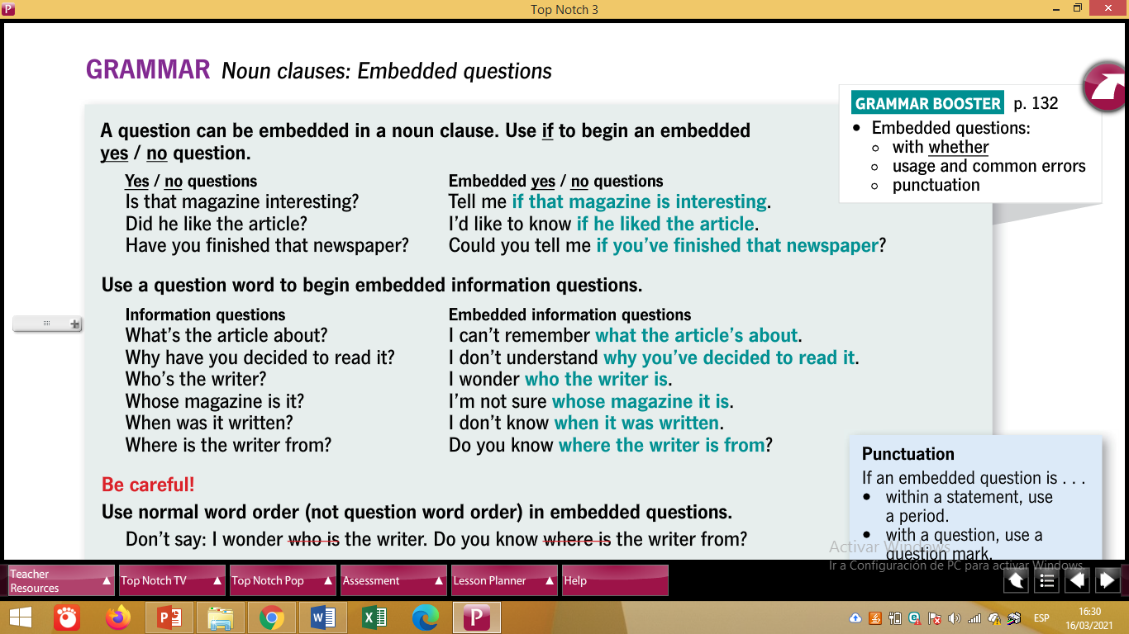
SMALL EXPRESSIONS TO START EMBEDDED QUESTIONS

Slide 12
- Does Julia write poems? I want to know if Julia writes poems.
S V O
- Did Richard like the article? I’d like to know if Richard liked the article.
S V O
- Have you finished that book?
Could you tell me if you have finished that book?
S V O

Slide 13
Examples to practice
DIRECT QUESTION | EMBEDDED QUESTIONS
Are the students procastinators? | I’m not sure if the students are procastinators.
Does Lenin help people? | I can’t remember if Lenin helps people.
Did you present the last homework? | I don’t know if you presented the last homework.
Will professors take Oral Lessons? | I wonder if professors will take Oral Lessons.
Have people read books in English? | Do you know if people have read books in English?

Slide 14
NOUN CLAUSES EMBEDDED QUESTIONS
2. INFORMATION QUESTIONS: WHERE, WHEN, WHY, HOW, WHO, WHOSE, etc.
- Where are you from?
I wonder where you are from.
S V Obj.
- When do we have English class?
I’m not sure when we have English class.
S V Obj.

Slide 15
SMALL EXPRESSIONS TO START EMBEDDED QUESTIONS

Slide 17
DIRECT QUESTIONS | EMBEDDED QUESTIONS
- What time did students upload the homework? | I can’t remember what time students uploaded the homework. S V Obj.
- Why have the professors sent projects? | I don´t know why the professors have sent projects. S V Obj.

Slide 18
Examples to practice
DIRECT QUESTIONS | EMBEDDED QUESTIONS
Whose magazine is this? | I don’t understand whose magazine this is.
How did you get that book? | I’m not sure how you got that book.
When will people live in peace? | I wonder when people will live in peace.
Why has Pauline traveled to Europe? | I can’t remember why Pauline has traveled to Europe.

Slide 19
EXTRA GRAMMAR POINT.
Short answers by using SO to replace a noun clause after the verbs:
THINK, BELIEVE, GUESS, HOPE
- Question: Did J.K. Rowling write a new book?
- Affirmatives: I think so / I believe so / I guess so / I hope so
- Negatives: I don’t think so / I don´t believe so
I guess not / I hope not

Slide 20

Extra emple with SO to replace a noun clause after the verbs:
THINK, BELIEVE, GUESS, HOPE
- Question: Teacher, do you think I will approve this level?
- Affirmatives: I think so / I believe so / I guess so / I hope so
- Negatives: I don’t think so / I don´t believe so
I guess not / I hope not

