Slide 1
Past Perfect

Slide 2
Description of an action that occurred before a specific time in the past.
CAMBIAR!!!!!!!!!!
HAD + PAST PARTICIPLE
MY FATHER HAD BOUGHT A CAR

Slide 3
Example:
The situation 1:
The class started at 7 a.m., but we arrived at 7:30.
The class had started before we arrived.
The situation 2:
It was 8 p.m., but Peter prepared the dinner at 7 p.m.
Peter had prepared the dinner before 8 p.m

Slide 4
ALREADY AFFIRMATIVE
The situation 1:
The class started at 7 am, but we arrived at 7:30.
The class had started before we arrived.
The class had already started.
The situation 2:
It was 8 p.m, but Peter prepared the dinner at 7 p.m.
Peter had prepared the dinner before 8 p.m.
Peter had already prepared the dinner.

Slide 5
BY TIME
The situation 1:
The class started at 7 a.m., but we arrived at 7:30.
The class had started before we arrived.
By 7:30 a.m. the class had already started.
The situation 2:
It was 8 p.m., but Peter prepared the dinner at 7 p.m.
Peter had prepared the dinner before 8 p.m.
By seven o’clock Peter had already prepared the dinner.

Slide 6
YET NEGATIVE
The situation 1:
The class started at 7 am, but we arrived at 7:30.
We hadn’t yet arrived when the class started.
The situation 2:
It was 8 p.m., but Peter prepared the dinner at 7 p.m.
It hadn’t yet been 8 and the dinner was ready.

Slide 7
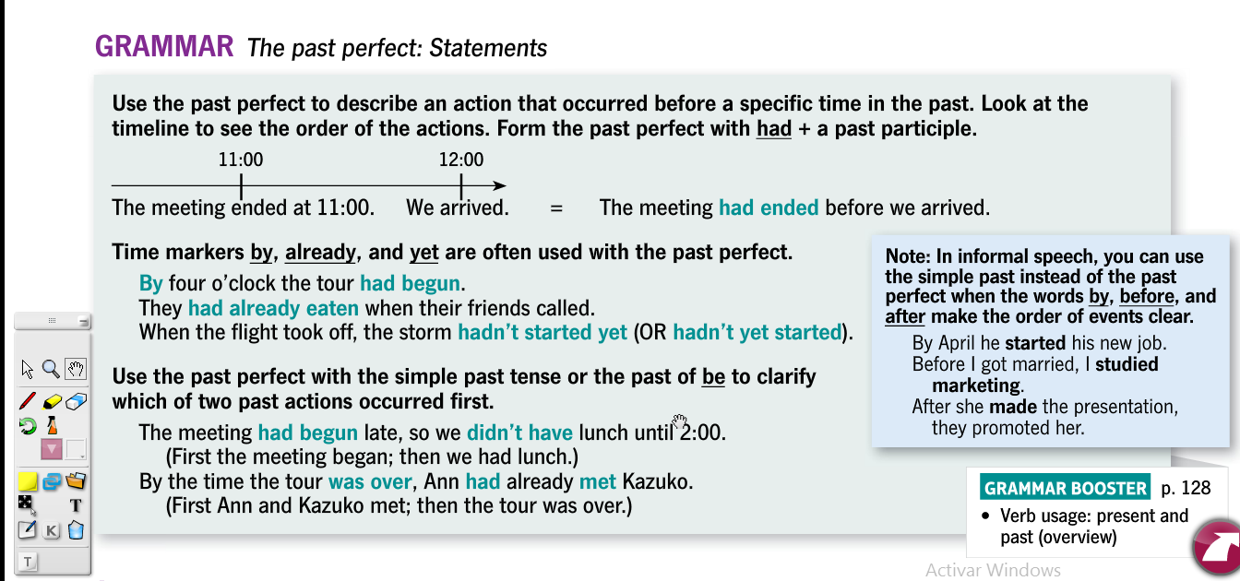

Slide 8
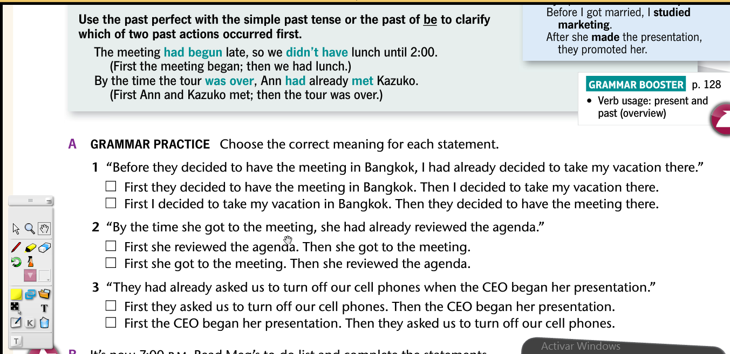

Slide 9
