Slide 1
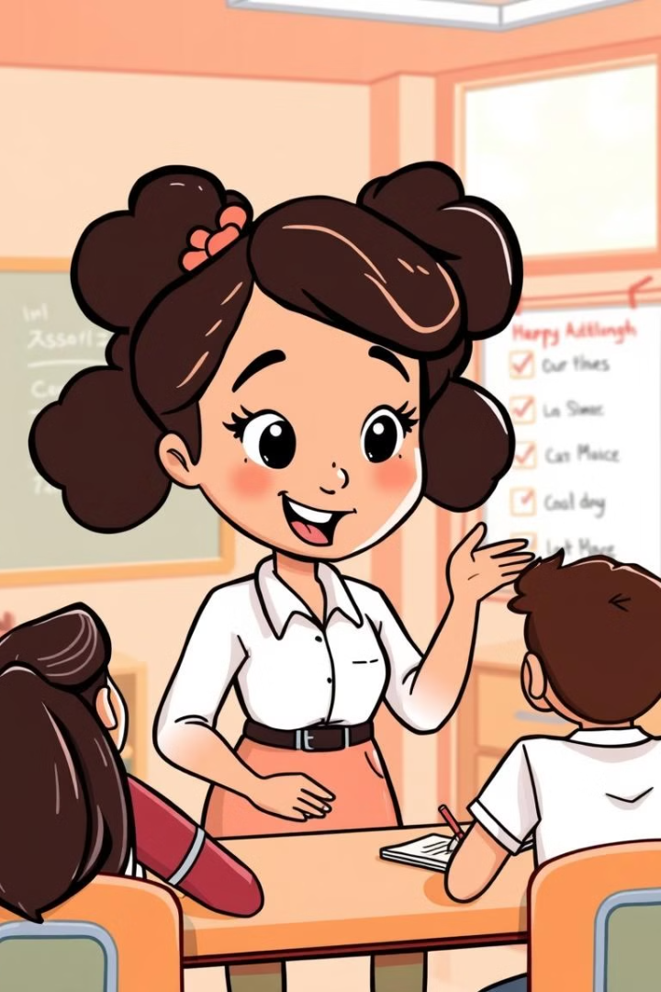
Tag Questions
Tag questions are short questions added to the end of a statement. They seek confirmation or engage listeners. They turn a statement into a question.
This presentation will cover the structure and usage of tag questions. We will explore their forms with different tenses and modal verbs.
By Teacher Lourdes Quinata

Slide 2
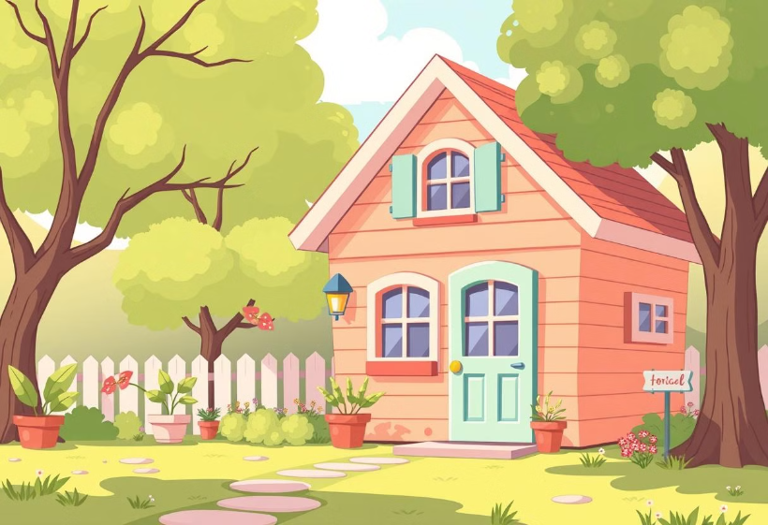
Positive Statements, Negative Tags
Basic Rule
A positive statement is followed by a negative tag question. This is the most common structure.
Example: You live here, don't you?
Structure: Positive Statement + negative question tag

Slide 3
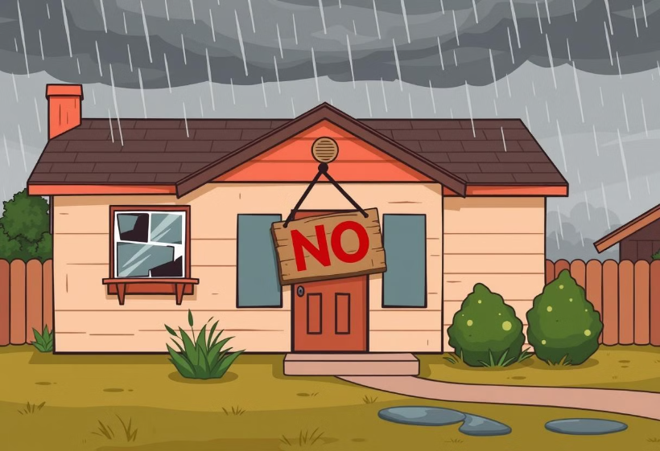
Negative Statements, Positive Tags
Basic Rule
A negative statement is followed by a positive tag question. This is the inverse of the previous rule.
Example: You don't live here, do you?
Structure: Negative Statement + Positive question tag

Slide 4
Present Tenses Tag Questions
Present Simple
Present Continuous
She works hard, doesn't she?
They aren’t at the mall, are they?
They are studying, aren't they?
Rita is coming tomorrow, isn’t she?
Auxiliary verbs are key to forming tag questions correctly. Note how the auxiliary changes with the tense. Do/ does - Am /Is /Are

Slide 5
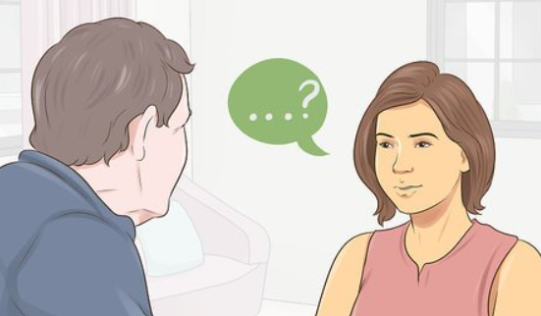
Past Tenses Tag Questions
Past Simple
You went to the party, didn't you?
Your shoes were dirty, weren’t they?
Past Continuous
She was sleeping, wasn't she?
In the past simple, use 'did' as the auxiliary verb, {was/were past of be]. In the past continuous, use 'was' or 'were'.

Slide 6
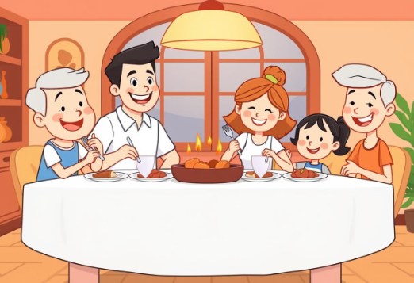
Present Perfect Tenses Tag Questions
Present Perfect Simple
Present Perfect Continuous
They have eaten dinner, haven't they?
She has been working all day, hasn't she?
Auxiliary Verb: have/has

Slide 7
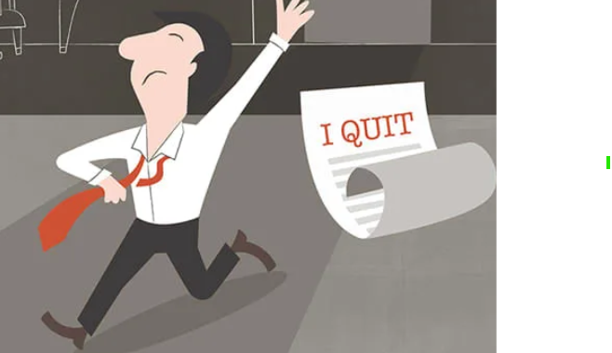
Past Perfect Tenses Tag Questions
Past Perfect Simple
Past Perfect Continuous
She had left when I arrived, hadn’t she?
Tom had been working here for 5 years before he quit, hadn't he?
Auxiliary Verb: had

Slide 8
Future Tenses Tag Questions
Future Simple (will + verb)
Future with be going to
You will come, won't you?
You're going to help, aren't you?
Future Continuous (will + be + gerund)
This time tomorrow, you will be traveling to Paris, won’t you?
Auxiliary: will
Remember to contract 'will not' to 'won't' in the tag question. 'Are/is/am' change as necessary.

Slide 9
Modal Verb Tag Questions
Can / Could
You can speak English, can't you? He couldn’t attend the meeting, could he?
Should
They should study, shouldn't they?
would
He wouldn’t help with the project, would he?
Auxiliary: Modals

Slide 10
Special Cases and Exceptions
"I am" Exception
"Let's" Exception
"Have got" Exception
"I am" becomes "aren't I?“ I am late, aren't I?
"Let's" becomes "shall we?" Let's go to the park, shall we?
"Have got" often uses "haven't/hasn't." He has got a car, hasn't he?

Slide 11
Time to Practice!
1
Remember the Rules
2
Identify the Tense
3
Use Correct Auxiliary
Keep practicing to master tag questions!

