Slide 1
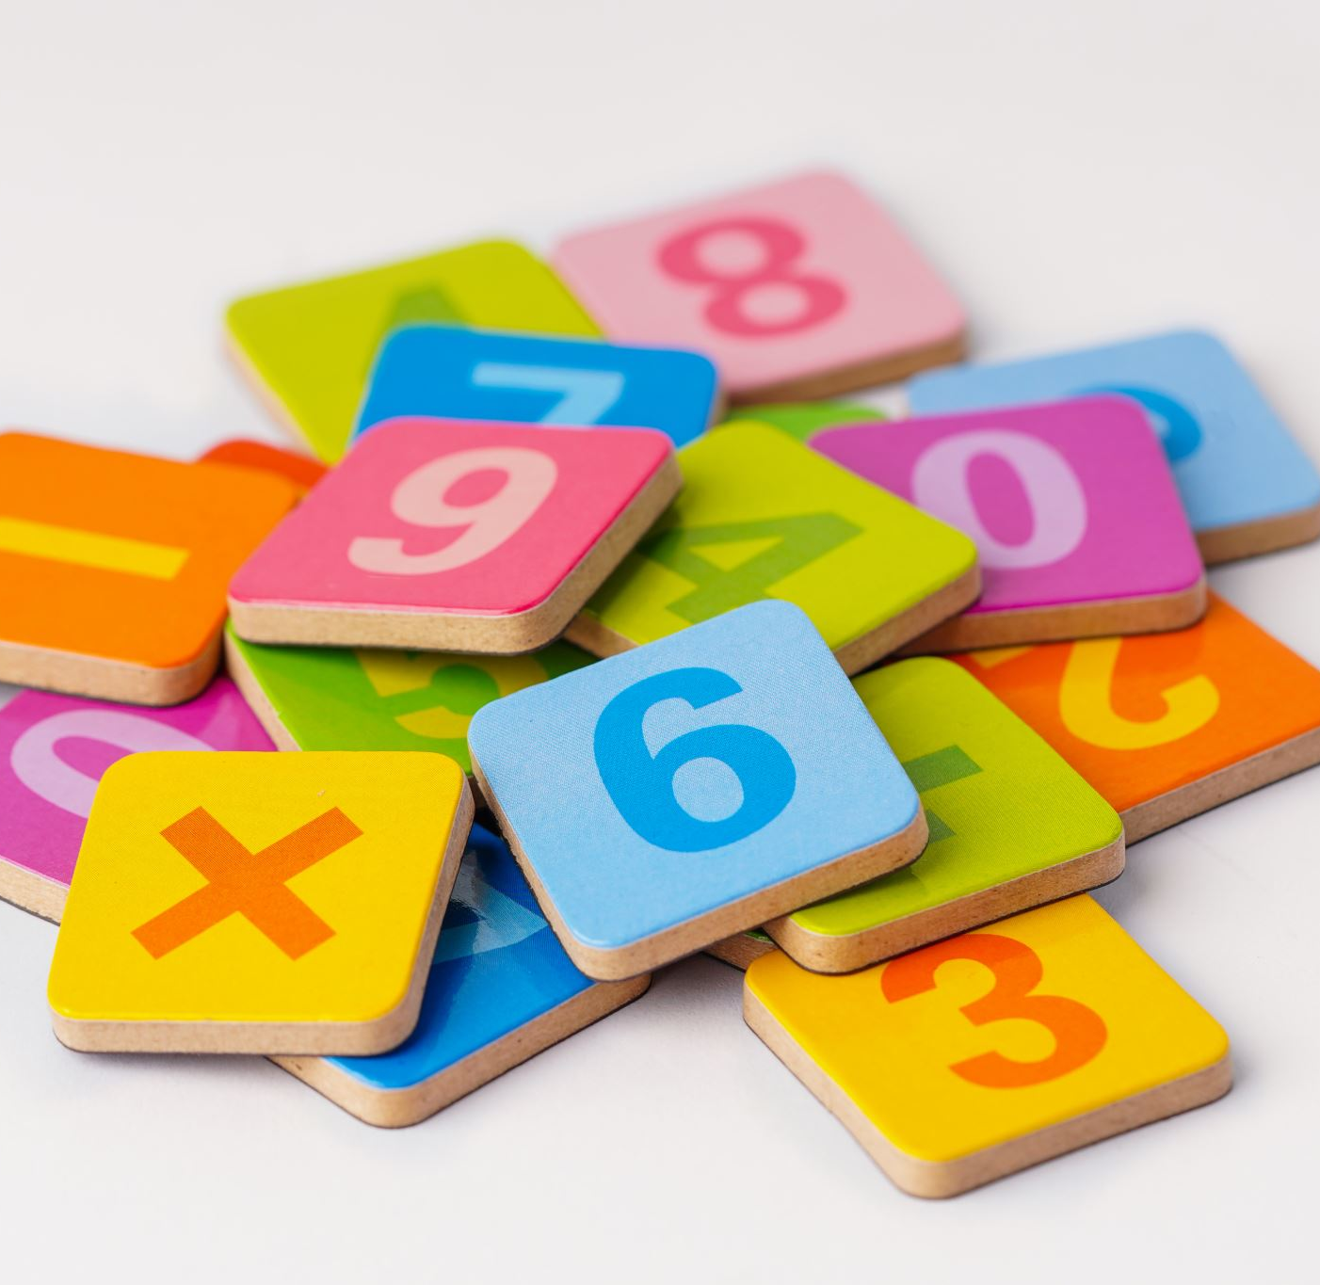
Cognitive Categories of Language

Slide 2
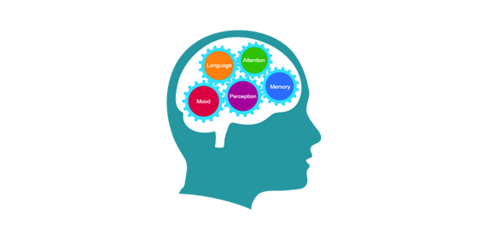
What are cognitive language categories?
Human thought and action is fundamentally shaped by a small set of cognitive categories, such as time, space, causality, or possession. It is not surprising, therefore, that all natural languages have developed many devices to express these categories.

Slide 3
What Is Cognition?
Cognition is a term referring to the mental processes involved in gaining knowledge and comprehension.
Some of the many different cognitive processes include thinking, knowing, remembering, judging, and problem-solving.

Slide 4
Types of Cognitive Processes
Attention: is a cognitive process that allows people to focus on a specific stimulus in the environment.
Language: Language and language development are cognitive processes that involve the ability to understand and express thoughts through spoken and written words. This allows us to communicate with others and plays an important role in thought.
Learning: Learning requires cognitive processes involved in taking in new things, synthesizing information, and integrating it with prior knowledge.

Slide 5
Memory: is an important cognitive process that allows people to encode, store, and retrieve information. It is a critical component in the learning process and allows people to retain knowledge about the world and their personal histories.
Perception: is a cognitive process that allows people to take in information through their senses, then utilize this information to respond and interact with the world.
Thought: Thought is an essential part of every cognitive process. It allows people to engage in decision-making, problem-solving, and higher reasoning.

Slide 6
Class Activity
Students take a comfortable position.
Watch the pictures carefully
Close your eyes
Put in blank your mind
Listen the sounds
Open your eyes and draw your thoughs
Show your draw
Explain to the hole class what do you feel about?

