Slide 1
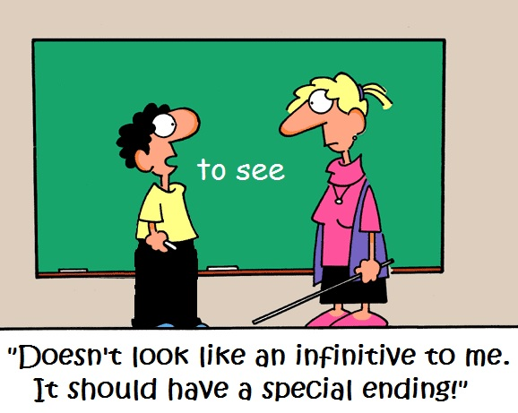
THE INFINITIVE OF PURPOSE

Slide 2
We can use TO INFINITIVE to say why we do something or express a purpose. It tells the other person the reason.
EXAMPLE
I went on holiday (this is what I did) to relax (this is why I did it).
She studies hard to get good marks.
He gave up cakes to lose weight.
I'm calling you to ask for your help.

Slide 3
We can use a negative infinitive of purpose by adding 'not' before 'to'.
Example:
He tiptoed through the hall not to be heard.
I drank coffee in order not to fall asleep.

Slide 4
SUMMARY
Utilizamos el infinitivo de un verbo (to do) para hablar acerca del propósito u objetivo de hacer algo.
I went out to send a letter. (Salí para enviar una carta). She called me to invite me to a party. (Me llamó para invitarme a una fiesta)
Es posible utilizar in order to (para, a fin de que) como sinónimo:
We shouted in order to get help. (Gritamos para pedir ayuda)
En las oraciones negativas utilizaremos el not antes del infinitivo TO
They spoke quietly in order not to wake the children.
En preguntas con WHY utilizamos el infinitive TO como respuesta similar a BECAUSE
Why did you click on that icon? To save the file.
https://www.youtube.com/watch?v=E7-h-TNnOsM

