Slide 1
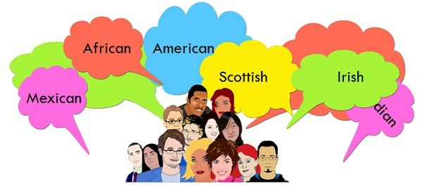
Race and Ethnicity
Race refers to the concept of dividing people into groups on the basis of various sets of physical characteristics and the process of ascribing social meaning to those groups. Ethnicity describes the culture of people in a given geographic region, including their language, heritage, religion and customs.

Slide 2
Differences Between Race vs. Ethnicity
Race and ethnicity are typically misunderstood, because many people simply don’t fit into neat categories offered on forms with checkboxes. People are able to self-identify their ethnicities and, to some extent, their races.
Race Narrow Based on similar physical and biological attributes | Ethnicity Broad Based on cultural expression and place of origin

Slide 3
What Is Race?
Race is usually associated with biology and linked with physical characteristics such as hair texture and skin color. It covers a relatively narrow range of options. Yet people of similar complexions/hair textures can be defined as different races, and the definitions in the U.S. have changed over time.
Although some may be considered to be of a certain race (e.g., Black), a person may identify more with an individual ethnicity, as opposed to race. This could apply for any member of any race.

Slide 4
When completing paperwork that asks for race, you may be asked to identify yourself as belonging to one or more of the following categories:
White
Black or African American
Asian
American Indian or Alaska Native
Native Hawaiian or Pacific Islander
Sometimes, you may be asked to select just one category. At other times, you may be invited to check all the categories that apply.

Slide 5
What Is Ethnicity?
Commonalities such as race, national origin, tribal heritage, religion, language, and culture can describe someone’s ethnicity.
Whereas someone might say their race is “Black,” their ethnicity might be Italian. Likewise, someone might say their race is "White," and their ethnicity is Irish.

Slide 6
Standards on race and ethnicity
White – A person having origins in any of the original peoples of Europe, the Middle East, or North Africa.
Black or African American – A person having origins in any of the Black racial groups of Africa.
American Indian or Alaska Native – A person having origins in any of the original peoples of North and South America (including Central America) and who maintains tribal affiliation or community attachment.

Slide 7
Asian – A person having origins in any of the original peoples of the Far East, Southeast Asia, or the Indian subcontinent including, for example, Cambodia, China, India, Japan, Korea, Malaysia, Pakistan, the Philippine Islands, Thailand, and Vietnam.
Native Hawaiian or Other Pacific Islander – A person having origins in any of the original peoples of Hawaii, Guam, Samoa, or other Pacific Islands.
The 1997 some standards permit the reporting of more than one race. An individual’s response to the race question is based upon self-identification.

Slide 8
Class activity:
Students work in 4 groups
Read the information about race and ethnicity
Make a summary using their ideas about the topic
Share your ideas with your classmates

