Slide 1
NOUN CLAUSES
READING FOR PLEASURE unit 4

Slide 4
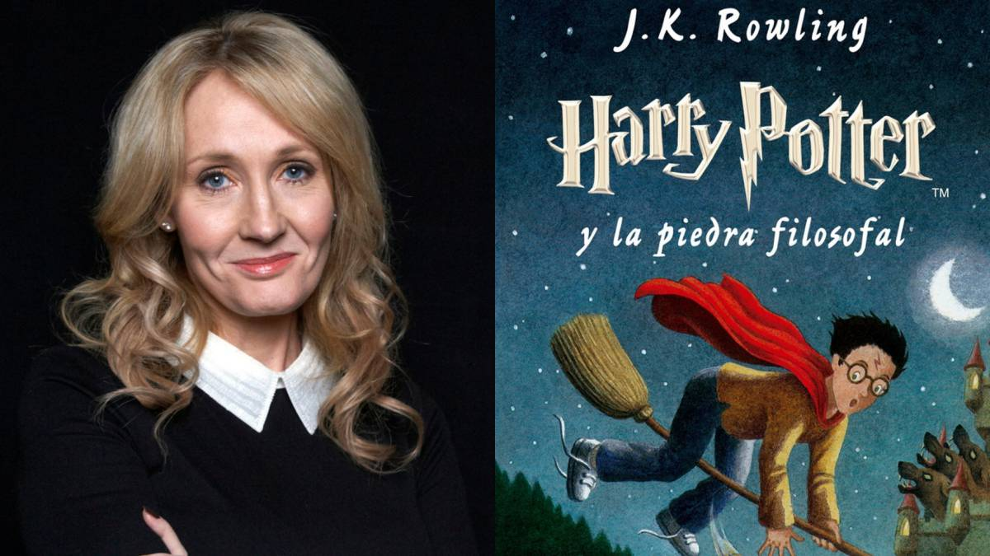
Joanne Kathleen Rowling
I didn´t know that J.K. Rowling wrote “Harry Potter”.
subject verb object
SENTENCE

Slide 5
I think that “Harry Potter” books are fantastic.
subject verb object
SENTENCE

Slide 6
- I am surprised that there are seven books about Harry Potter.
SENTENCE
adjective

Slide 7
VERBS BE(am/is/are/was/were) + ADJECTIVES

Slide 8
VERBS BE(am/is/are/was/were) + ADJECTIVES
NOUN CLAUSES (VERBS) | NOUN CLAUSES (ADJECTIVES)
- I think that “Harry Potter” books are fantastic. | - I am surprised that there are seven books about Harry Potter.

Slide 9
NOUN CLAUSES: EMBEDDED QUESTIONS
They are kind of Indirect Questions that are included in a sentence.
1. YES / NO QUESTIONS IF
2. INFORMATION QUESTIONS WHERE, WHEN, WHY, HOW, WHO, WHOSE, etc.

Slide 10
NOUN CLAUSES: EMBEDDED QUESTIONS
1. YES / NO QUESTIONS IF
Is that magazine interesting? Tell me if that magazine is interesting.
subject verb object

Slide 11
SMALL EXPRESSIONS TO START EMBEDDED QUESTIONS

Slide 13
- Does Julia write poems? I want to know if Julia writes poems.
S V O
- Did Richard like the article? I’d like to know if Richard liked the article.
S V O
- Have you finished that book?
Could you tell me if you have finished that book?
S V O

Slide 14
Examples to practice IF
DIRECT QUESTION | EMBEDDED QUESTIONS
Are the students procastinators?
Does Guillermo help people?
Did you present the last homework?
Will professors take Oral Lessons?
Have people read books in English?

Slide 15
NOUN CLAUSES EMBEDDED QUESTIONS
2. INFORMATION QUESTIONS: WHERE, WHEN, WHY, HOW, WHO, WHOSE, etc.
- Where are you from?
I wonder where you are from.
S V Obj.
- When do we have English class?
I’m not sure when we have English class.
S V Obj.

Slide 16
SMALL EXPRESSIONS TO START EMBEDDED QUESTIONS

Slide 18
DIRECT QUESTIONS | EMBEDDED QUESTIONS
- What time did students upload the homework? | I can’t remember what time students uploaded the homework. S V Obj.
- Why have the professors sent projects? | I don´t know why the professors have sent projects. S V Obj.

Slide 19
Examples to practice
DIRECT QUESTIONS | EMBEDDED QUESTIONS
Whose magazine is this?
How did you get that book?
When will people live in peace?
Why has Pauline traveled to Europe?

Slide 20
EXTRA GRAMMAR POINT.
Short answers by using SO to replace a noun clause after the verbs:
THINK, BELIEVE, GUESS, HOPE
- Question: Did J.K. Rowling write a new book?
- Affirmatives: I think so / I believe so / I guess so / I hope so
- Negatives: I don’t think so / I don´t believe so
I guess not / I hope not

Slide 21
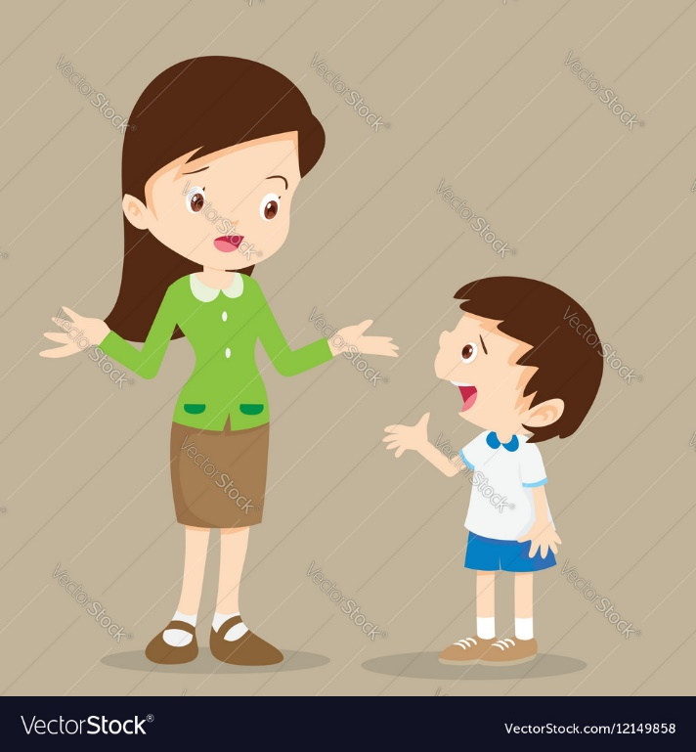
Extra emple with SO to replace a noun clause after the verbs:
THINK, BELIEVE, GUESS, HOPE
- Question: Teacher, do you think I will approve this level?
- Affirmatives: I think so / I believe so / I guess so / I hope so
- Negatives: I don’t think so / I don´t believe so
I guess not / I hope not

Slide 22
Do you think that pandemic will finish? (THINK)
I think so because the vaccine is important to finish the pandemic.
I don’t think so because people are very irresponsible.
Will professors help students? (BELIEVE)
Did Peter write poems in English? (GUESS)
Will Jonathan be in the party? (HOPE)

