Slide 1
DRESS CODE

Slide 2
1) What dress code, are they wearing: Casual, conservative, strictness, liberal

Slide 3
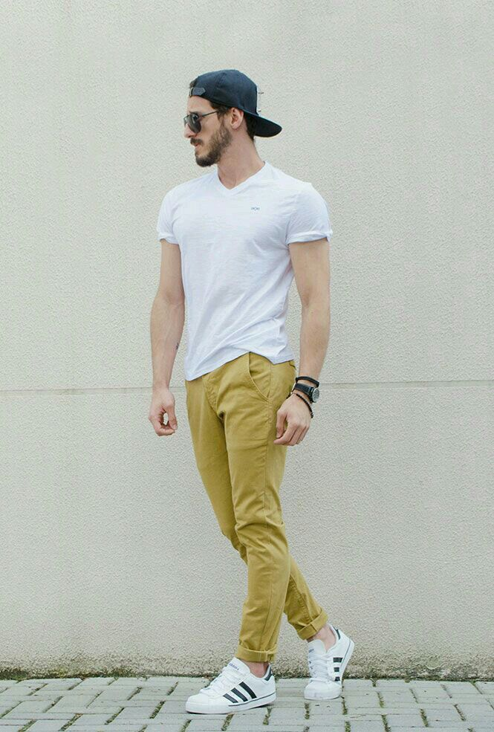
1) What dress code, are they wearing:

Slide 4
1) What dress code, are they wearing:

